Slide 1

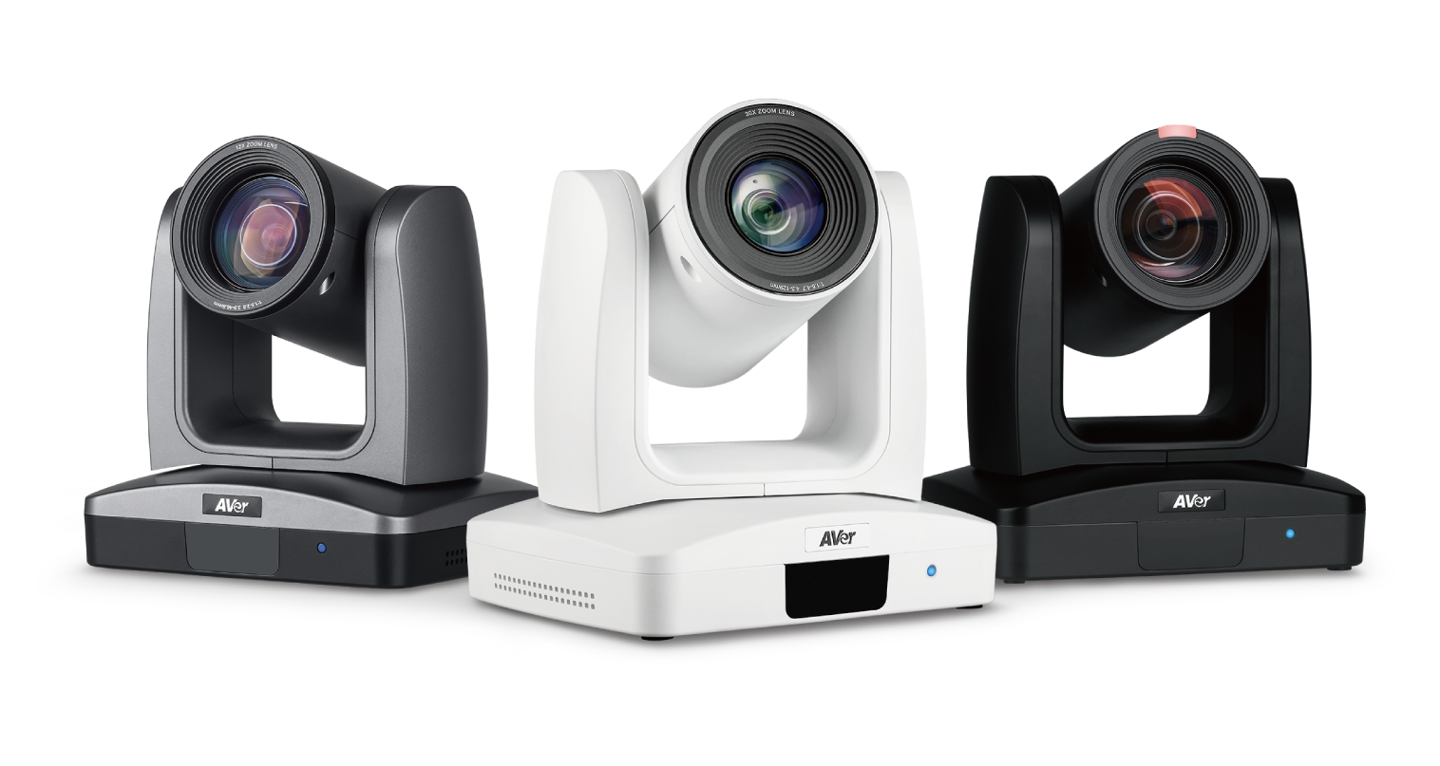
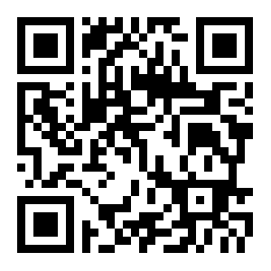
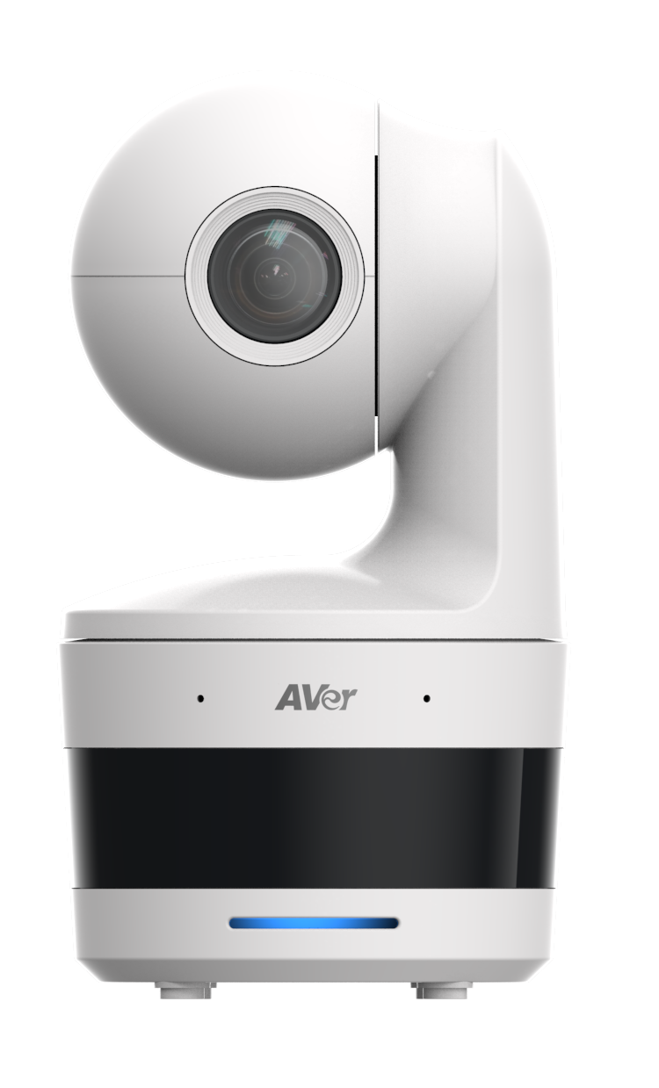
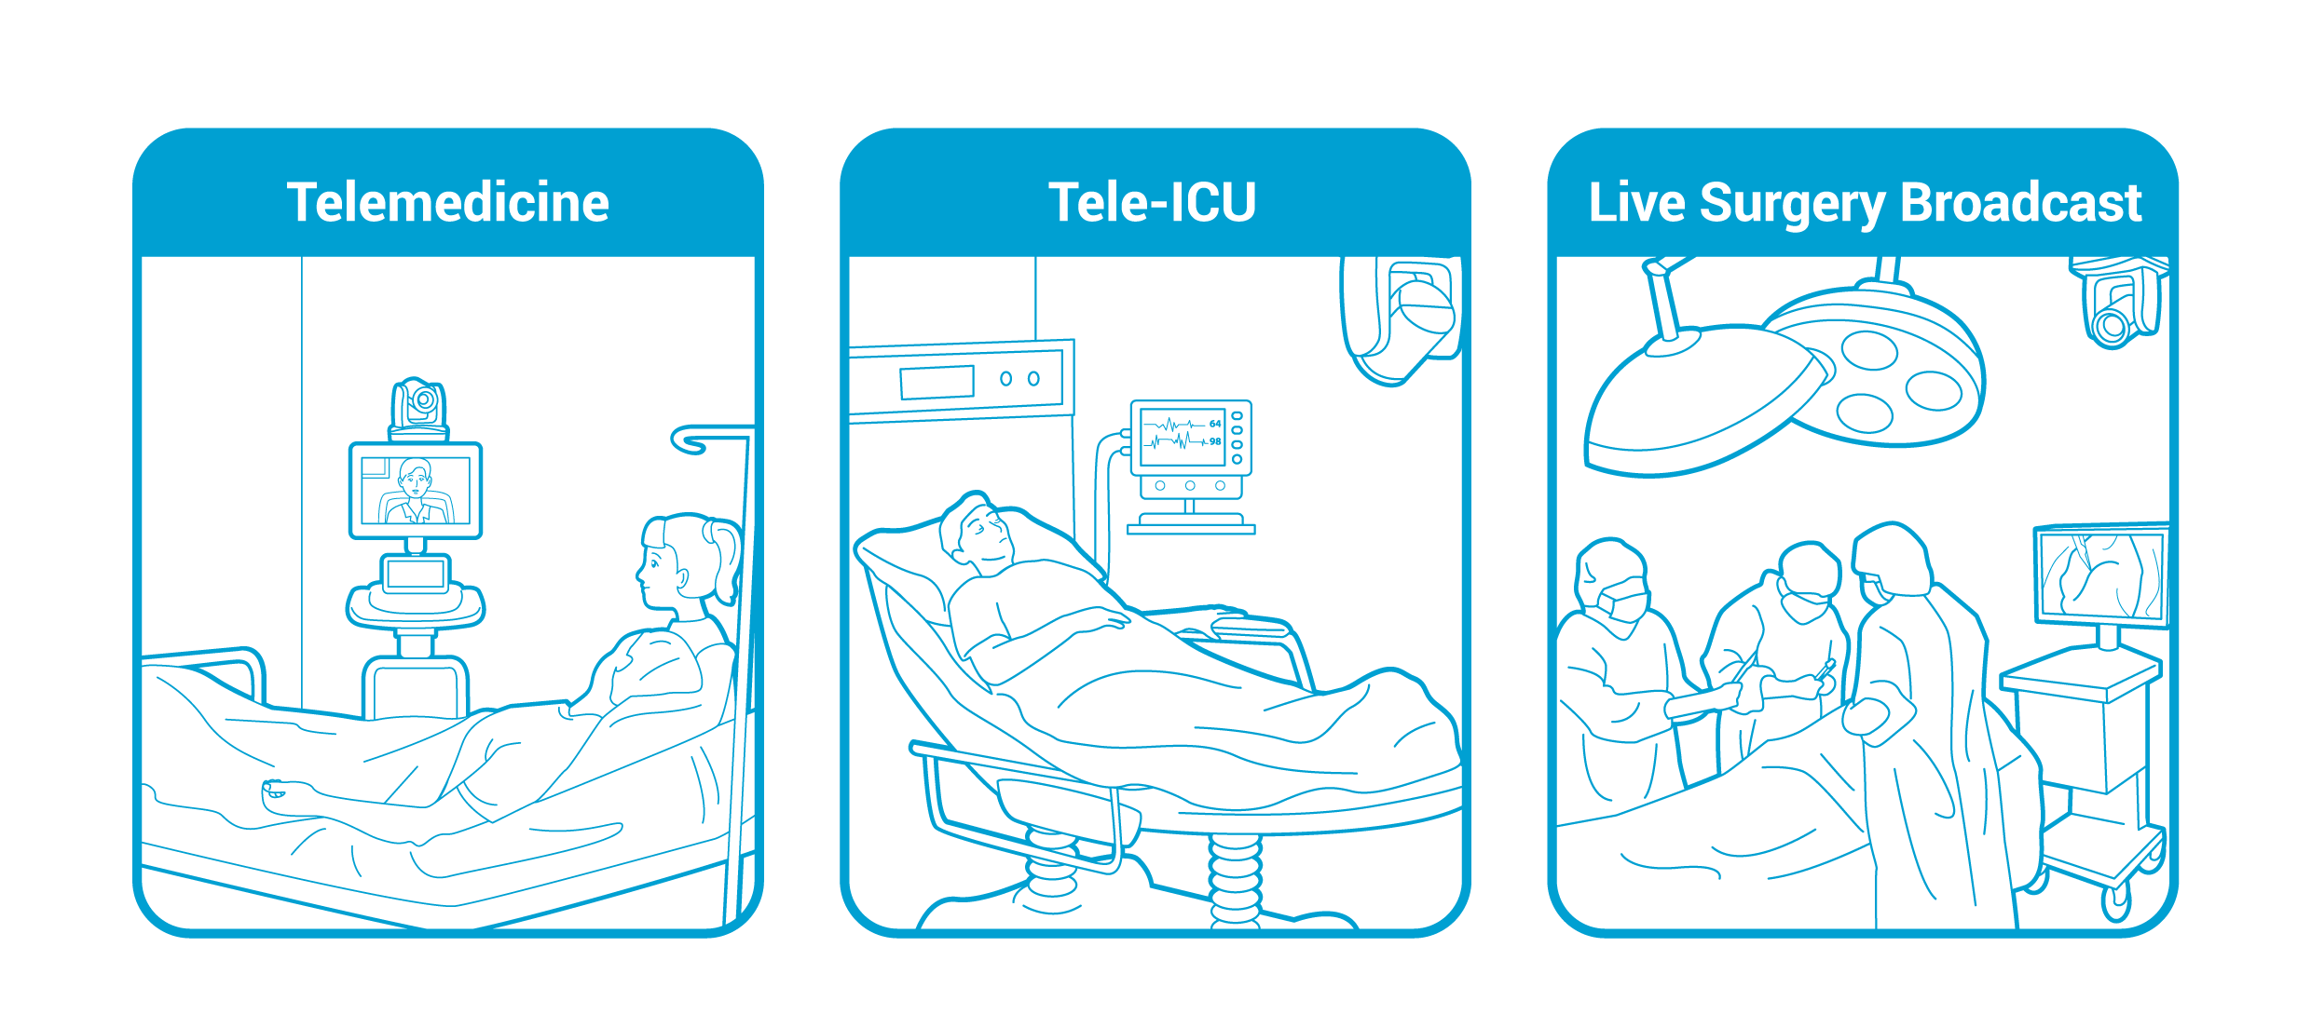

AVer Healthcare Solutions
Professional PTZ Cameras
PTZ300, PTC300 Series & DL10W
eu.ipe@aver.com
www.avereurope.com

Slide 2

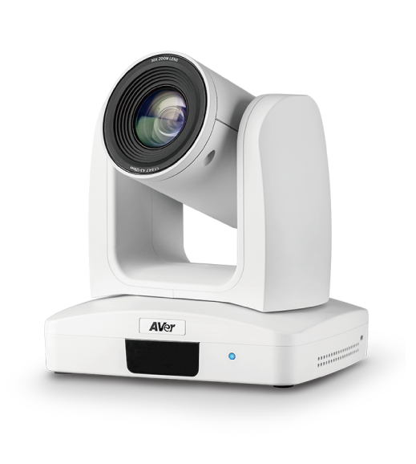


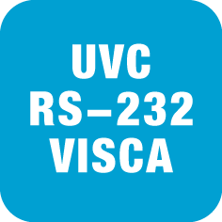
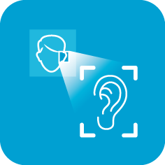

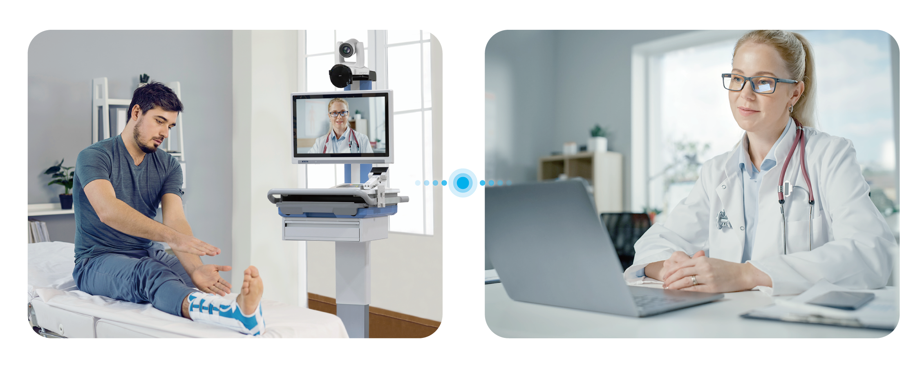

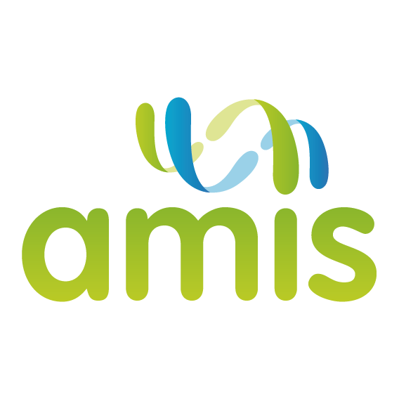
Telemedicine Solutions
Zoom In/Out Ability Enhances Diagnosis Accuracy
Multiple Control Protocols Allow Versatile Connectivity
Wide-Angle
Pan-Tilt Degree
Remotely
Control
Versatile Camera
Control
Close-Ups with
Zoom Lens
AVer PTZ310
AVer DL10W
Taipei Chang Gung Memorial Hospital vs. Taoyuan
Hualing Medical Station, Taiwan
The hospital integrated AVer PTZ Camera with Advantech
Telehealth Cart to implement real-time diagnosis.
Local Site
Remote Site
Strategic Partners

Slide 3
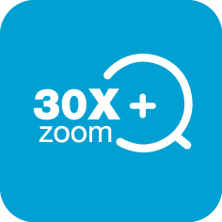



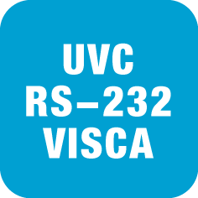
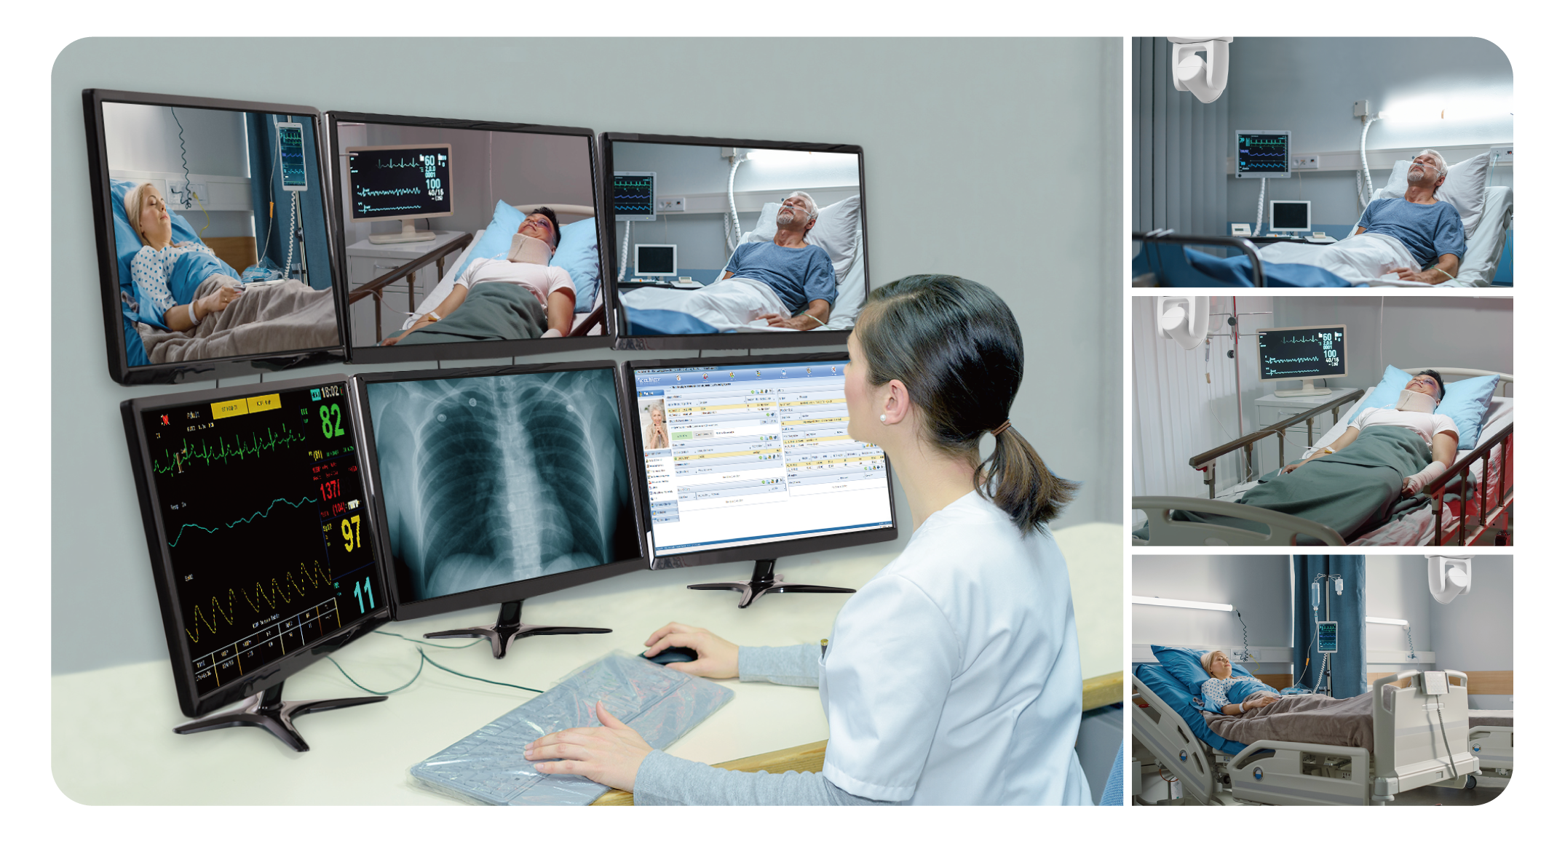
Tele-ICU Solutions
Monitor Problems via Vital Signs & Medical Dashboards
Multiple Control Protocols Allow Remote Monitoring
from Nurse Station
AVer PTZ330
30X
Optical Zoom
Two-Way
Audio
Monitor Patients
in Multipoint
Close-Ups with
Zoom Lens
Versatile Camera
Control
Far Eastern Memorial Hospital, Taiwan
The care team can monitor problems from nurse station by
watching live video shot by AVer PTZ Cameras.

Slide 4
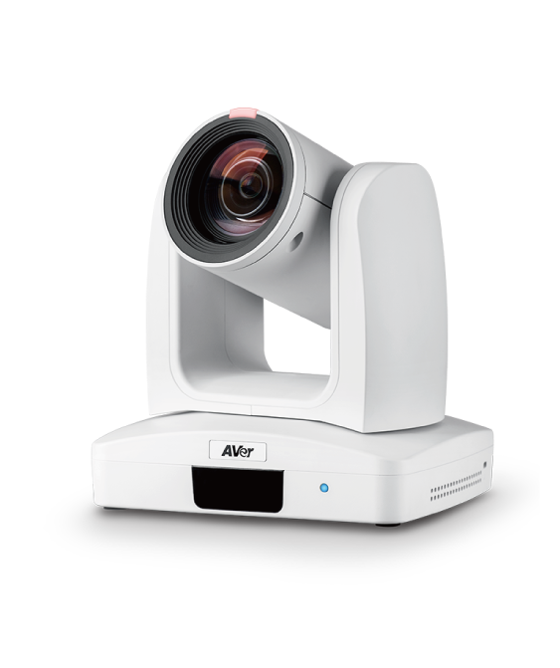



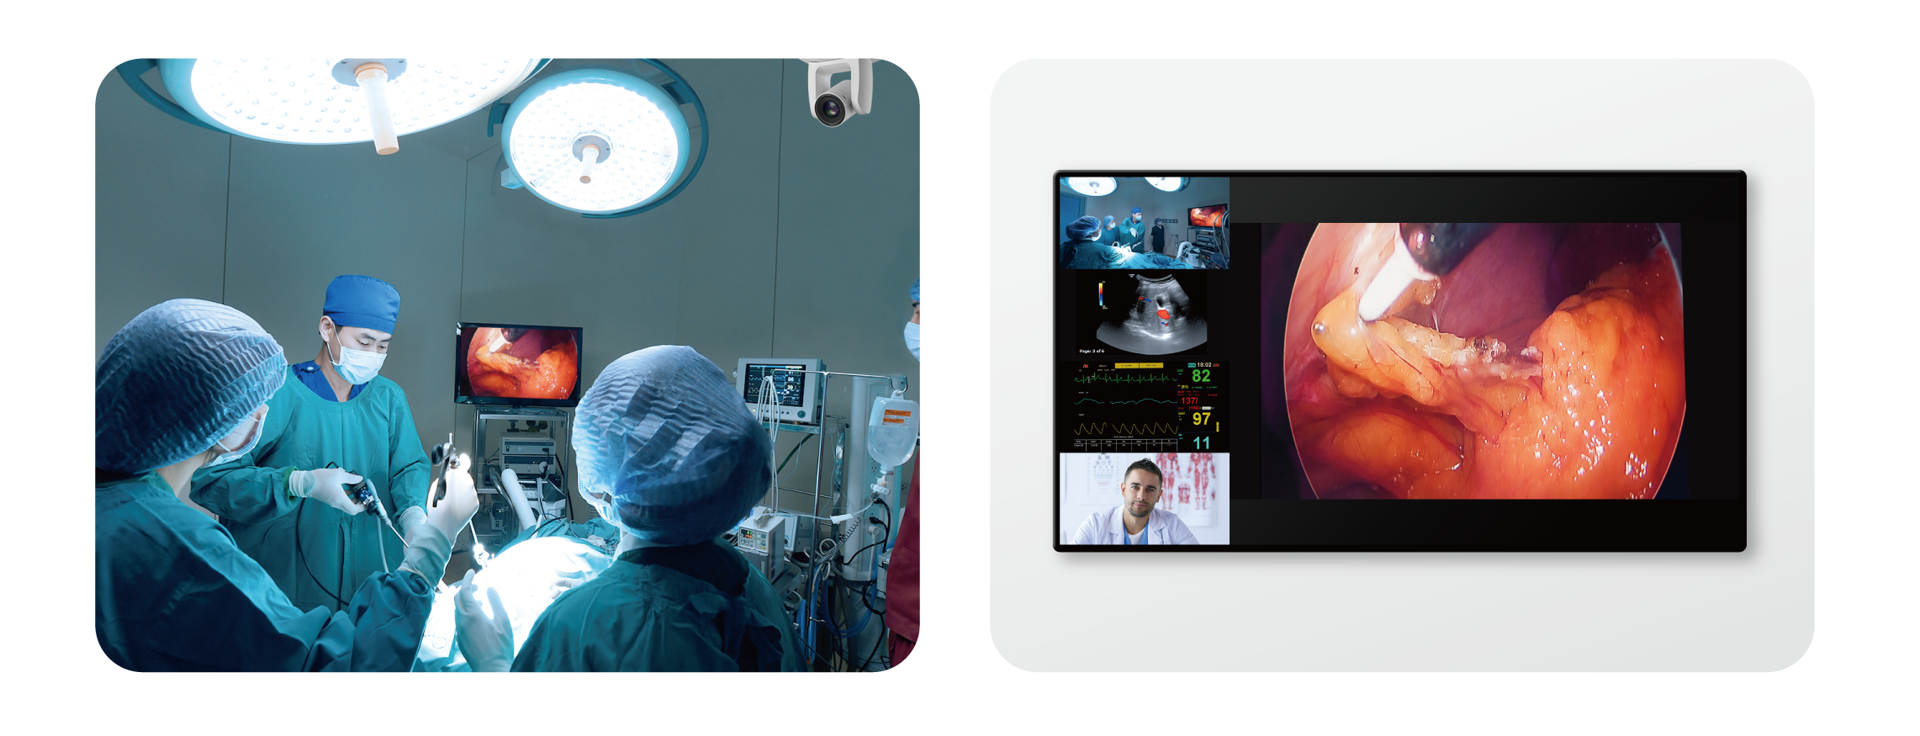
Live Surgery Broadcast
Solutions
Stream Surgeries via NDI with 4K Resolution
Capture Details with Superb Zoom Capability
®
SDI Output
4K Ultra HD
NDI |HX
Interface
AVer PTC310HN
Cheng Hsin General Hospital & Advantech, Taiwan
The AVer PTZ Camera was deployed in the surgery room to
livestream the procedures to the audience.
©2022 AVer Information Europe B.V. All rights reserved.
All brand names and logos are trademarks of their respective companies.
2022Q1

