Slide 1
Accelerate Transformation with Avanade Digital Care
Notes:
Speaker: Andy

Slide 2


Avanade can help Integrated Care Systems dramatically improve Digital Services, Collaboration, Automation and Data/AI across all parties by leveraging the investments made by NHS England in the current and new NHS mail and central tenant.
Avanade can also enable process automation across organizational boundaries and turn imaging archives into a strategic asset.
By working with Avanade we can help you transform digital care while delivering demonstrable productivity gains.

Slide 3

Digital care centrally managed, delivered locally
Leverage Existing Licences
Accelerate Time to Value
Avanade can help ICSs and organizations that use NHS Mail today to transform how Digital care is delivered. A suite of outcomes can now be centrally managed but delivered and integrated into your local systems using tried and tested capabilities.
Our unique offering leverages all
of the investment made by NHS England, using Microsoft technologies that are familiar
and accessible.
From Intranets to fully integrated digital care, we can reduce deployment risks and time to value.
Avanade, leveraging Microsoft Cloud for Healthcare, uses a single integration service to local clinical systems which is connected to each digital capability: integrate once,
use many.
Patient/Member Experience & Engagement
Clinician Experience & Care Team Collaboration
Tenant Integration
Dynamics
M365
NHS Central Tenant
Azure
Power Platform
Trust Integration
Data & AI Driven Insights
Notes:
Care 24/7 is modular, with each asset standing on its own to deliver independent value. It is designed to seamlessly integrate with your EMR and allows you to deliver better experiences through the overall care continuum. We’ve created the assets you see on this slide as an answer to some of the most pressing challenges in healthcare today. While we don’t have assets currently built to answer every specific need, we can leverage the Care 24/7 infrastructure and Microsoft for Healthcare ecosystem to design and build any solution to meet your individual needs.

Slide 4








Leverage Existing Licences
Ambient Listening
& Virtual Assistant (Nuance)
Accelerate Time to Value
Digital Front Door / Patient Portal
Provider Focus
GenAI
Consumer Outreach & Engagement (COrE)
Virtual Consultations
Ecosystem Focus
Avanade can help ICSs and organizations that use NHS Mail today to transform how Digital care is delivered.
A suite of outcomes can now be centrally managed but delivered and integrated into your local systems using tried and tested capabilities.
Our unique offering leverages all of the investment made by NHS England, using Microsoft technologies that are familiar and accessible.
From Intranets to fully integrated digital care, we can reduce deployment risks and time to value.
With 8 public references and dozens of implementations, we have repeatable playbooks in “Avanade Digital Care” and “Healthcare on Azure
& Fabric”
Patient Experience Accelerator (PExA)
Virtual Huddles / Tumor Board
Digital Contact Centre
Avanade Digital Care
Clinician Experience & Care Team Collaboration
Virtual Rounding
Patient/Member Experience & Engagement
Tenant Integration
Virtual Patient Visits / Telemedicine
Dynamics
M365
NHS Central Tenant
Azure
Power Platform
Family Inpatient Bridge*
Trust Integration
Data & AI Driven Insights
Healthcare on Azure & Fabric
Enhanced with Copilot
Can be Enhanced & Integrated with Nuance DAX, DMO, PES or DICOM Imaging
Notes:
Care 24/7 is modular, with each asset standing on its own to deliver independent value. It is designed to seamlessly integrate with your EMR and allows you to deliver better experiences through the overall care continuum. We’ve created the assets you see on this slide as an answer to some of the most pressing challenges in healthcare today. While we don’t have assets currently built to answer every specific need, we can leverage the Care 24/7 infrastructure and Microsoft for Healthcare ecosystem to design and build any solution to meet your individual needs.

Slide 5
















Leverage Existing Licences
Provider Focus
Ambient Listening
& Virtual Assistant (Nuance)
Accelerate Time to Value
Digital Front Door / Patient Portal
Consumer Outreach & Engagement (COrE)
GenAI
In-route EMS Consults
Avanade can help ICSs and organisations that use NHS Mail today to transform how Digital care is delivered.
A suite of outcomes can now be centrally managed but delivered and integrated into your local systems using tried and tested capabilities.
Our unique offering leverages all of the investment made by NHS England, using Microsoft technologies that are familiar
and accessible.
From Intranets to fully integrated digital care, we can reduce deployment risks and time to value.
Our Vision is to provide
a broad range of Patient, Clinician and Data/AI services.
Start with one and then add others as a change request rather than complex project.
Patient Experience Accelerator (PExA)
Virtual Consultations
Ecosystem Focus
Virtual Huddles / Tumor Board
Digital Contact Centre
Asynchronous Care & Message Triage
Avanade Digital Care
Clinician Experience & Care Team Collaboration
Virtual Rounding
Virtual Expert Image Collaboration (Agfa)
Patient/Member Experience & Engagement
Telemedicine
Tenant Integration
Care Team Collaboration
Care Coordination / Joint Care Plans (Clinical Reviews)
Dynamics
M365
Virtual Patient Visits
NHS Central Tenant
Remote Nursing (Acute)
Azure
Power Platform
Utilization Management (Case Reviews)
Family Inpatient Bridge*
Trust Integration
Discharge Planning
Connected Home Health (Healthcare @Home)
Virtual Mentoring & Observation
Care and Medical Management
Generative AI
Data & AI Driven Insights
Healthcare on Azure & Fabric
Medical R&D
Human Health Insights
Healthcare Command Center
Precision Medicine
Enhanced with Copilot
Integrity, Quality, and Performance Analytics
Can be Enhanced & Integrated with Nuance DAX, DMO, PES or DICOM Imaging
Population Health
Notes:
Care 24/7 is modular, with each asset standing on its own to deliver independent value. It is designed to seamlessly integrate with your EMR and allows you to deliver better experiences through the overall care continuum. We’ve created the assets you see on this slide as an answer to some of the most pressing challenges in healthcare today. While we don’t have assets currently built to answer every specific need, we can leverage the Care 24/7 infrastructure and Microsoft for Healthcare ecosystem to design and build any solution to meet your individual needs.

Slide 6
Automate Healthcare using the Microsoft platform
Leverage the central licensing from NHS England and benefit from cross ICS automation using native
Microsoft Power Platform and Azure capabilities
Description
Features
Benefits
Automation across Silos
Deliver Enterprize Automation on the Microsoft Platform
Re-Use Central Licensing
Avanade Business Process Mining & Automation (BPMA)services focus on the standardization, optimization and automation of end-to-end business processes to reduce cost, improve performance and increase resiliency.
Automate across organizational boundaries without compromising control or IG using our federated solutions. Scope, build and deploy using a hybrid Agile framework with DevOps support. Robotic Process Automation, Virtual Agents, Intelligent Document Extraction, Process Mining and more.
Automate over organizational boundaries and silos of information safely using process federation
Microsoft Power Automate, Copilot and Avanade Digital Care
Virtual Agents leveraging Generative AI technology stacks
Opportunity Discovery and IA business case creation
Strategy & governance to enable best practice automation CoE
Operating Model Design to support scalable enterprise level automation
Automation Roadmap to define rapid path to Hyperautomation
Infrastructure & Architecture for best practice automation platform setup
Federation means pan-ICS automation, shared CoE, local automation and no IG concerns
Significant contribution to 2% year on year productivity saving
Experienced Multi-disciplinary team (Business Analysts, Developers, Architects, Process SMEs)
Practical experience in governance, risk, compliance and data sovereignty
Lean process experts to optimize processes to unlock maximum benefits
Access to a broader knowledge community globally across Avanade
Rapid IA solutions development using technical accelerators and IPs, including GenAI

Slide 7
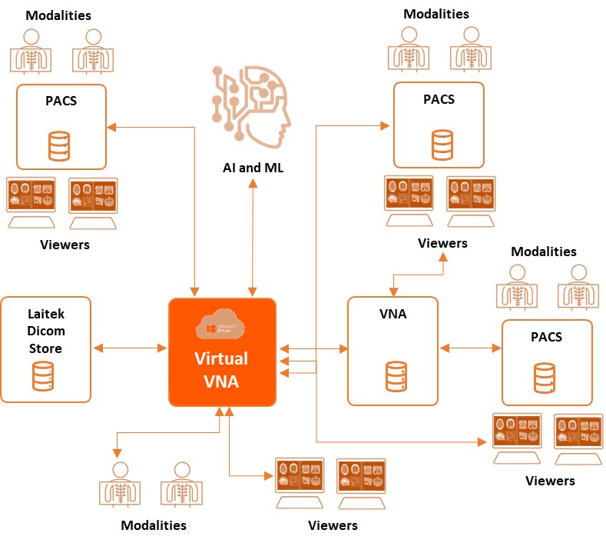
Turn your imaging archive into a strategic asset
Remove structural and design constraints that are systemic with traditional PACS and VNA with our cloud-based solution to reduce costs, improve efficiency and enable AI
Challenge
Virtual VNA
Benefits
Ever increasing costs for
low utility
A Virtual VNA offers flexibility and speed to evolve, enabling you to; partner with other care and service providers, track and manage processes across organizations & the care continuum, and enable new technology including AI & automation.
Overlay onto existing infrastructure
Diagnostic imaging demands some of the largest storage capabilities in healthcare
With ever increasing resolutions and tomography, traditional PACS and VNAs are creating an untenable strain on ICT resources
Architecture is too brittle to respond to strategic growth requirements
Access the images anytime, anywhere, on any device
No format lock to support retrieval through current & future standards
Best-in-class integration and data migration for superior data quality
Continuous Migration for Out of Clinical Lifecycle data
Leverage deconstructed VNA in the Cloud for greater flexibility

Slide 8
Thank you
Contact: matthew.chase@avanade.com

