Slide 1

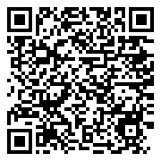

Welcome to
The National MAT
Conference
QR Code to Agenda

Slide 2
Introduction
Introduction to the conference and chair Matt McDermott opening address
Agenda
Programme
An hourly breakdown of the event
KEY POINTS
Speaker information
Further information about out speakers and the talks they will be delivering

Slide 3
08:00
Registration, Networking & Breakfast
09:00
Chairs Opening Address
09:10
Is your Trust next? What to expect on MAT Summative Evaluations?
09:35
Revolutionising trust wide reporting
10:00
Social mobility - Being the 'Difference Makers'
10:30
Morning Break, Networking & Refreshments
11:30
Opportunity of Technology in Education with Apple
11:55
Could your admissions process be hurting your trust performance and growth?

Slide 4
12:20
Strategic Governance in Strong Trusts: The executive’s role
12:45
Lunch and Networking
13:45
The Golden Thread of Equality, Diversity and Inclusion at the heart of our Trust.
14:10
From vision to strategy to daily good practice
14:35
Trust mergers – Due diligence is key, but what about reverse due diligence?
15:05
Panel Discussion
15:35
Close of Day

Slide 5
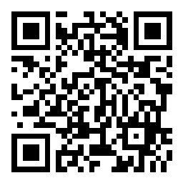
Please use the QR code to register for slido
By doing this you can ask questions , respond to polls and talk with fellow attendees

Slide 6
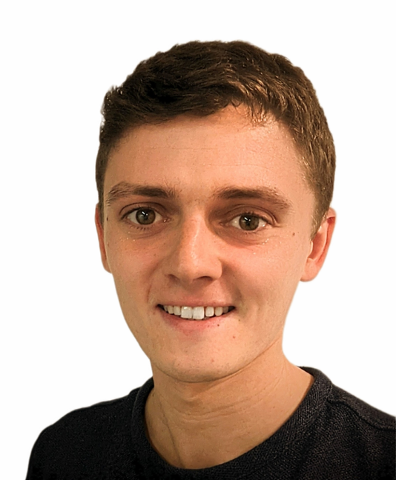


CHAIRS OPENING ADDRESS
Matt McDermott
Founder of MATA
Director of Convenzis Education

Slide 7
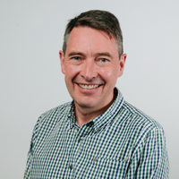
IS YOUR TRUST NEXT? WHAT TO EXPECT ON MAT SUMMATIVE EVALUATIONS?
Andrew Riches
CEO
IPAT Multi Academy Trust

Slide 8

MAT Summary Evaluation
Andy Riches

Slide 9
Our aim
The big picture
What is the MAT summary evaluation?
What to expect during the inspection process?
What preparations do you need to make with colleagues and in compiling evidence to create the narrative for your Trust: Creating the narrative
An opportunity to reflect now and develop your strategy

Slide 10

Not just about MATSE: Trusts are increasingly under the microscope!
This is an extract from Ofsted's annual report 2022.
“For the most part, we continue to inspect and regulate individual institutions. We inspect schools individually – but nearly 4 in 10 of them are in multi-academy trusts (MATs), and trusts are becoming larger. These trusts have a huge influence on how children are being educated, so we would like to be able to assess how this influence is being used.”
You need to consider the multiple audiences looking at the Trust and the messages you want to convey.

Slide 11
Ofsted line of enquiry
Sound financial standing
Pupil roll/ admissions
Positive perception
Staff development and retention
Compelling identity and narrative
“A Strong Trust”
MAT Assurance framework markers
Growth in the number of schools
An ambitious curriculum
The impact of the Trust on its schools
School improvement impact
Shared vision and values
High quality staff recruitment and retention

Slide 12
Your organisation: Starter for 10
Under the following headings, how would you describe your organisation in terms of the following:
The shared vision and values
How do you work with People and Partners – staff recruitment/staff retention/CPD
Your Leadership and management
Your School improvement impact – how do you improve your schools?
Your Curriculum and Assessment – what is your approach
Governance: Strengths and Structures
Behaviour and attitudes at your schools

Slide 13
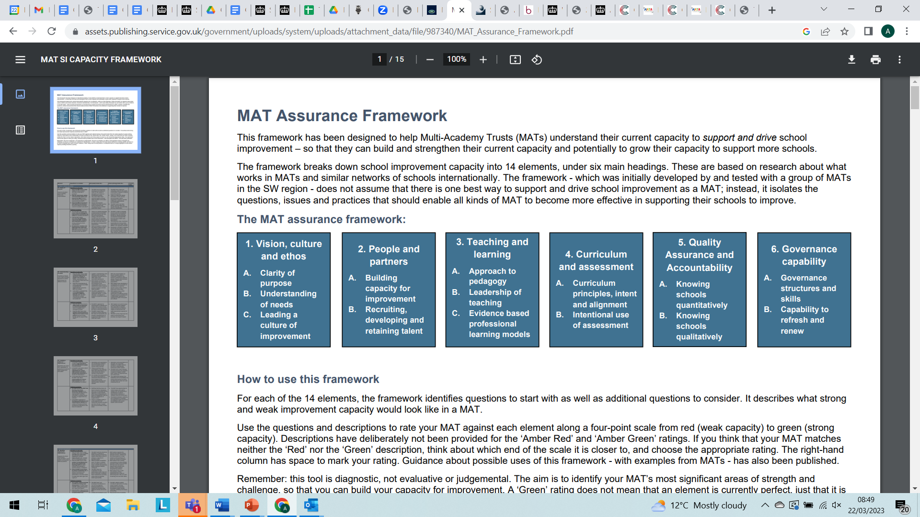
Not just about MATSE!

Slide 14

What is the MATSE?

Slide 15
MAT Summary evaluations
  Not classed as an inspection but a review of a MAT (strengths and areas for improvement) conducted by a team of Ofsted inspectors (normally a week).
  The summary evaluation explores the extent to which a MAT is delivering a high-quality education and improving pupils’ achievement – what is the impact of the Trust on its academies?
  Trust schools (if within an inspection window) are normally inspected first before the summary evaluation.
  Summary evaluations normally happen in the summer term after percentage of the schools within the Trust have been inspected stage 1.

Slide 16
What happens during the inspection?
The Initial conversation with the CEO.
Evidence – what do you have (you don’t have to but…preparation the is everything).
Take the lead in presenting your evidence: tell them, show them (the team are more interested in the views of others).
Who do they want to see during the inspection?

Slide 17
Trustees
Trust Leaders
You!
Who do they want to see?
Governors
CFO
School Leaders
Central Team Members

Slide 18
MAT Summary evaluations: The Strong Trust
Inspectors are looking at the following:
Impact of the Trust on its academies
Governance and delegation (vision, trust wide policies, trustees – support and challenge)
  Leadership and Management (improvement – impact – improvement – supporting staff)
  Curriculum and the quality of education (what is the approach of the Trust – the guiding light)
  Behaviour and Attitudes (attendance, behaviour, culture, inclusivity)
  Safeguarding
The discussions will centre on the quality of education across the MAT and the arrangements put in place by the MAT to oversee, challenge and support its academies to improve

Slide 19
Key indicators - the top 10!
Vision and values of the Trust
What impact you are having on your schools – both in terms of promoting strong performance and tackling underperformance?
Can you explain your governance structure and demonstrate that it is effective?
How are you avoiding common governance pitfalls, such as poor communication and unclear relationships between the board, the executive and local governing bodies?
How do you identify and deploy leadership expertise within your trust?
Do you understand the strengths and weaknesses of all your schools?
Do your local governing bodies (or equivalent) value the trust and the support it provides?
Are you a learning organisation?
How do the MAT’s values translate meaningfully into practices at all levels?
having very effective HR, finance and estate management functions that closely supported schools to allow school leaders to retain focus on school improvement.

Slide 20
Preparation
Start now and use this as an opportunity
Have a script for those key individuals involved
  Use the key indicators
  Have evidence of the impact and work those colleague undertake within the Trust
Creating the narrative that showcases what you do

Slide 21
Key area | What do you do? | Evidence and Impact? | Action needed?
The shared vision and values
How do you work with People and Partners – staff recruitment/ staff retention/CPD
Your Leadership and management
How do you improve your schools - impact
Curriculum and assessment
Governance
Behaviour and attitudes at your schools

Slide 22

Questions?

Slide 23
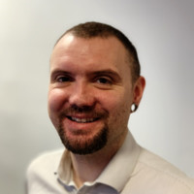

REVOLUTIONISING TRUST WIDE REPORTING
Tim Cropper-Williams
Senior Product Manager for IRIS Education
IRIS Software Group

Slide 24
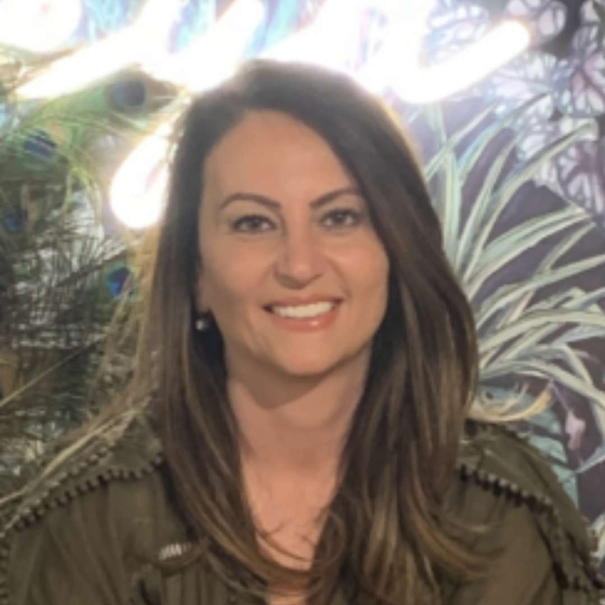
SOCIAL MOBILITY - BEING THE 'DIFFERENCE MAKERS'
Gulcin Sesli
Co CEO
The Spring Partnership Trust

Slide 25
Opportunity of Technology in Education with Apple
Apple Education

Slide 26

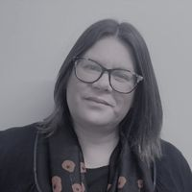

COULD YOUR ADMISSIONS PROCESS BE HURTING YOUR TRUST PERFORMANCE AND GROWTH?
Antony Wambua
COO
Applicaa Ltd
Elaine Harper
Data Manager
The Leigh Academies Trust

Slide 27


Slide 28
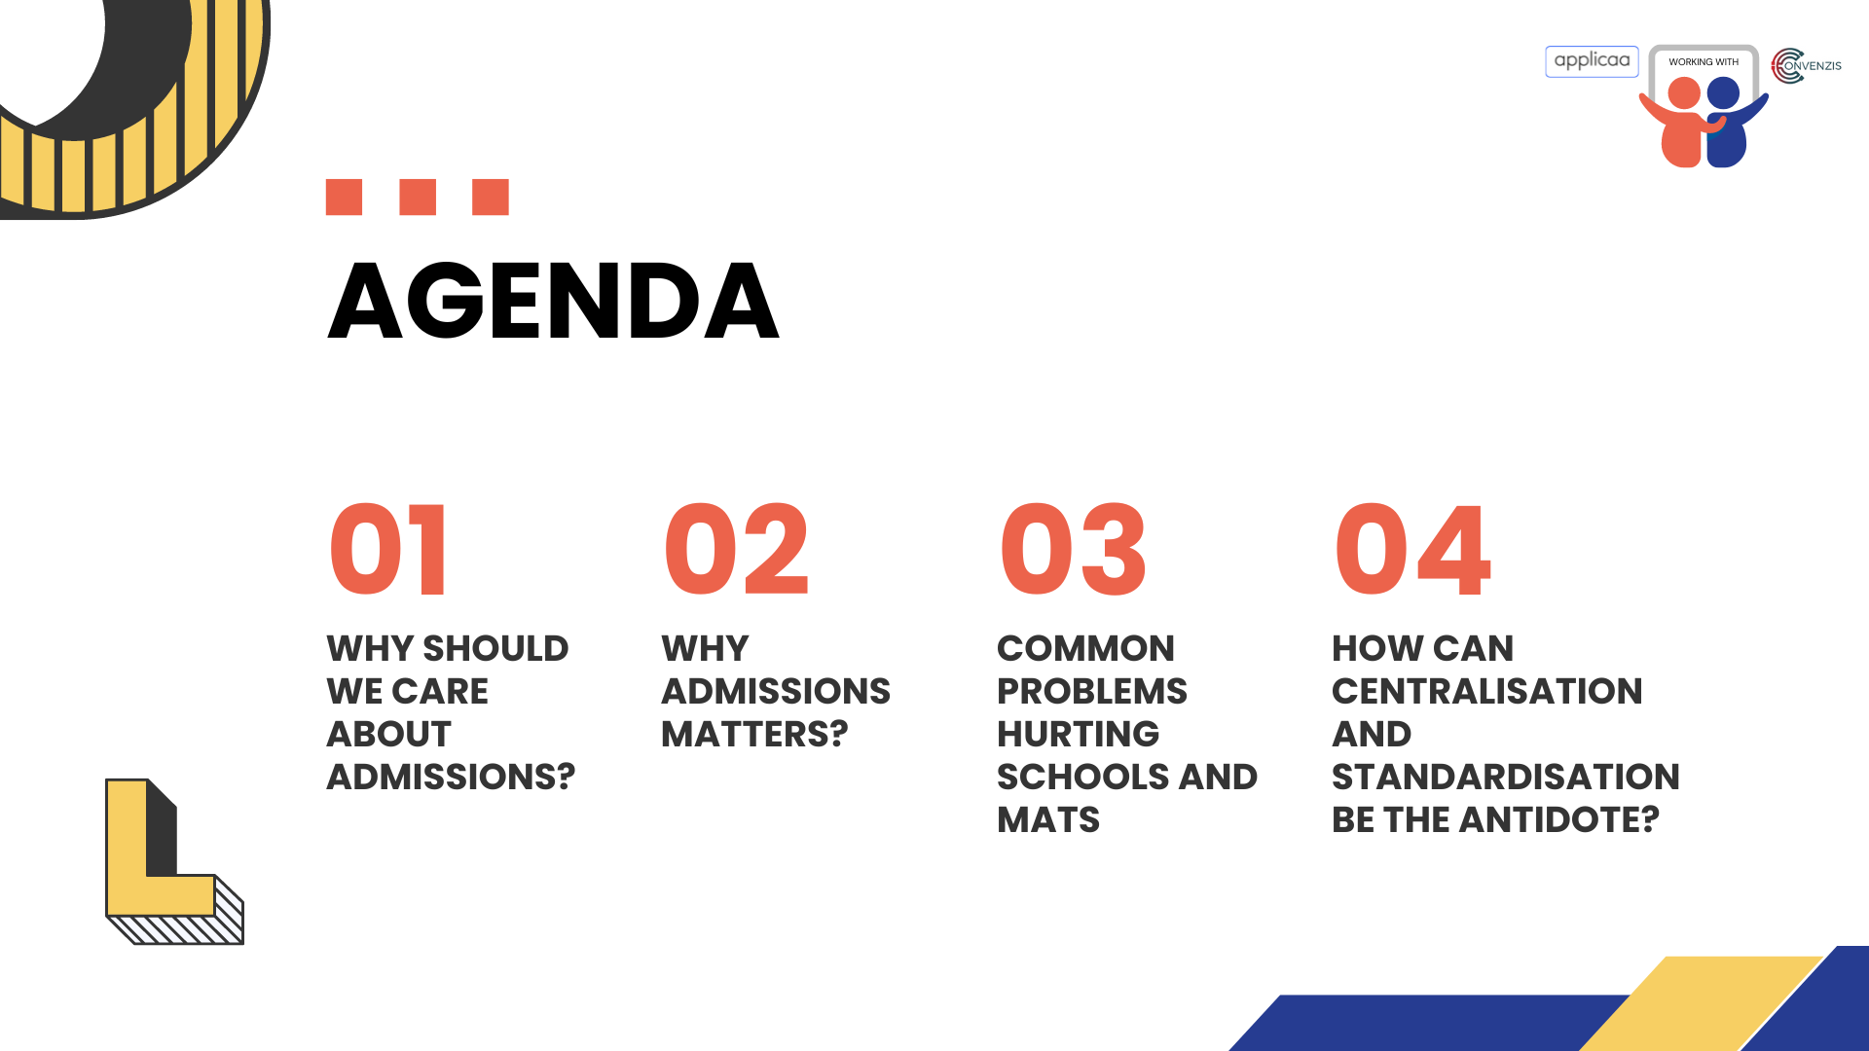

Slide 29


Slide 30
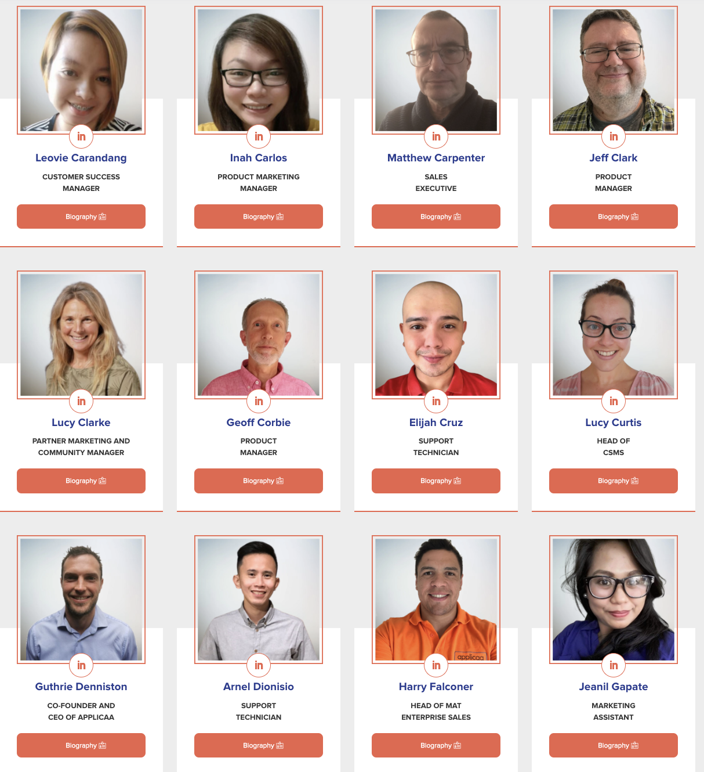


Notes:
And this is a case for a significant number of our Applicaa team, who have come from a school backgrounds with a wealth of experiences and are passionate about helping schools grow, work smarter and provide students and parents with better experiences.

Slide 31


Slide 32

Notes:
Parental engagement and communication
For many new families their first interaction is receiving a letter or email in the post from the new school then waiting to receive a paper pack in the mail or joining a info evening
For many it feels impersonal and sporadic
If parents aren’t engaged we get:
Poor data accuracy and delayed info from parents
Difficulties around consents and policy agreements
Mail merging difficulties
Outdated and inefficient processes
Paper forms, MS forms or basic MIS data collection
Lots of manual work for staff inputting data, or collecting partial data, needed multiple collection points,
More work for staff, potential GDPR issues, safeguarding issues due to lack of info and timely collection
Provisions for Vulnerable
CTFs usually out of date
SEND, LAC, FSM, Medical key to get info early to provide provisions and transition. Early collection = early intervention (reaching out to parents, feeders schools Ed Psych etc)
Having to organise or getting September surprises
Student retention (in MAT)
6th form is crucial for funding
Students looking for best education and attention to their needs
Decisions have an emotional elment - how does it make us feel and how to we feel about it
Basic paper forms, Ms forms are laborious, lead to data gaps, difficulties in communication and organisation
Slow manual enrolments with queues cause students to enrol elsewhere
Staff turnover
Admin staff over stretched and under resourced
-Thousands of Admin staff no longer working in schools due to workload and pay
Pressures put assistant heads, heads of year etc

Slide 33

Parental engagement and communications
Increasing the frequency and quality of communications around the admissions process:
Reduced time to complete by 10%
Increases completion rate by 15%
Personalisation of messages helps build relationship and foster positive emotions
Notes:
Parental engagement and communication
For many new families their first interaction is receiving a letter or email in the post from the new school then waiting to receive a paper pack in the mail or joining a info evening
For many it feels impersonal and sporadic
If parents aren’t engaged we get:
Poor data accuracy and delayed info from parents
Difficulties around consents and policy agreements
Mail merging difficulties

Slide 34
Outdated and inefficient manual processes
For a school processing 200 forms they spend on average the following amount of time and money on key tasks:
£2,000 printing and sending paper forms to parents
100 Hours (£1,250) manually entering data into MIS
50 Hours (1 Week) following up with incomplete forms or mistakes
50 - 100 Hours (1 - 2.5 Weeks) generating reports, chasing references, collecting transition data, organising timetables etc..)
Notes:
This is just for 1 school, now imagine for a MAT of 4 or 10 or even 20.
The loss of recourse as MATs get bigger is staggering.
Outdated and inefficient processes
Paper forms, MS forms or basic MIS data collection
Lots of manual work for staff inputting data, or collecting partial data, needed multiple collection points,
More work for staff, potential GDPR issues, safeguarding issues due to lack of info and timely collection

Slide 35
Delayed provision planning for vulnerable students
Just under 1.5 million pupils in England have special educational needs
An increase of 77,000 from 2021. Both the number of pupils with an EHC plan and the number of pupils with SEN support have increased:
The percentage of pupils with an education, health and care (EHC) plan has increased to 4.0%.
The percentage of pupils with SEN but no EHC plan (SEN support) has increased to 12.6
https://explore-education-statistics.service.gov.uk/find-statistics/special-educational-needs-in-england/2021-22
Notes:
Provisions for Vulnerable
CTFs usually out of date
SEND, LAC, FSM, Medical key to get info early to provide provisions and transition. Early collection = early intervention (reaching out to parents, feeders schools Ed Psych etc)
Having to organise or getting September surprises
Delay in collection and processing information from parents and schools means provision planning and assessment has to be done in September rather than staff reaching out to families and schools in Summer term
Staffing decreases and SEN/D increases means schools and MATs have to use resources wisely so crucial that schools are proactive rather than reactive

Slide 36
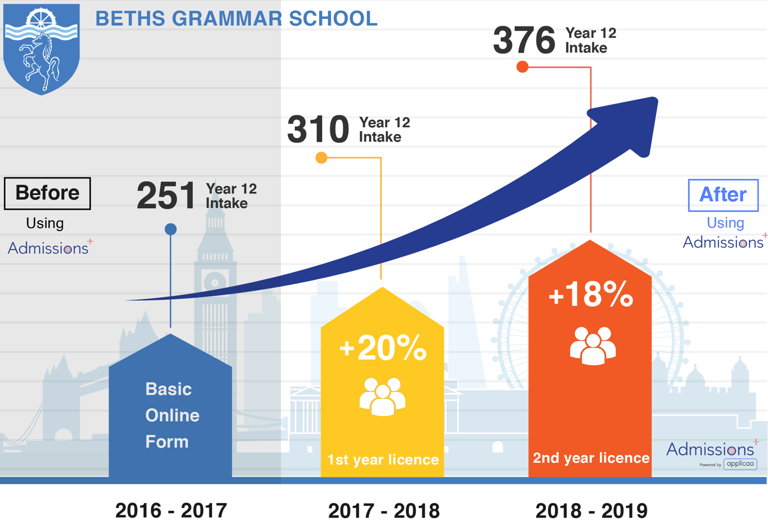
Student Retention & Recruitment
Beths Grammar School, East London
They had capacity but had hit a limit on how many student they were enrolling.
Issues they faced:
Difficulty in communication with applicants
Applications wasn’t accessible enough for internal applicants
Were losing potential students on Enrolment day due to delays in communicating offers
Notes:
Student retention (in MAT)
6th form is crucial for funding
Students looking for best education and attention to their needs
Decisions have an emotional element - how does it make us feel and how to we feel about it
Basic paper forms, Ms forms are laborious, lead to data gaps, difficulties in communication and organisation
Slow manual enrolments with queues cause students to enrol elsewhere

Slide 37
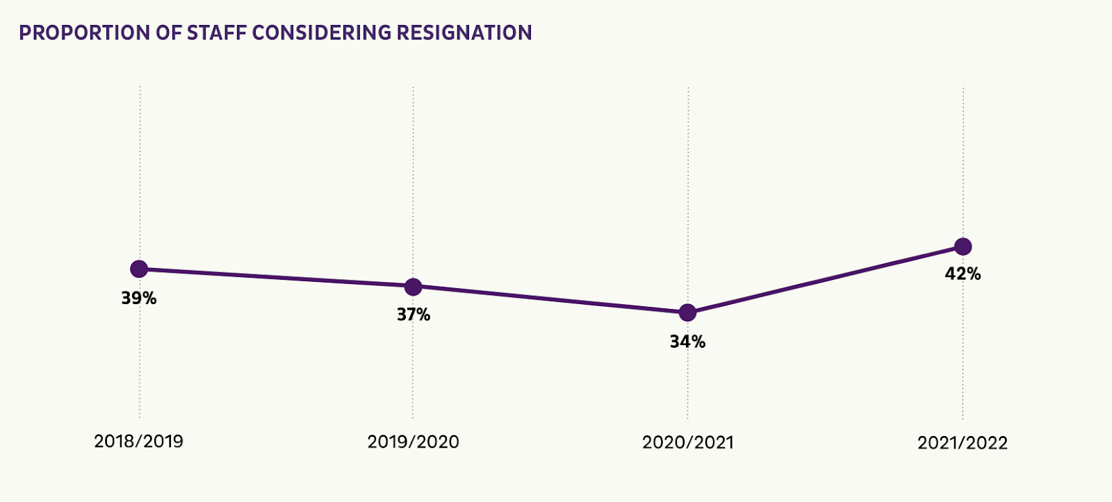
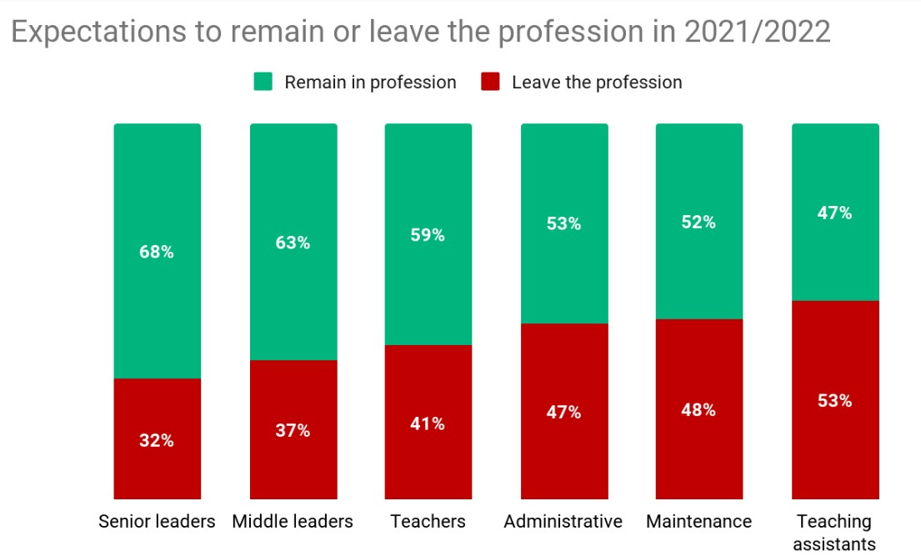
Staff Turnover
Staff Retention in Academies: Experiences Before, During and After the Lockdowns (4 Year Study)
https://home.edurio.com/blog/staff-turnover-in-schools
Notes:
There is some concern in the sector that school staff in lower-paid positions are looking for roles outside of schools. As Sam Freedman writes for Schools Week, “Being a driver for Amazon or similar is becoming increasingly remunerative relative to minimum wage posts in the public sector”.
Staff turnover
Admin staff over stretched and under resourced
Thousands of Admin staff no longer working in schools due to workload and pay
Pressures put assistant heads, heads of year etc

Slide 38

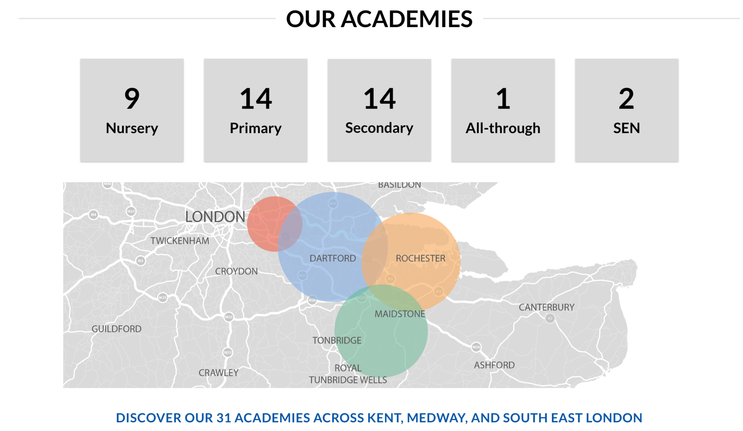
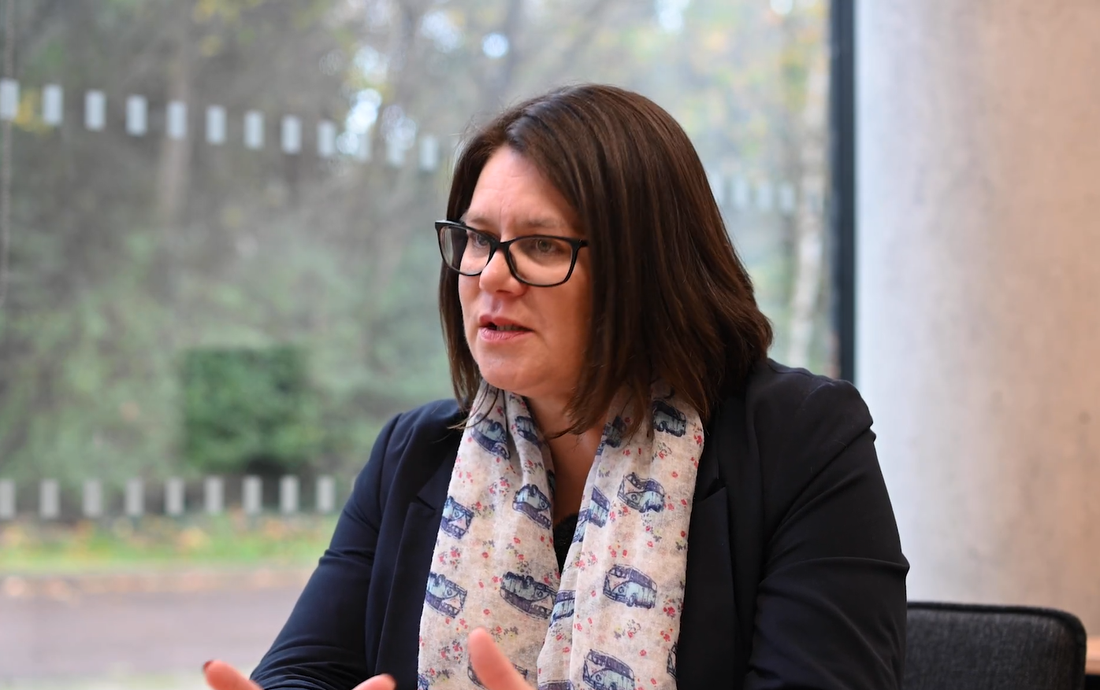
A MAT Case Study
Academies across Kent, Medway and South-East London
Central Trust team for IT and data
Elaine Harper
Trust Data Manager
Notes:
With Applicaa the average increase in Enrolments for Sixth Forms is 13%
If you have 100 students joining in Year 12
13% = £130,000 over 2 years

Slide 39

Streamlining processes
Improved staff workload
The benefits of centralisation and standardisation
Reducing costs
Increased student retention
Improved compliance
Notes:
Reducing costs
Using software allows accurate price per pupil costing in your systems. Reduce admin time and costs (paper form, overtime etc) means schools and trusts can do away with hiring temps or fill vacancies in the office
Professional and easy applications leading to 30% increase in application and 13% in enrolment - consistency across all schools
Streamlining processes
Standardised processes ensure efficiency within all schools and can be replicated across the trust ensuring new schools can benefit quickly
Clear and easy workloads ensure data is collected and processed to ensure all stakeholders can do their jobs in an timely manner
Improved compliance
Centralised admissions systems help MATS to ensure that admissions is transparent to parents
Policies and agreements can be updated
New rules and regulations can be changed centrally and staff updated
Increased student retention

Slide 40
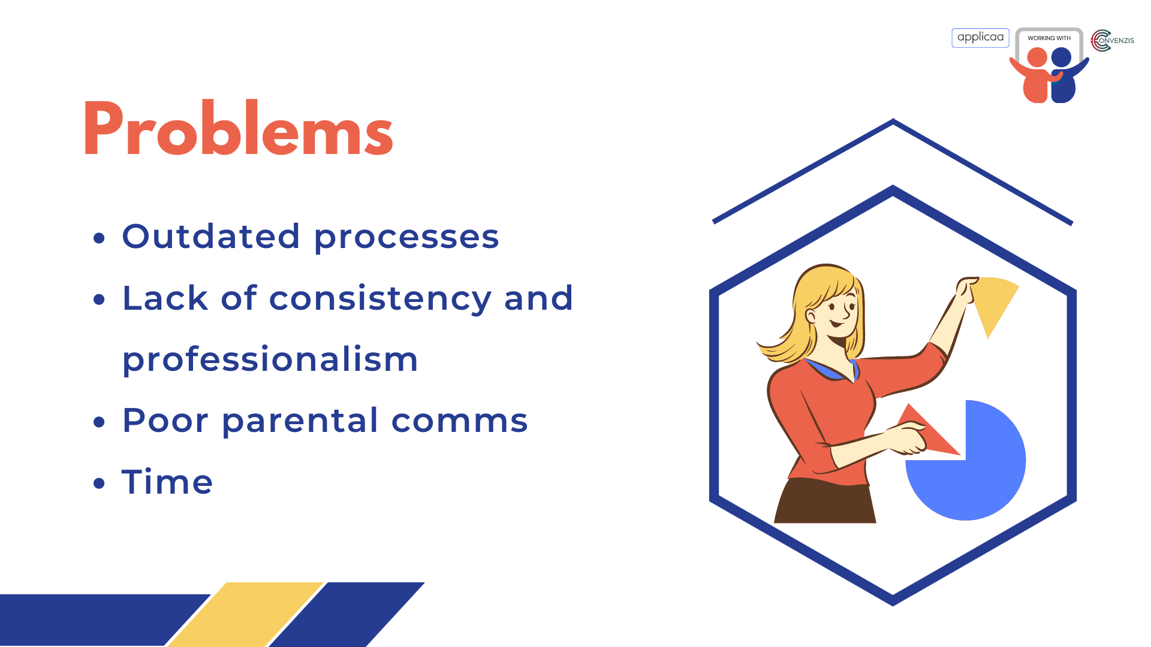



Problems
Outdated processes
Lack of consistency and professionalism
Poor parental comms
Time
Notes:
With Applicaa the average increase in Enrolments for Sixth Forms is 13%
If you have 100 students joining in Year 12
13% = £130,000 over 2 years

Slide 41
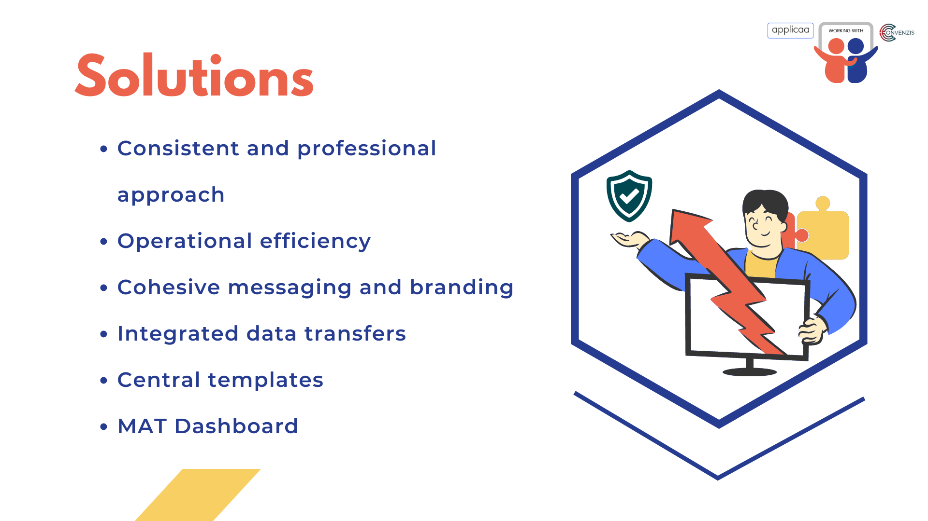

Solutions
Consistent and professional approach
Operational efficiency
Cohesive messaging and branding
Integrated data transfers
Central templates
MAT Dashboard
Notes:
With Applicaa the average increase in Enrolments for Sixth Forms is 13%
If you have 100 students joining in Year 12
13% = £130,000 over 2 years

Slide 42
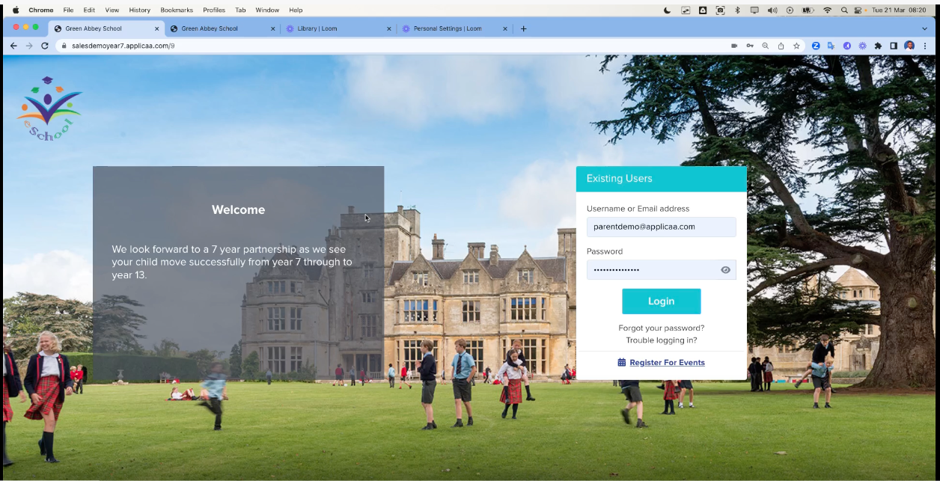
Click to play

Slide 43


Slide 44


Questions & Answers

Slide 45
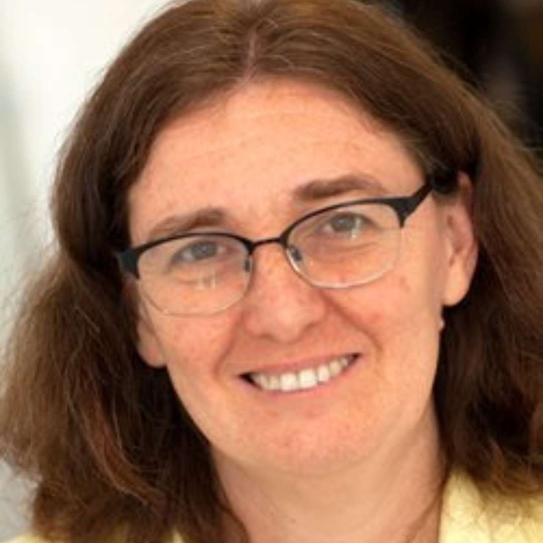
Strategic Governance in Strong Trusts: The executive’s role
Emma Knights OBE
CEO
National Governance Association

Slide 46
Good Governance:
Strategic governance in strong trusts
Emma Knights OBE, Chief Executive,
National Governance Association
23 March 2023

Slide 47



















Independent and confidential advice
Sector-leading
induction guides
NEW: virtual Welcome to Governance LIVE sessions
Membership magazine
The essential
information hub
Keeping you informed
Making your voice heard
Access to independent
and timely advice for GOLD members – governing boards, governance professionals, headteachers and executive leaders.
Supporting new and experienced governors, trustees and chairs:
Welcome to Governance,
The Chair’s Handbook,
Welcome to a Multi
Academy Trust.
Make an impact in the first six months as a governor/trustee, via sessions that complement local school, trust or LA induction programmes.
Thought-provoking articles on aspects of all education and governance, published five times a year.
Access members-only guidance, research, practical resources and much more.
A weekly e-newsletter during term-time featuring the latest education news, policy updates, guidance and much more.
We raise the profile of governance through our engagement with policy makers and through our campaigns.
High-profile events
NEW: Governance Leadership forums
Webinars and podcasts
E-learning anytime, anywhere
Tailored to your board’s
circumstances
Development programmes
National Leaders
of Governance
Hear from high-profile speakers and share best practice. Events include: NGA Summer and Annual Conferences, Governance Professionals’, SEND and MAT Governance Networks.
Networking events for those governing and leading schools to share experiences, debate future plans and discuss key issues they face.
Supporting governing boards through NGA’s series of webinars and podcasts.
Develop governance skills
and knowledge with over 50 high-quality e-learning modules, and bitesize modules.
Includes external reviews of governance, online appraisals and virtual face-to-face training workshops delivered by our team of expert consultants.
For chairs and governance professionals to lead and support your governing board to have real impact on your school or trust’s improvement.
DfE-designated experts delivering school and trust governance support where it can make
a difference.
0121 237 3780
www.nga.org.uk

Slide 48
What is governance?
Governance determines who has the power,
who makes the decisions,
how other players make their voice heard and
how account is rendered
                Institute on Governance, Canada

Slide 49
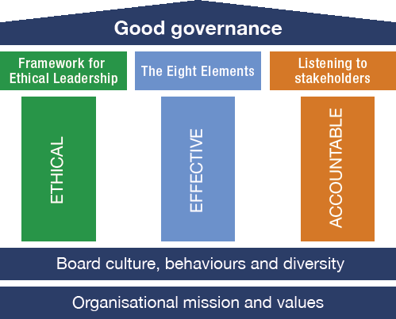
nga.org.uk/Knowledge-Centre/Good-governance

Slide 50

Framework for Ethical Leadership in Education
The Nolan Principles of Public Life:
Selflessness
Integrity
Objectivity
Accountability
Openness
Honesty
Leadership
Leaders should show leadership through the following personal characteristics or virtues:
Trust
Wisdom
Kindness
Justice
Service
Courage
Optimism
nga.org.uk/ethical-leadership

Slide 51
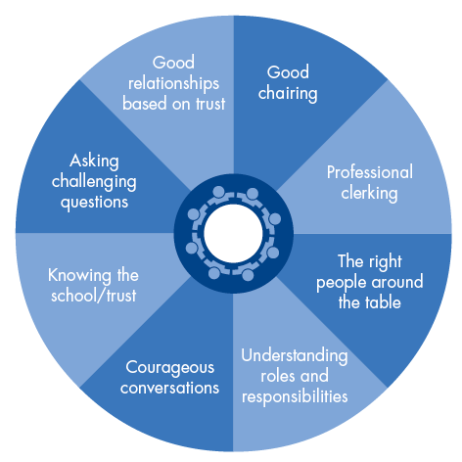
Eight elements of effective governance

Slide 52
DfE definition of a strong trust: further information coming soon ….
Delivering high quality and inclusive education, including for disadvantaged children and children with SEND, operating fair access and using evidence-based curriculum design and implementation.
School improvement - working quickly to improve standards within all their schools, particularly transforming previously under performing schools
Strategic governance - operating an effective and robust governance structure that involves schools and exemplifies ethical standards. Utilising the expertise and skills on its boards to oversee the strategic direction and hold leaders to account. Having a strong local identity, engaging effectively with parents and the wider community.
Strong and effective financial management - prioritising the use of resources, including the estate, to deliver the best educational experience for children
Workforce - training, recruiting, developing, deploying and retaining great teachers and leaders throughout their careers and prioritising staff wellbeing.

Slide 53


Slide 54
What good working relationships look like
Understanding respective roles: nuanced relationships
  The board staying strategic and not stepping into the operational
Everyone is on board: common mission & ethos, sense of purpose & direction, values lived
High expectations of each other
Investing time in the relationship
Professional recruitment & development of the board
Building trust: no surprises, sharing of problems & public unity
All encouraging challenge of each other & debate; watch the dynamics in the meeting
All enabling & welcoming of stakeholder voices
The right balance between support and challenge
Questioning & listening: https://www.nga.org.uk/News/Podcasts.aspx

Slide 55
What about local governance?
The Schools White Paper says “all trusts should have local governance arrangements for their schools to be responsive to communities and stakeholders, including parents”
Local governance tends to cover standards; stakeholders, safeguarding & SEND: 4S’s but some also have more delegated, including financial and staffing responsibilities
NGA Blog/April-2022/Local-governance-setting-the-standard sets out the benefits that local governance offers and some expectations
Evidence based governance
Visible governance
Accountable governance
Checks and balances
Collaborative governance

Slide 56
Local governance: NGA’s expectations are going down well!
1. Communication – two-way communication is crucial, including regular chairs/vice chairs meetings
2. Separation – MAT governance has three layers for a reason: to ensure accountability of those serving on each layer remains distinct and there are no conflicts of interest
3. Investment in professional, expert support – there must be a lead governance professional in any MAT to guide and connect the work of local committees and the trust board
4. Clear delegation – a good scheme of delegation essential to ensuring harmonious working between the layers of governance
5. The local tier does not need to have its own committees – an academy committee/LGB is itself a committee of the trust board
6. Meaningful & accepted role in challenge – appointment of own chair and a formal process for removing governors inc. appeal

Slide 57
Local governance: expectations continued
7. A local tier formed by local volunteers not executives – executives don’t control conversation
8. Trust boards are visible and accountable to the local tier – local governors are invited to hear of the work of the trustees as a minimum on an annual basis eg through the AGM
9. Input from local tier, namely the chair, in performance management of school heads
10. The trust values and seeks engagement from the local tier in the recruitment of new heads, including the local chair in the recruitment process
11. A whole trust governance development plan encourages governors to learn from schools outside their trust
12. Contribution to school improvement and awareness of school’s budget and spending plan
13. Stop press: we will be proposing another expectation about the role of local governors in Ofsted inspections

Slide 58

NGA’s Outstanding Governance Awards 2023
NGA’s Outstanding Governance Awards recognise the excellent practice and achievements of governing boards and governance professionals across the country
Outstanding governance in a single school
Outstanding governance in a multi academy trust
Outstanding governance in a federation
Outstanding clerk to a governing board
Outstanding lead governance professional
Deadline for entry – Monday 27 March 2023
www.nga.org.uk/awards
Notes:
SH

Slide 59


Governance training for trust and school leaders
Four practical setting-specific sessions for MAT, SAT, Academy and maintained leaders
For academy leaders within MATs: nga.org.uk/governance-for-academy-leaders
For maintained school leaders: nga.org.uk/governance-for-maintained-leaders
For MAT executive leaders: nga.org.uk/governance-for-MAT-leaders
For SAT leaders: nga.org.uk/governance-for-SAT-leaders
A 90-minute standalone session covering all the essentials of good governance
Notes:
Each workshop is £60 for NGA members and £125 for non-members

Slide 60

Equality, Diversity and Inclusion (EDI): Beyond Compliance
NGA has partnered with ASCL to develop a series of e-learning modules which support governing boards and leaders to promote EDI. They focus on creating an inclusive culture
The first 2 modules look at why EDI is important and how different types of bias manifest in day-to day life. The 3rd explores what it means to fulfil the duties of a governor or trustee while putting EDI principles into practice. It provides actionable advice for governing boards to ensure they are effectively promoting the principles and creating a welcoming environment.
These modules are available to all Learning Link subscribers now but also
freely available to those who sign up for a free trial of Learning Link

Slide 61
Thank- you
Any questions?
Emma.knights@nga.org.uk

Slide 62

Diversity and Inclusion at the heart of our Trust.
Garry Ratcliffe
CEO
The Golden Thread Alliance

Slide 63

The Golden Thread of Equality, Diversity and Inclusion
Garry Ratcliffe, CEO

Slide 64
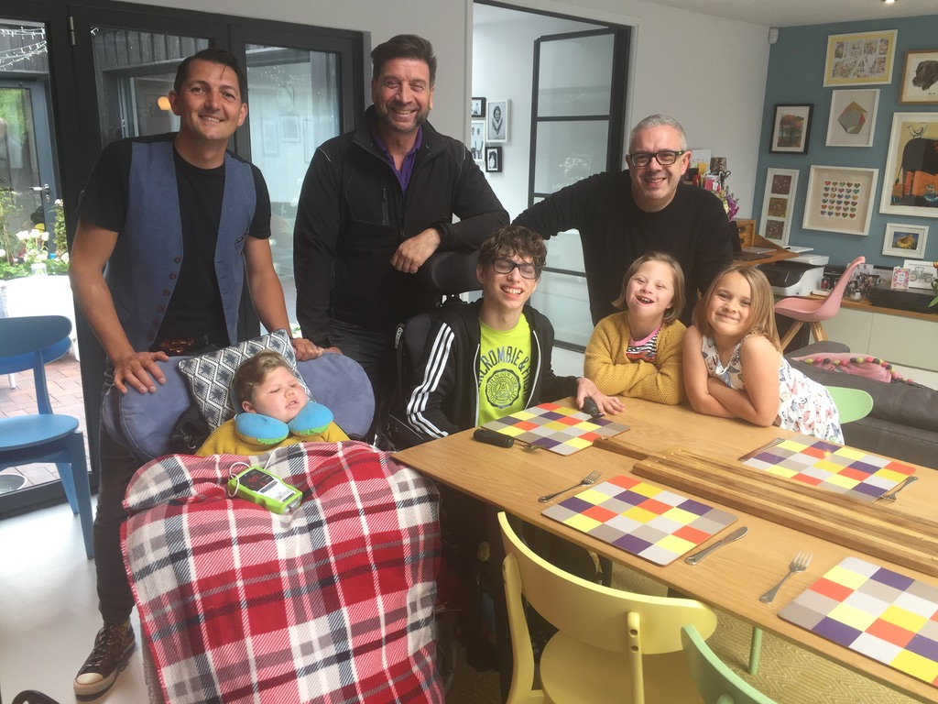
Meet the Family…

Slide 65


Slide 66


Slide 67
Why a value of EQUALITY?
We live in a diverse community/county/country/world.
We live at a time where acceptance of equality is being challenged, stress tested and scrutinised in legislation and in the community.
We believe that developing our values, understanding and behaviour around “equality” will make us better humans/citizens.
Experience of discrimination is too common amongst our pupils, families and staff.

Slide 68


Pledges

Slide 69
Pledge Conversations

Slide 70
Equality through:
GOVERNANCE
CURRICULUM
PEOPLE, CULTURE AND COMMUNITY
A FOCUS ON STAFF

Slide 71
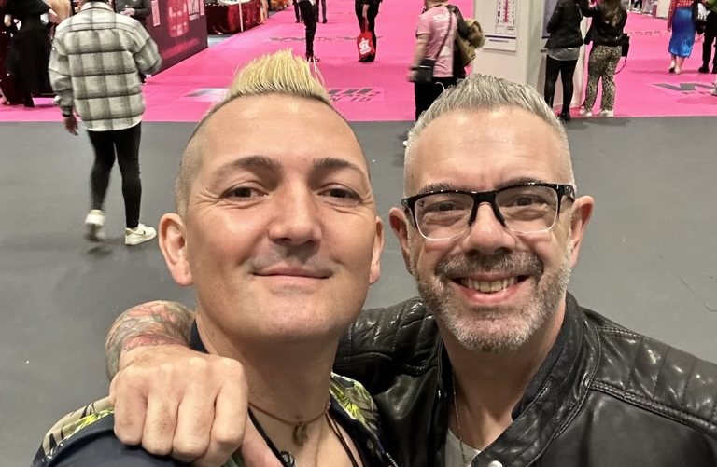
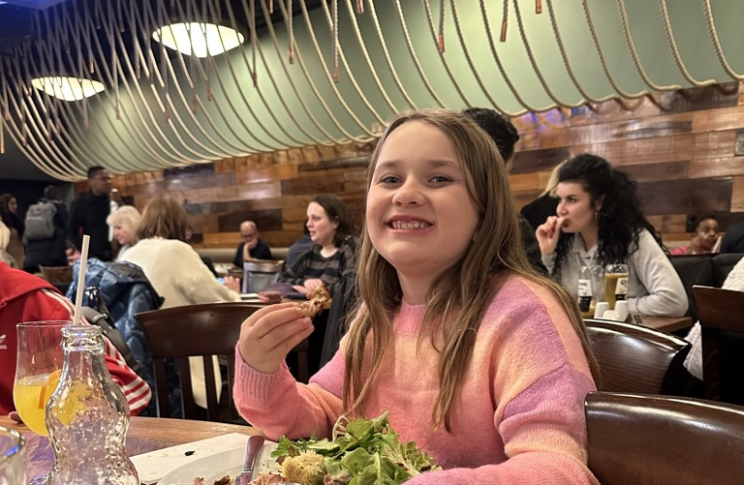
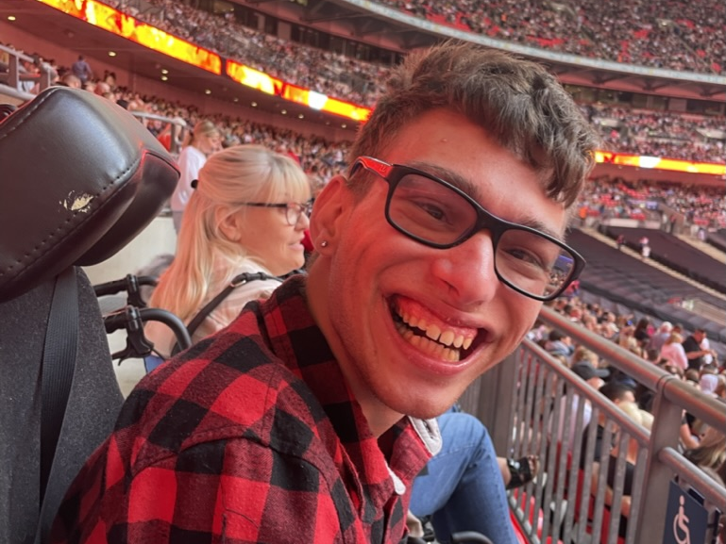
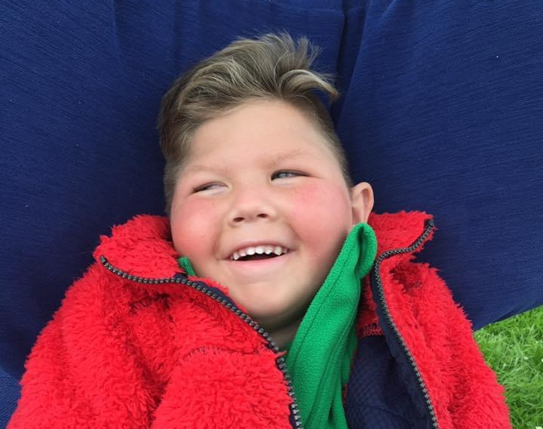
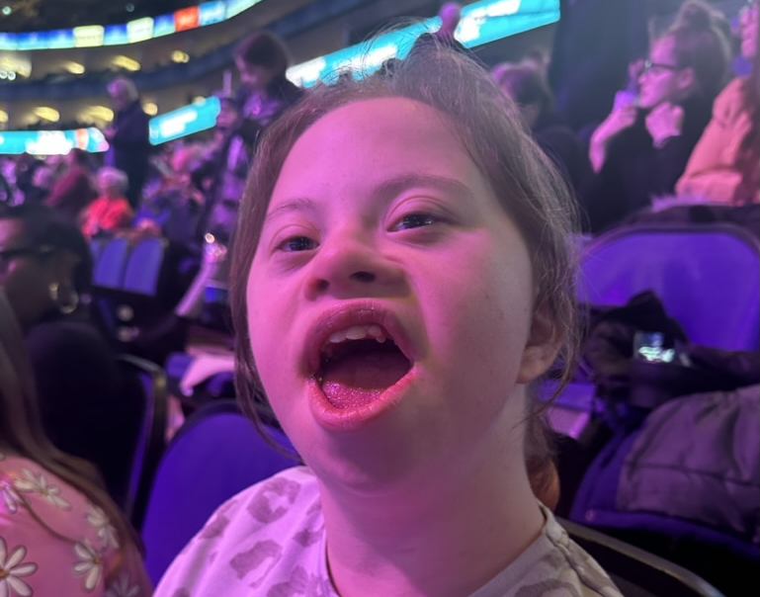

Slide 73
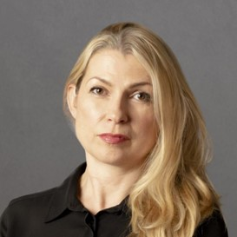

From vision to strategy to daily good practice
Clare Wilson
Team Manager
Education Data Hub

Slide 74
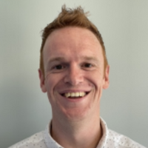
Trust mergers – Due diligence is key, but what about reverse due diligence?
Phil Reynolds
Chief Financial Officer
The Island Learning Trust

Slide 75
CHAIRS CLOSING ADDRESS
Matt McDermott
Founder of MATA
Director of Convenzis Education

