Slide 1
Welcome to the NHS Radiology Summit!
26th September 2024
15 Hatfields Conference Centre, London SE1 8DJ

Slide 2
Slido
Please scan the QR Code on the screen. This will take you through to Slido, where you can interact with us.

Slide 3
Chair Opening Address
Dr. Ramdas Senasi
Consultant Radiologist
Hull University Teaching Hospitals

Slide 4
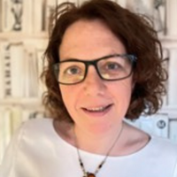
Fireside Chat
Sheila Black
Head of Imaging Transformation - NHSE

Slide 5
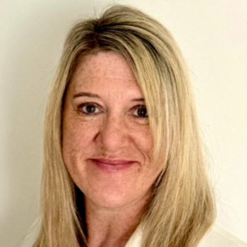
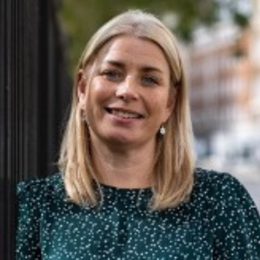
Addressing the Radiology Workforce Crisis: Strategies for Tackling the Staffing Shortfall in the NHS Panel Discussion
Mr Chris Sleight MSc BSc FIBMS
Chief Officer - Greater Manchester Diagnostics Network
Sheila Black
Head of Imaging Transformation
NHSE
Melanie Smith
Diagnostics Workforce Transformation Lead
NHS London North West
Glenda Shaw
Quality Improvement Partner
Royal College of Radiologists & College of Radiographers

Slide 6
Main Sponsor

Slide 7
Slido
Please scan the QR Code on the screen. This will take you through to Slido, where you can interact with us.

Slide 8
Case Study
Grant Roberts
Chief Executive Officer
Managed Healthcare Services Ltd.

Slide 9
Refreshments & Networking

Slide 10
Chair Afternoon Address
Dr. Ramdas Senasi
Consultant Radiologist
Hull University Teaching Hospitals

Slide 11
Case Study

Slide 12
Slido
Please scan the QR Code on the screen. This will take you through to Slido, where you can interact with us.

Slide 13
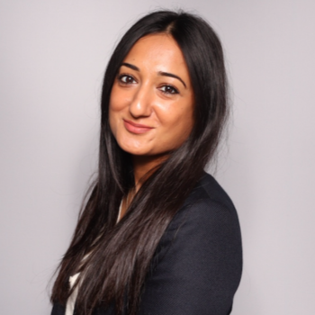
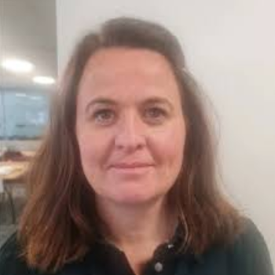
Case Study
Dr Bea Bakshi
CEO and Co-Founder
C the Signs
Claire Corbett
Head of Cancer and Long Term Conditions
Suffolk and North East Essex ICB

Slide 14
Creating a future where every patient survives cancer
DR BEA BAKSHI General Practitioner, Co-Founder & CEO
C the Signs
CLAIRE CORBETT
Head of Cancer and Long-Term Conditions, Suffolk & North East Essex ICB

Slide 15
Cancer in the UK

Slide 16
LATE-STAGE DETECTION IMPLICATIONS:
Patients diagnosed at the late stages:
50%
5-year patient survival rate in late stages:
<30%
Death rates in non-screenable cancers:
75%
390,000
Patients diagnosed with cancer annually in the UK
OPPORTUNITIES IN CANCER DETECTION
Cancers diagnosed after a symptomatic presentation:
95%
10-year patient survival rates when diagnosed early:
>80%
Cost savings achieved through early detection of cancer:
£1bn
£14bn+
Annual cancer expenditure

Slide 17
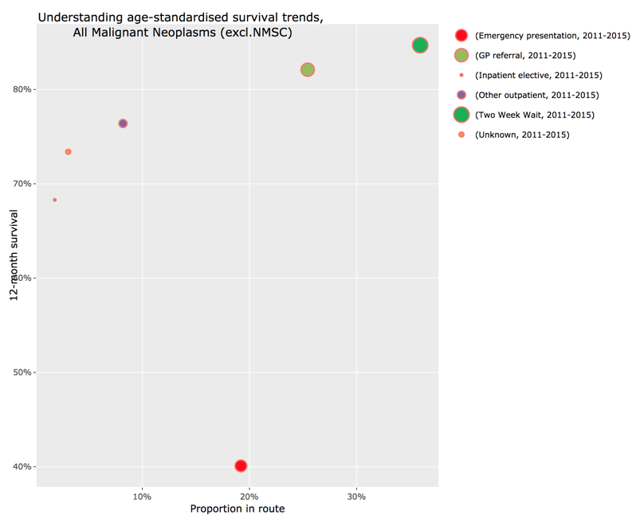
One year survival by route to diagnosis
20% diagnosed in A&E
two-thirds saw their GP in the preceding 12 months with accelerating symptoms. <40% of patients survive to 1 year. Increasing the Cancer Detection Rate in Primary Care has been shown to lead to stage shift and improved survival rates.
Challenges in primary care GPs detect only 8 new cases of cancer per year and have a 54% sensitivity for cancer.

Slide 18
Cancer Prediction System

Slide 19
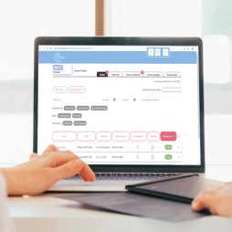
Clinical Signs
Symptoms
Exam
findings
Demographics
C the Signs Cancer prediction platform that uses AI to analyse data in the EHR and patient reported data to identify patients at risk of cancer, determine the cancer type, and navigate to the best pathway.
Family history
Genetics
Medication
history
Past test results
Risk
factors
Lifestyle
PATIENTS
PROVIDER
POPULATION

Slide 20
What are example factors or data points used in the Model for cancer prediction?
Demographics | Risk factors | Symptoms | Clinical signs | Investigation results
Age Sex | Smoking status Family history of X cancer History of alcohol excess | Bloating Fatigue Back pain | Finger clubbing Cranial nerve palsy Abdominal mass | Hyperglycaemia Iron deficiency anaemia Ovarian cyst

Slide 21
Supporting the end-to-end patient journey
Patient
Diagnosis
Tracking of all newly diagnosed cancer patients
Real-time notifications for cancer care reviews
Data analytics to support with PCN DES, QOF and IIF targets
Real-time Dashboard for ICB’s, Cancer Alliances and Practices
Data reports for cancer detection rate, conversion rate, pathway utlisation and real-time improvements.
Patient Navigation
Real-time, notifications for accurate patient referrals
Accelerate diagnosis and treatment
Eliminate inappropriate referrals
Customisable criteria to optimise conversion rates
Cloud-based technology with real-time updates
Patient
Safety
Automated tracking of all patients on USC and diagnostic pathways
Automated tracking of test results, and pre-population of abnormal results for further actioning
Support with timed pathways for alerts and flags
Removed human to human handovers and errors
Patient Assessment
Real-time decision support
Identify cancer risk and tumour type
Supports Vague & non-specific presentations
Over 50+ types of cancers
Access to USC, diagnostics & non-urgent pathways

Slide 22
Adoption in the NHS

Slide 23
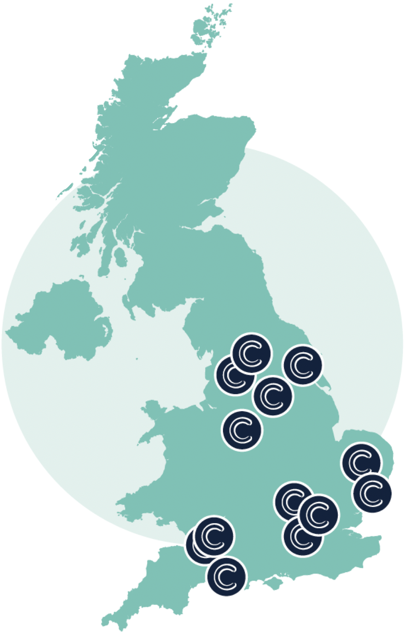
1,400 GP practices using the C the Signs technology in partnership with ICBs and Cancer Alliances
Hull Teaching Hospital
Somerset Foundation Trust
Bury
Staffordshire PCN
South West London PCNs
North East London PCNs UK Primary Care Defense
Suffolk & North East Essex ICB
Norfolk and Waveney ICB
South Yorkshire & Bassetlaw ICB
North West London ICB Somerset ICB
Dorset ICB
Bradford & Craven Health & Care Partnership
South Liverpool Collaborative

Slide 24
C the Signs: real-world evidence and research
20%
Increase in Faster Diagnosis Standard performance
8-12%
Increase in rate of cancer detection
25,000
Cancers
detection
50+
Pan-cancer detection
350,000 patients' risk assessed
99%
Sensitivity for cancer
99%
Negative
predictive value
94%
Accuracy in predicting tumor origin

Slide 25
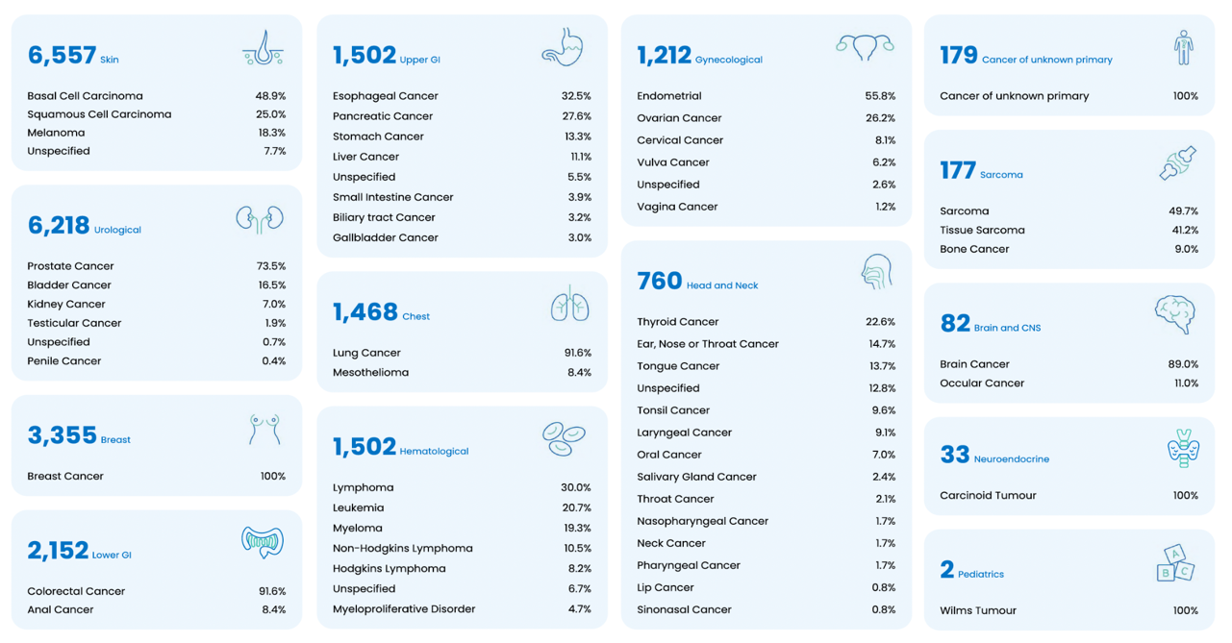
Finding rare & harder to detect cancers across 50+ cancers

Slide 26
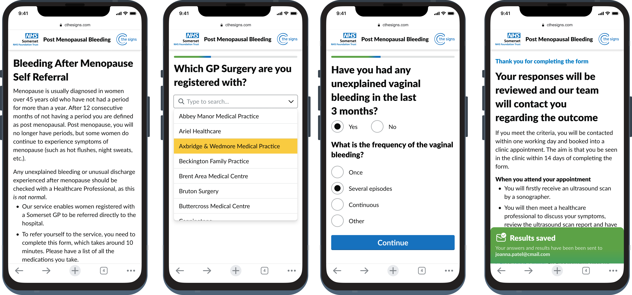
C my Signs launched 2024 - Patient initiated pathways
Post-menopausal bleeding pathway made available to patients in Somerset.
Time to diagnosis for patients using the self-assessment pathway went from 60 days down to 5 days

Slide 27
Suffolk & North East Essex ICB case study

Slide 28
Implementing C the Signs in SNEE ICB to improve early cancer diagnosis
In 2021, 43% of cancer diagnoses were made through the urgent suspected cancer (USC) referral route, 19% through routine referrals from primary care, and 18% via emergency presentations (with 50% of these patients being sent to A&E by their GP).
In total, approximately 70% of cancer diagnoses were made following contact with primary care, often after multiple visits.
Opportunity to improve earlier identification of patient in primary care & optimise route to diagnosis through USC pathways
C the Signs was implemented in Ipswich and East Suffolk in 2021 to support early cancer diagnosis.

Slide 29
Improving cancer detection in Suffolk & North East Essex ICB
A study was undertaken between 1st May 2021 and 31st March 2022 in Ipswich and East Suffolk, with a cohort of practices adopting the tool and the other cohort used as an in-area control.
Impact on cancer detection rates in trial sites compared to matched controls and NHS England
70%
c the signs launched
+
12.3% Increase in cancer detection rates across the trial sites (p<0.05)
The cancer detection rate increased from 58.7% to 66% - a rate of increase of 12.3% (p<0.05).
65%
60%
+0.06% Increase in cancer detection rate across control site
55%
-0.04% Decrease in cancer detection rates across NHS England
50%
0%
2017/18
2018/19
2019/20
2020/21
2021/22

Slide 30
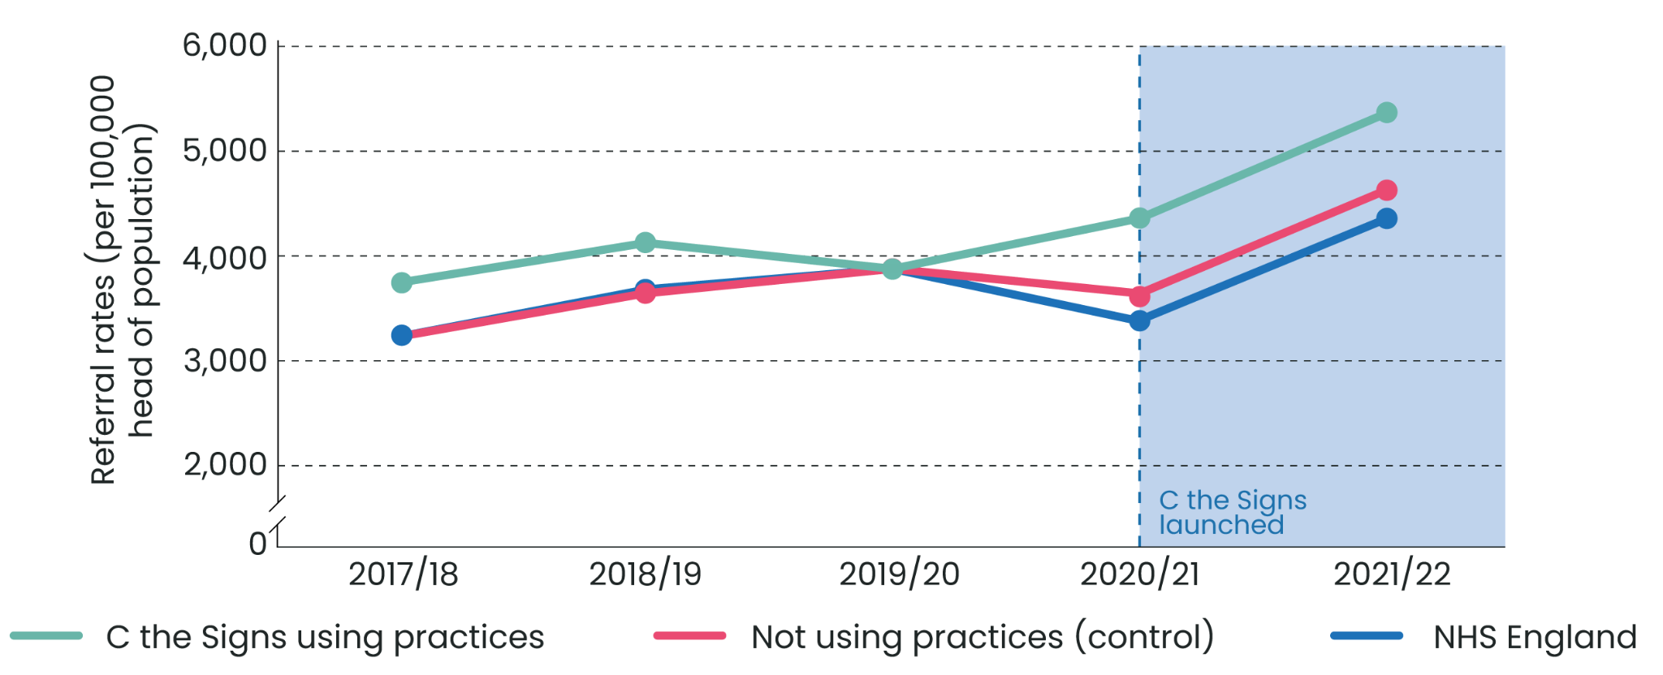
Impact on healthcare utlisation in Suffolk & North East Essex ICB
Impact on cancer referral rates in trial sites compared to matched controls and NHS England
+23.6% increase in trial site
+27.1% Increase in control site
+27.6% Increase across England
The increase in cancer detection was not from an increase in resource utlisation

Slide 31
Improving access to diagnostics for patients at low risk for cancer
Many at-risk cancer patients don’t meet the referral criteria
Primary care needs better access to investigations to speed up diagnosis.
In September 2023, NHS England released guidance on using urgent direct access investigations for patients below the referral threshold.
There is evident need for
primary care to have increased access to
appropriate investigations to speed up time to diagnosis for these patients

Slide 32
Aligning Stakeholders
We needed the pathway to integrate with existing workflows and not impact the workforce or increase workload
Concerns over the impact access would have on radiology capacity
Patient safety was a key priority - to ensure they received appropriate follow up and onward referral to a USC if required
The radiology team at East Suffolk & North East Essex Foundation Trust was a key stakeholder
Vague national referral criteria made it difficult to predict patient numbers and required capacity.

Slide 33
Implementation
Collaborated closely with the radiology team to establish clear referral criteria for the pathway.
Criteria were based on NHSE guidance while also considering local priorities
Allowed flexibility for GP suspicion, which has proven to be a reliable indicator of cancer risk.
Opening access across all of primary care at once could overwhelm diagnostic capacity and services, to address this, we implemented a phased deployment across Primary Care
Real-time analytic review enabled us to track patients going through pathway in real-time to assess for any changes to criteria
Diagnostics were performed and reported in line
with the 28-day faster diagnosis standard. Initially, only CT scans were made available through this
pathway, as this service had the greatest capacity, with planned expansion to MR and USS

Slide 34
Positive feedback from primary care
“I find the service very useful. I have requested a CT scan twice using this service. This is particularly useful when there is high suspicion of cancer/concern, and it doesn't fit the 2ww pathway. Both patients received an appointment within a few weeks. The quick response helped me to decide whether onward referral was
required or not.”
Dr Jyoti Ravikumar, General Practitioner, Combs Ford Surgery

Slide 35
Primary care feedback
“I find the service very useful. I have requested a CT scan twice using this service. This is particularly useful when there is high suspicion of cancer/concern, and it doesn't fit the 2ww pathway. Both patients received an appointment within a few weeks. The quick response helped me to decide whether onward referral was
required or not.”
Dr Jyoti Ravikumar, General Practitioner, Combs Ford Surgery

Slide 36
Patient feedback
“My mum died of ovarian cancer, so that's always been in the back of my mind. Because I didn’t fit the criteria, I would have had to wait quite a long time and that's very worrying if you’re poorly. Anything that helps other people get it done quicker, is amazing. When you’re having to wait longer, it can be very concerning.
The CT scan gave further information into what needed investigating further. It was completed within 10 days of me being really poorly, this scan was organised and I now have a colonoscopy and an endoscopy booked.”
Judith Sutton, Patient, 64 years, Stonemarket

Slide 37
Thank you, Questions?
Dr Bea Bakshi MBBS BSc MRCGP
bbakshi@cthesigns.com
Claire Corbett
claire.corbett@snee.nhs.uk

Slide 38
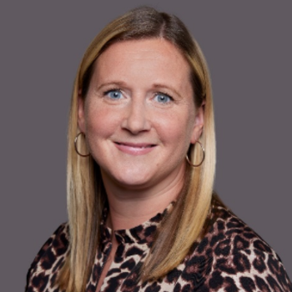
Keynote Presentation
Lucy Lehane
Innovation Lead - British InVitro Diagnostics Association (BIVDA)

Slide 39
10th NHS Radiology Summit
The Vital Role of Diagnostics
in Modern Healthcare

Slide 40
Lucy Lehane
Over 25 years in Diagnostics
Trained in the NHS
Experience in Medical & Clinical Affairs, Marketing Comms, and Product Strategy
Declarations:
BIVDA Innovation Lead
BSI Chair of Health Sector Advisory Board
SBRI Healthcare Review Panel
Conflicts of Interest - None

Slide 41
Trends in the Diagnostics Industry
BIVDA - British In Vitro Diagnostics Association
Why are diagnostics important?
What can we test and why?
Innovations and the Future

Slide 42
Diagnostics and the MedTech Industry
Global Trends:
Ageing population
Pandemic
Prevalence of chronic conditions
Innovation & Technology

Slide 43
National Association for manufacturers and distributors of IVD’s in the UK.
Represent >95% of the industry with over 230 member organisations.
Promote and support the use of diagnostics.
Encourage Innovation and Adoption of new tech.
“Advancing the vital role of diagnostics in shaping the future of healthcare”

Slide 44
The Four Humours
Theory developed in Ancient Greece and Rome, influenced European medicine until at least the 18th Century.
Blood, Phlegm, Black Bile and Yellow Bile.
In a healthy person, the 4 humours are considered to be “Balanced”.
In order to heal the sick, the balance of the four humours had to be restored.

Slide 46
“70% of clinical decisions are influenced by diagnostic tests”

Slide 47
What samples can we collect from the human body?

Slide 48
“Global access to high quality diagnostics is poor, and even when diagnostics are available they are often of variable quality”
Lancet Commission on Diagnostics, 2021

Slide 49
Diagnostic Testing
at point of need

Slide 50
Where can testing take place?
To Reassure
To Know
To reach a diagnosis
To start (the right) treatment faster

Slide 52
References and Resources
Lucy@Lehaneconsulting.co.uk

Slide 53
Case Study

Slide 54
Slido
Please scan the QR Code on the screen. This will take you through to Slido, where you can interact with us.

Slide 55
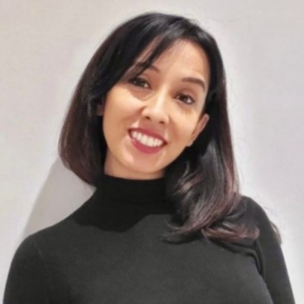
Case Study
Farzana Rahman
CEO & Co-Founder
Hexarad

Slide 74
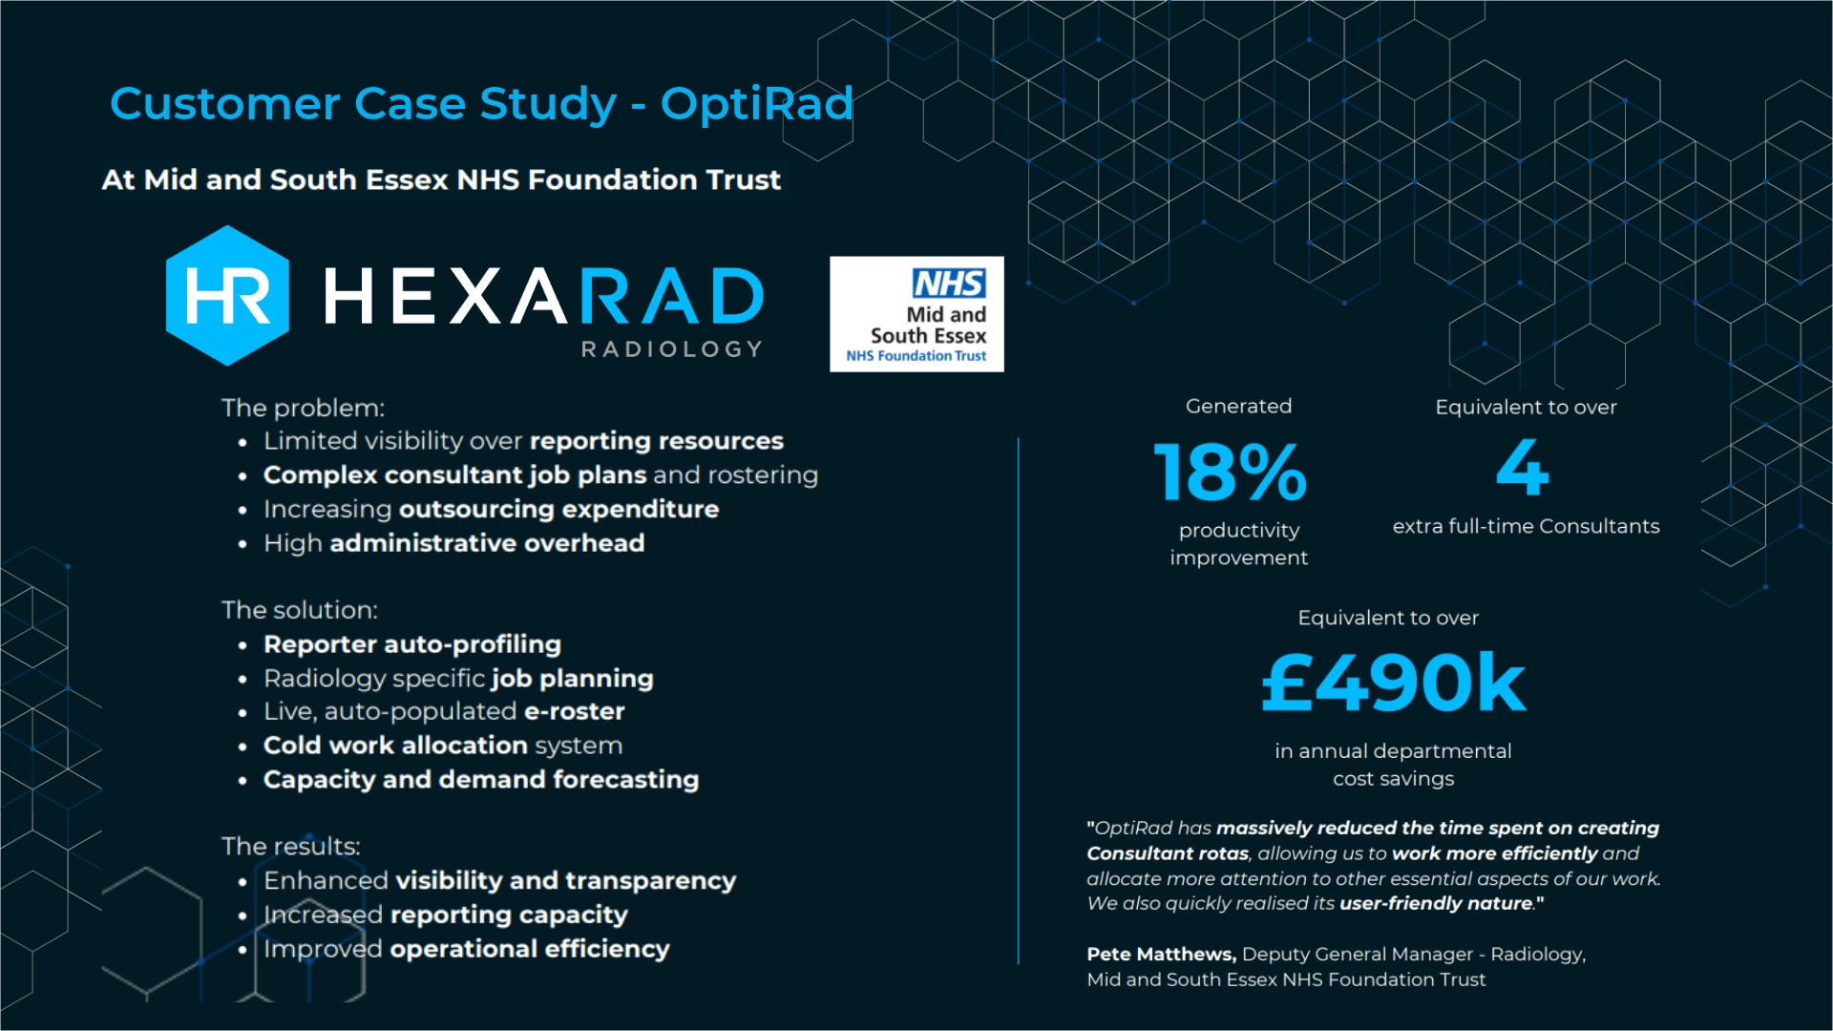

Slide 84
Notes:
Inbulit chat function – means you can get hold of us instantly – lack of phone interruptions mean you can get better quality reports quickly. governance (everything document and time stamped)

Slide 87
Case Study

Slide 88
Slido
Please scan the QR Code on the screen. This will take you through to Slido, where you can interact with us.

Slide 89
NHS Imaging Congress
Imaging & AI Platform as a Service
Healthcare and Data Services
Public Sector BU & Office of the CIO
Notes:
Hello Everyone, nice to be back again this year and I appreciate the opportunity to speak to you about our Imaging and AI Platform as a Service.
My name is Simon Staveley, and I’m the Health Sector specialist for Exponential-e’s Platform and Managed Services Team.
Exponential-e are an IT and Network Services company, and our role is one of an enabler for Digital Healthcare Solutions, - providing secure and resilient data platforms which form the foundations for our partners to build on, and to manage your data in a cost-effective way.

Slide 90
The Challenge
Public Sector, notably the NHS is under significant pressure to deliver best value, increase efficiency, deliver better outcomes and respond to new challenging dynamics without compromising the level of service delivered.
Healthcare and Data Services
Public Sector BU & Office of the CIO
Notes:
- And cost is becoming a bigger challenge every day, with Public Sector and notably the NHS under increased pressure to deliver best value, increase efficiency and deliver better outcomes, and respond to new challenges, without compromising services.
- And in the field of radiology, there are particular challenges with more radiologists leaving the workforce that are joining, and an ever growing population compounding the issue. - therefore, the industry is looking to technology solutions such as AI and other clinical support tools to relieve some of the pressure that the NHS faces.

Slide 91
The Opportunity
To provide highly resilient secure private data and AI platforms that provide scale out capacity and computational power to accelerate digital outcomes within the NHS.
Added to harness the data, via approved data pathways for real time clinical and academic AI insights, to accelerate patient diagnostic outcomes and underpin researchers in developing new innovations to accelerate human progress .
Healthcare and Data Services
Public Sector BU & Office of the CIO
Notes:
But whilst and the potential for AI assisted decision support holds great promise for improving those efficiencies and outcomes, it also comes with the burden of having to store and manage huge volumes of data, as well as provide ever growing amounts of costly computer processing.
A large trust can hold as much as 500TB of radiology images, and will soon have 1000TB of digital pathology images, and these are truly enormous amounts of data.
Now, if we can harness that data, we can use it to accelerate patient diagnostic outcomes, researchers can use it to develop new innovations, and we can ultimately drive faster and more reliable results, manage costs and resources more effectively, and ultimately deliver better care. But it does all hinge on how the data is stored, how it can be accessed, and if it can be done in a cost effective way.

Slide 92
Data Challenges…and Opportunities
Data Growth
Data Retention
Data Intelligence
Data Governance
A Petabyte? What the heck is a Petabyte?
Healthcare and Data Services
Data Platform Solutions | Cloud Services by Exponential-e
Public Sector BU & Office of the CIO
Notes:
So I imagine most of you have heard of a GB and are familiar with that scale when choosing your smart phone data package. However there’s probably fewer of you who have dealt in Terabytes, and fewer still who can imagine the size of a petabyte.
OK, so for those who haven’t, a typical movie that you stream on Netflix is between 1-2GB, a TB is 1000 GB, and a PB is 1000 TB. So a PB is one million GB and that is enough storage space to store half a million digital movies, which according to Google is the approximation of every film that has ever been made since movie making began in 1888.. That would take 120 years of non stop watching to get through
So a Petabyte is ludicrously big.
And yet…, due to the exponential rise in healthcare data, the PB is now the denomination of storage which NHS regions, and even some large individual trusts are have to plan in, with annual growth in the order of PB becoming the norm. So how do Trust manage this? How do you plan for the expense?
Well, Public Cloud is always an option for this, and we are advocates for public cloud for the right use cases, such as for automatically scaling up and scaling down compute resource to meet fluctuating demands, or for application development..
.

Slide 93
Why Public Cloud isn’t always the answer
+50%
64%
70%
30%
Organisations have data security and compliance issues*
Organisations have higher total cost of service(s) than anticipated*
Customers report cloud repatriation activities**
Public applications expected to repatriated over the next two years (average)**
*ESG Hybrid Cloud Tipping Point, June 2022* *IDC: Cloud Repatriation Accelerates in a Multi-Cloud World, 2023
Notes:
However many legacy healthcare applications cannot run in a cost effective way on the cloud, and when data is just growing and growing as with radiology, public cloud gets cost prohibitive.
There are also compliance and security challenges, as whilst the public cloud can be configured in a compliant and secure way, if you’re not extremely competent at managing cloud workloads it’s entirely possible for copies of your data to end up in US or Asia Pacific availability zones. It’s something we’ve had to help many of our customers to resolve.
So, For these reasons, we are now seeing a growing number of companies involved in repatriation activities. And that in itself is another problem.
What happens if you have several PB of image data with a public cloud provider, and you want to switch to another provider? Let’s say their prices go up, or there’s ongoing service issues? Moving all of that data will be extremely costly and very time consuming. So this is why we are providing more cost effective solutions, with greater levels of assurance, and with non disruptive and low cost options to exit a service contract. Not that we expect to give you a reason to leave.
.

Slide 94
Healthcare and Data Services
Public Sector BU & Office of the CIO
94
Notes:
Ok, so let me give you a very quick whistle stop tour of who we are and why we’re a safe pair of hands. We are a private owned UK based company established for more than 20 years, and our founding director Lee Wade (probably the hardest working man I’ve ever met) is still in the office every day at 7am sharp. He can’t get enough. (joke about my appraisal) and we have grown organically over that time with a compound annual growth of 25% in the last 5 years. We employ 700+ staff and have more than 3000 customers, with a turnover of £210m 22/23. We have a 24 hour Service Desk which operates from two UK sites in London and Swansea, as well as team of field based engineers and two data centre teams who are hands on in our secure DCs around the country
We have won and continue to win awards based on our merit, and our live NPS score, which is a measure of how likely our customers would recommend us, is consistently over 70% against an industry average of less than 30%.
We are also one the highest accredited companies in the UK, with 9 ISO from the British Standards Institute for our Information Security and environmental standards, and 40% of our staff are Security Cleared or Deep Vetted, allowing us to manage the most sensitive workloads for Home Office, Justice and the MOD.
122

Slide 95
Trusted partner of the NHS
16%
+65%
of London’s NHS Organisations
70+
Health Organisations
9 ISO Accreditations
Trusts, ICS, CCGs, GPs, Community, STPs
HSCN Stage 3 Compliant
of all HSCN Circuits
Healthcare and Data Services
Public Sector BU & Office of the CIO

Slide 96
Core Service Offerings For Health
MANAGED & PROFESSIONAL SVS
CYBER SECURITY
LIMS and RS
DC TRANSFORMATION
+65%
of London’s NHS Organisations
70+
Health Organisations
TRE / SRE / MLOPS PLATFORMS
DATA PLATFORMS
HSCN CONNECTIVITY
Healthcare and Data Services
Public Sector BU & Office of the CIO
Notes:
OK, so as I said at the top, we are an enabler of digital solutions and we support better patient outcomes by providing cost effective, complaint and reliable platforms. And whilst this is absolutely critical, if we are fulfilling our mandate most of you won’t every know were there. Our core service offering start with network connectivity, and we manage our own high performance, business only fibre network which spans the UK. Over this, we deliver a low latency HSCN service which currently connects 70 of trusts in greater London, and about 18% nationwide. Our network has points of presence in 39 data centres around the UK, and we build and manage resilient data platforms for hosting digital health solutions, trusted research environments and telemedicine services. In total, we provide services to 70+ health organizations.
So what does the platfrom look like?

Slide 97
Picture Archiving and Communication System (PACS) Ready Stacked Solutions
Imaging & AI Ready Stacked Solutions
A.I & ML Solutions
TRE / SRE / MLOPS Computation Environments and Data Anonymisation Services
COMMISSIONING
APPLICATION MANAGEMENT
VIRTUAL MACHINE
VIRTUAL MACHINE
CONTAINER
CONTAINER
CONTAINER
Managed and Professional Services
APP
APP
APP
APP
SERVICE MANAGEMENT
APP
APP
APP
BIN / LIB
BIN / LIB
BIN / LIB
BIN / LIB
BIN / LIB
OPERATING SYSTEM
OPERATING SYSTEM
DRaaS and BUaaS
HOSTING
FULL INFRASTRUCTURE UP TO OS LAYER
HYPERVISOR
CONTAINER RUNTIME
OPERATING SYSTEM
OPERATING SYSTEM
Long Term Archive Tier
Integrated DR as a Service, Backup as a Service, Archive as a Service
Fast Tier 1 & Medium Tier 2 Storage
Sustainable Datacentres Hyperconverged Modular Infrastructure to run Imaging applications
Notes:
Start with sustainable datacentres, which are part of the Carbon Neutral DC Pact and run entirely on renewables, then we build high performance hyperconverged compute infrastructure to host the infrastructure. Leveraging our partnership with Dell technologies, we provide fast and medium performance storage for live patient cases, and then automatic tiering to more cost-effective archive storage layers.
To protect the data we deliver backup and DR as a service across multiple locations, and this is all supported by a rich potfolio of managed and professional services. So, what’s unique about Exponential-e, and how do you help with this massive issue of data and the associated costs? Well, we have demonstrated time and again that we deliver this full solution stack for the same price per GB as the archive storage from public cloud provides, which equates to 30%+ cost saving over a 5 year term.
Moreover, whilst Public Cloud has monthly paid revenue models which are not a good fit for NHS budget cycles, as well as huge challenges with how you’d ever get your data back, our data platforms can be purchased on government frameworks with a Capex finance model, with a depreciable asset that you own at the end of the term. We can literally take you to our data centres and show you storage nodes where your patient data is held, and you could power it down and take it away with you.
125

Slide 98
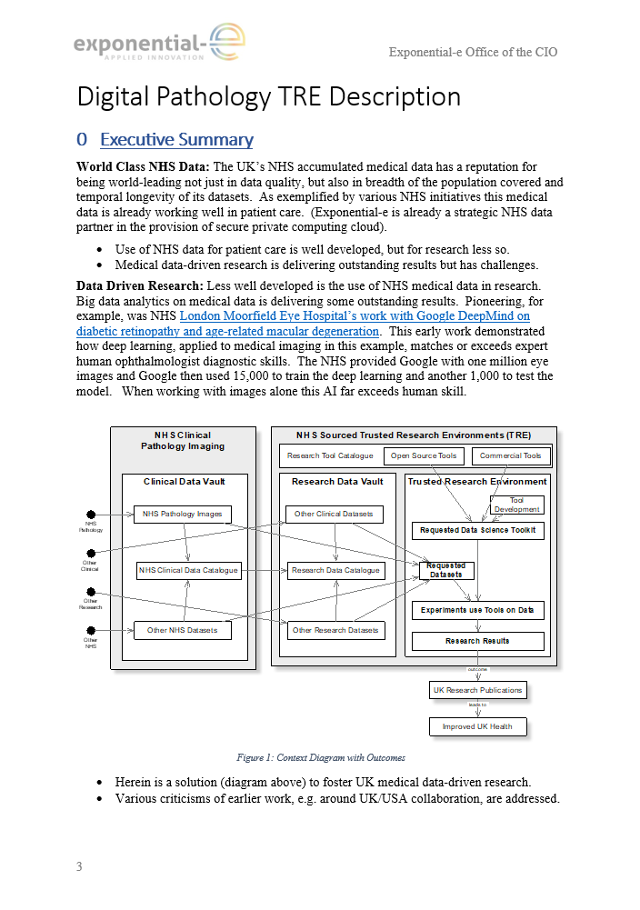
Documented Blueprint
Notes:
We can also host multiple application on the same data platform to create a greater pool of data for AI interrogation and machine learning, and we have a documented blueprint on best practices research environments, which we produced with data and AI scientists.

Slide 99
Data Architecture
Trusted Research Environments (TRE)
Clinical
Parallel Request Goes to TRE Environment Build team to automate the delivery of TRE workbench
Throughout a Meta Data Map is collated and securely stored to allow for digital tractability, audit and reconnection where required of research findings to original clinical data
TRE Automatically deployed and data copied from staging areas to the Data Storage layer in the TRE
Meta Data Mapping
Centralised PACS and Cyber Recovery Platform distributed across 2 x DC’s and integrated to customer side scanners with dedicated WAN / HSCN Connectivity
Data gets moved in to a Data Staging area to ensure segregation of TRE from Clinical production service and final validation steps completed on data to verify Anonymization measure met
Data Staging Area
DC2
PACS
PACS
Data request goes in to System Administrator / Image Data and Metadata Curator. Via Clinical Omero instance data identified on Source lcoations
Data request goes via the TRE approval process to agree to data set provision
In the New TRE side of the service, Second Data Index Engine
established, deployed on localised Private Infrastructure
Data Index Engine + Visualisation
DC2
Batch process established on agreed change schedule e.g. Nightly, Weekly, Monthly to copy across Data but in transit, auto anonymization completed against agreed criteria
Data Index Engine
Researcher logs in via a secure Virtual Desktop Image (VDI) to Data Index Engine + Visualisation
and searches for the data that they would like to use within their TRE.
Added decision made on environmental size required for research AI
PACS Data in phase one indexed in Data Index Engine
. Future indexation to wider data sources in unstructured Data Vault
Repeat indexation based on agreed change schedule e.g. Nightly, Weekly, Monthly
Healthcare and Data Services
In Clinical Production side of the service, Data Index Engine
instance established, deployed on localised Private Infrastructure in Secondary DC
Public Sector BU & Office of the CIO

Slide 100
Example Customers / Use Cases
Provision of Data Platform to support the NPIC Digital Pathology Service
Scope inclusive of
WAN links to hospitals
Dual Datacenter Private PACS Platform to host Sectra
Full managed service for the PACS underpinning platform
TRE environment for Halo based imaging environment to allow research capability development
Integrated security services
High, Mid and Archive Storage services geo delivered across 2 x Tier 3 DC’s to allow full system resilience and failover
Long term partneship focusing on innovation and introduction of AI
6000 User Managed Service for
Device as a Service end to end service (Design, Procure, Build, Implement, Change, Break fix etc.)
Tech Hub
24 x 7 x 365 Service Desk
Full Service Now ITSM Install and operation
CSOC - Cyber Security Operations
Ongoing Security assesments and penetration testing
Delivering a robust and innovative solution to allow NHS users access to telemedicine systems via a secure encrypted platform
133 locations within HM Prisons, Young Offender Institutes, Secure Children Homes and Immigration Removal Centres
Reduces offsite and outside visits to less secure locations and provide assessment at the point of patient
Service provides
Device as a Service with custom tablets
Secure encrypted data passage to back end SystmOne services
24x7x365 support services
Mobile system access
2FA security
Bash Hussain, Deployment Director at NPIC said:
“We have achieved a key milestone for the NPIC programme which has significant infrastructure needs for storage and processing of clinical images. Working alongside Exponential-e will provide the programme with a resilient, scalable platform needed to meet both our clinical and research ambitions.”
Andrew Stevens, Chief Executive Officer at Solent NHS Trust, elaborated:
"Exponential-e's experience in healthcare technology made them a strong potential partner, but it was their willingness to understand where we were, where we wanted to be, and – most importantly – their willingness to tackle any associated ICT challenges head-on. It has been exciting to see the level of engagement across every area of this project from teams at both companies, and I look forward to continuing our work together."
Michael Wheatley Drug Strategy and Delivery Team - Transforming Delivery in Prisons, HMPPS
“The confidence we had in Exponential-e and the support they offered, alongside approval from HMPPS Information Security and the MOJ Digital and Technology team, meant that we were able to commit to delivering the Telemedicine programme within the required timeframe - as ambitious as it was - which was a great achievement”
Healthcare and Data Services
Public Sector BU & Office of the CIO
Notes:
Just to finish, I wanted to highlight some of out existing customers and the use cases, You will of course all be familiar with NPIC and the incredible work that Bash and his team are doing, with the NPIC Sectra Application running on our platform.
Other sure cases include our fully outsourced IT Service Desk and PC as a Service solution for NHS solent, and then tying in with our trust as a highly scure provider, is the telemedicine service which we has transformed delivery of patient care within HM Prosion and Probation Services.

Slide 101
Summary
Secure & resilient Enabler for Digital Health Solutions
Hosting some of the largest PACS/IMS/LIMS/RIS in the UK
Cost effective vs. Public Cloud with Capex finance options

Slide 102
Cross-sector Innovation Panel Discussion
Dr Rizwan Malik
Consultant Radiologist
Bolton NHS Foundation Trust
Dr Amrita Kumar
Consultant Radiologist & Clinical AI Lead - Frimley Health NHS Foundation Trust
Sarim Ather
MSK Radiology Consultant and Digital Lead - Oxford University Hospitals NHS Foundation Trust
Dr. Mike Nix
Principal Clinical Scientist (AI R&D)
Leeds Teaching Hospitals NHS Trust
Farzana Rahman
CEO & Co-Founder - Hexarad

Slide 103
Drinks and Networking

Slide 104
Scan here to claim your CPD Certificate...
26th September 2024
15 Hatfields Conference Centre, London SE1 8DJ

Slide 105
Thank you for attending the NHS Radiology Summit!

Slide 106
Chair Afternoon Address
Dr. Ramdas Senasi
Consultant Radiologist
Hull University Teaching Hospitals

Slide 107
Case Study

Slide 108
Slido
Please scan the QR Code on the screen. This will take you through to Slido, where you can interact with us.

Slide 109
Case Study
Dr Bea Bakshi
CEO and Co-Founder
C the Signs
Claire Corbett
Head of Cancer and Long Term Conditions
Suffolk and North East Essex ICB

Slide 110
Creating a future where every patient survives cancer
DR BEA BAKSHI General Practitioner, Co-Founder & CEO
C the Signs
CLAIRE CORBETT
Head of Cancer and Long-Term Conditions, Suffolk & North East Essex ICB

Slide 111
Cancer in the UK

Slide 112
LATE-STAGE DETECTION IMPLICATIONS:
Patients diagnosed at the late stages:
50%
5-year patient survival rate in late stages:
<30%
Death rates in non-screenable cancers:
75%
390,000
Patients diagnosed with cancer annually in the UK
OPPORTUNITIES IN CANCER DETECTION
Cancers diagnosed after a symptomatic presentation:
95%
10-year patient survival rates when diagnosed early:
>80%
Cost savings achieved through early detection of cancer:
£1bn
£14bn+
Annual cancer expenditure

Slide 113
One year survival by route to diagnosis
20% diagnosed in A&E
two-thirds saw their GP in the preceding 12 months with accelerating symptoms. <40% of patients survive to 1 year. Increasing the Cancer Detection Rate in Primary Care has been shown to lead to stage shift and improved survival rates.
Challenges in primary care GPs detect only 8 new cases of cancer per year and have a 54% sensitivity for cancer.

Slide 114
Cancer Prediction System

Slide 115
Clinical Signs
Symptoms
Exam
findings
Demographics
C the Signs Cancer prediction platform that uses AI to analyse data in the EHR and patient reported data to identify patients at risk of cancer, determine the cancer type, and navigate to the best pathway.
Family history
Genetics
Medication
history
Past test results
Risk
factors
Lifestyle
PATIENTS
PROVIDER
POPULATION

Slide 116
What are example factors or data points used in the Model for cancer prediction?
Demographics | Risk factors | Symptoms | Clinical signs | Investigation results
Age Sex | Smoking status Family history of X cancer History of alcohol excess | Bloating Fatigue Back pain | Finger clubbing Cranial nerve palsy Abdominal mass | Hyperglycaemia Iron deficiency anaemia Ovarian cyst

Slide 117
Supporting the end-to-end patient journey
Patient
Diagnosis
Tracking of all newly diagnosed cancer patients
Real-time notifications for cancer care reviews
Data analytics to support with PCN DES, QOF and IIF targets
Real-time Dashboard for ICB’s, Cancer Alliances and Practices
Data reports for cancer detection rate, conversion rate, pathway utlisation and real-time improvements.
Patient Navigation
Real-time, notifications for accurate patient referrals
Accelerate diagnosis and treatment
Eliminate inappropriate referrals
Customisable criteria to optimise conversion rates
Cloud-based technology with real-time updates
Patient
Safety
Automated tracking of all patients on USC and diagnostic pathways
Automated tracking of test results, and pre-population of abnormal results for further actioning
Support with timed pathways for alerts and flags
Removed human to human handovers and errors
Patient Assessment
Real-time decision support
Identify cancer risk and tumour type
Supports Vague & non-specific presentations
Over 50+ types of cancers
Access to USC, diagnostics & non-urgent pathways

Slide 118
Adoption in the NHS

Slide 119
1,400 GP practices using the C the Signs technology in partnership with ICBs and Cancer Alliances
Hull Teaching Hospital
Somerset Foundation Trust
Bury
Staffordshire PCN
South West London PCNs
North East London PCNs UK Primary Care Defense
Suffolk & North East Essex ICB
Norfolk and Waveney ICB
South Yorkshire & Bassetlaw ICB
North West London ICB Somerset ICB
Dorset ICB
Bradford & Craven Health & Care Partnership
South Liverpool Collaborative

Slide 120
C the Signs: real-world evidence and research
20%
Increase in Faster Diagnosis Standard performance
8-12%
Increase in rate of cancer detection
25,000
Cancers
detection
50+
Pan-cancer detection
350,000 patients' risk assessed
99%
Sensitivity for cancer
99%
Negative
predictive value
94%
Accuracy in predicting tumor origin

Slide 121
Finding rare & harder to detect cancers across 50+ cancers

Slide 122
C my Signs launched 2024 - Patient initiated pathways
Post-menopausal bleeding pathway made available to patients in Somerset.
Time to diagnosis for patients using the self-assessment pathway went from 60 days down to 5 days

Slide 123
Suffolk & North East Essex ICB case study

Slide 124
Implementing C the Signs in SNEE ICB to improve early cancer diagnosis
In 2021, 43% of cancer diagnoses were made through the urgent suspected cancer (USC) referral route, 19% through routine referrals from primary care, and 18% via emergency presentations (with 50% of these patients being sent to A&E by their GP).
In total, approximately 70% of cancer diagnoses were made following contact with primary care, often after multiple visits.
Opportunity to improve earlier identification of patient in primary care & optimise route to diagnosis through USC pathways
C the Signs was implemented in Ipswich and East Suffolk in 2021 to support early cancer diagnosis.

Slide 125
Improving cancer detection in Suffolk & North East Essex ICB
A study was undertaken between 1st May 2021 and 31st March 2022 in Ipswich and East Suffolk, with a cohort of practices adopting the tool and the other cohort used as an in-area control.
Impact on cancer detection rates in trial sites compared to matched controls and NHS England
70%
c the signs launched
+
12.3% Increase in cancer detection rates across the trial sites (p<0.05)
The cancer detection rate increased from 58.7% to 66% - a rate of increase of 12.3% (p<0.05).
65%
60%
+0.06% Increase in cancer detection rate across control site
55%
-0.04% Decrease in cancer detection rates across NHS England
50%
0%
2017/18
2018/19
2019/20
2020/21
2021/22

Slide 126
Impact on healthcare utlisation in Suffolk & North East Essex ICB
Impact on cancer referral rates in trial sites compared to matched controls and NHS England
+23.6% increase in trial site
+27.1% Increase in control site
+27.6% Increase across England
The increase in cancer detection was not from an increase in resource utlisation

Slide 127
Improving access to diagnostics for patients at low risk for cancer
Many at-risk cancer patients don’t meet the referral criteria
Primary care needs better access to investigations to speed up diagnosis.
In September 2023, NHS England released guidance on using urgent direct access investigations for patients below the referral threshold.
There is evident need for
primary care to have increased access to
appropriate investigations to speed up time to diagnosis for these patients

Slide 128
Aligning Stakeholders
We needed the pathway to integrate with existing workflows and not impact the workforce or increase workload
Concerns over the impact access would have on radiology capacity
Patient safety was a key priority - to ensure they received appropriate follow up and onward referral to a USC if required
The radiology team at East Suffolk & North East Essex Foundation Trust was a key stakeholder
Vague national referral criteria made it difficult to predict patient numbers and required capacity.

Slide 129
Implementation
Collaborated closely with the radiology team to establish clear referral criteria for the pathway.
Criteria were based on NHSE guidance while also considering local priorities
Allowed flexibility for GP suspicion, which has proven to be a reliable indicator of cancer risk.
Opening access across all of primary care at once could overwhelm diagnostic capacity and services, to address this, we implemented a phased deployment across Primary Care
Real-time analytic review enabled us to track patients going through pathway in real-time to assess for any changes to criteria
Diagnostics were performed and reported in line
with the 28-day faster diagnosis standard. Initially, only CT scans were made available through this
pathway, as this service had the greatest capacity, with planned expansion to MR and USS

Slide 130
Positive feedback from primary care
“I find the service very useful. I have requested a CT scan twice using this service. This is particularly useful when there is high suspicion of cancer/concern, and it doesn't fit the 2ww pathway. Both patients received an appointment within a few weeks. The quick response helped me to decide whether onward referral was
required or not.”
Dr Jyoti Ravikumar, General Practitioner, Combs Ford Surgery

Slide 131
Primary care feedback
“I find the service very useful. I have requested a CT scan twice using this service. This is particularly useful when there is high suspicion of cancer/concern, and it doesn't fit the 2ww pathway. Both patients received an appointment within a few weeks. The quick response helped me to decide whether onward referral was
required or not.”
Dr Jyoti Ravikumar, General Practitioner, Combs Ford Surgery

Slide 132
Patient feedback
“My mum died of ovarian cancer, so that's always been in the back of my mind. Because I didn’t fit the criteria, I would have had to wait quite a long time and that's very worrying if you’re poorly. Anything that helps other people get it done quicker, is amazing. When you’re having to wait longer, it can be very concerning.
The CT scan gave further information into what needed investigating further. It was completed within 10 days of me being really poorly, this scan was organised and I now have a colonoscopy and an endoscopy booked.”
Judith Sutton, Patient, 64 years, Stonemarket

Slide 133
Thank you, Questions?
Dr Bea Bakshi MBBS BSc MRCGP
bbakshi@cthesigns.com
Claire Corbett
claire.corbett@snee.nhs.uk

Slide 134
Keynote Presentation
Lucy Lehane
Innovation Lead - British InVitro Diagnostics Association (BIVDA)

Slide 135
10th NHS Radiology Summit
The Vital Role of Diagnostics
in Modern Healthcare

Slide 136
Lucy Lehane
Over 25 years in Diagnostics
Trained in the NHS
Experience in Medical & Clinical Affairs, Marketing Comms, and Product Strategy
Declarations:
BIVDA Innovation Lead
BSI Chair of Health Sector Advisory Board
SBRI Healthcare Review Panel
Conflicts of Interest - None

Slide 137
Trends in the Diagnostics Industry
BIVDA - British In Vitro Diagnostics Association
Why are diagnostics important?
What can we test and why?
Innovations and the Future

Slide 138
Diagnostics and the MedTech Industry
Global Trends:
Ageing population
Pandemic
Prevalence of chronic conditions
Innovation & Technology

Slide 139
National Association for manufacturers and distributors of IVD’s in the UK.
Represent >95% of the industry with over 230 member organisations.
Promote and support the use of diagnostics.
Encourage Innovation and Adoption of new tech.
“Advancing the vital role of diagnostics in shaping the future of healthcare”

Slide 140
The Four Humours
Theory developed in Ancient Greece and Rome, influenced European medicine until at least the 18th Century.
Blood, Phlegm, Black Bile and Yellow Bile.
In a healthy person, the 4 humours are considered to be “Balanced”.
In order to heal the sick, the balance of the four humours had to be restored.

Slide 142
“70% of clinical decisions are influenced by diagnostic tests”

Slide 143
What samples can we collect from the human body?

Slide 144
“Global access to high quality diagnostics is poor, and even when diagnostics are available they are often of variable quality”
Lancet Commission on Diagnostics, 2021

Slide 145
Diagnostic Testing
at point of need

Slide 146
Where can testing take place?
To Reassure
To Know
To reach a diagnosis
To start (the right) treatment faster

Slide 148
References and Resources
Lucy@Lehaneconsulting.co.uk

Slide 149
Case Study

Slide 150
Slido
Please scan the QR Code on the screen. This will take you through to Slido, where you can interact with us.

Slide 151
Case Study
Farzana Rahman
CEO & Co-Founder
Hexarad

Slide 180
Notes:
Inbulit chat function – means you can get hold of us instantly – lack of phone interruptions mean you can get better quality reports quickly. governance (everything document and time stamped)

Slide 183
Case Study

Slide 184
Slido
Please scan the QR Code on the screen. This will take you through to Slido, where you can interact with us.

Slide 185
NHS Imaging Congress
Imaging & AI Platform as a Service
Healthcare and Data Services
Public Sector BU & Office of the CIO
Notes:
Hello Everyone, nice to be back again this year and I appreciate the opportunity to speak to you about our Imaging and AI Platform as a Service.
My name is Simon Staveley, and I’m the Health Sector specialist for Exponential-e’s Platform and Managed Services Team.
Exponential-e are an IT and Network Services company, and our role is one of an enabler for Digital Healthcare Solutions, - providing secure and resilient data platforms which form the foundations for our partners to build on, and to manage your data in a cost-effective way.

Slide 186
The Challenge
Public Sector, notably the NHS is under significant pressure to deliver best value, increase efficiency, deliver better outcomes and respond to new challenging dynamics without compromising the level of service delivered.
Healthcare and Data Services
Public Sector BU & Office of the CIO
Notes:
- And cost is becoming a bigger challenge every day, with Public Sector and notably the NHS under increased pressure to deliver best value, increase efficiency and deliver better outcomes, and respond to new challenges, without compromising services.
- And in the field of radiology, there are particular challenges with more radiologists leaving the workforce that are joining, and an ever growing population compounding the issue. - therefore, the industry is looking to technology solutions such as AI and other clinical support tools to relieve some of the pressure that the NHS faces.

Slide 187
The Opportunity
To provide highly resilient secure private data and AI platforms that provide scale out capacity and computational power to accelerate digital outcomes within the NHS.
Added to harness the data, via approved data pathways for real time clinical and academic AI insights, to accelerate patient diagnostic outcomes and underpin researchers in developing new innovations to accelerate human progress .
Healthcare and Data Services
Public Sector BU & Office of the CIO
Notes:
But whilst and the potential for AI assisted decision support holds great promise for improving those efficiencies and outcomes, it also comes with the burden of having to store and manage huge volumes of data, as well as provide ever growing amounts of costly computer processing.
A large trust can hold as much as 500TB of radiology images, and will soon have 1000TB of digital pathology images, and these are truly enormous amounts of data.
Now, if we can harness that data, we can use it to accelerate patient diagnostic outcomes, researchers can use it to develop new innovations, and we can ultimately drive faster and more reliable results, manage costs and resources more effectively, and ultimately deliver better care. But it does all hinge on how the data is stored, how it can be accessed, and if it can be done in a cost effective way.

Slide 188
Data Challenges…and Opportunities
Data Growth
Data Retention
Data Intelligence
Data Governance
A Petabyte? What the heck is a Petabyte?
Healthcare and Data Services
Data Platform Solutions | Cloud Services by Exponential-e
Public Sector BU & Office of the CIO
Notes:
So I imagine most of you have heard of a GB and are familiar with that scale when choosing your smart phone data package. However there’s probably fewer of you who have dealt in Terabytes, and fewer still who can imagine the size of a petabyte.
OK, so for those who haven’t, a typical movie that you stream on Netflix is between 1-2GB, a TB is 1000 GB, and a PB is 1000 TB. So a PB is one million GB and that is enough storage space to store half a million digital movies, which according to Google is the approximation of every film that has ever been made since movie making began in 1888.. That would take 120 years of non stop watching to get through
So a Petabyte is ludicrously big.
And yet…, due to the exponential rise in healthcare data, the PB is now the denomination of storage which NHS regions, and even some large individual trusts are have to plan in, with annual growth in the order of PB becoming the norm. So how do Trust manage this? How do you plan for the expense?
Well, Public Cloud is always an option for this, and we are advocates for public cloud for the right use cases, such as for automatically scaling up and scaling down compute resource to meet fluctuating demands, or for application development..
.

Slide 189
Why Public Cloud isn’t always the answer
+50%
64%
70%
30%
Organisations have data security and compliance issues*
Organisations have higher total cost of service(s) than anticipated*
Customers report cloud repatriation activities**
Public applications expected to repatriated over the next two years (average)**
*ESG Hybrid Cloud Tipping Point, June 2022* *IDC: Cloud Repatriation Accelerates in a Multi-Cloud World, 2023
Notes:
However many legacy healthcare applications cannot run in a cost effective way on the cloud, and when data is just growing and growing as with radiology, public cloud gets cost prohibitive.
There are also compliance and security challenges, as whilst the public cloud can be configured in a compliant and secure way, if you’re not extremely competent at managing cloud workloads it’s entirely possible for copies of your data to end up in US or Asia Pacific availability zones. It’s something we’ve had to help many of our customers to resolve.
So, For these reasons, we are now seeing a growing number of companies involved in repatriation activities. And that in itself is another problem.
What happens if you have several PB of image data with a public cloud provider, and you want to switch to another provider? Let’s say their prices go up, or there’s ongoing service issues? Moving all of that data will be extremely costly and very time consuming. So this is why we are providing more cost effective solutions, with greater levels of assurance, and with non disruptive and low cost options to exit a service contract. Not that we expect to give you a reason to leave.
.

Slide 190
Healthcare and Data Services
Public Sector BU & Office of the CIO
190
Notes:
Ok, so let me give you a very quick whistle stop tour of who we are and why we’re a safe pair of hands. We are a private owned UK based company established for more than 20 years, and our founding director Lee Wade (probably the hardest working man I’ve ever met) is still in the office every day at 7am sharp. He can’t get enough. (joke about my appraisal) and we have grown organically over that time with a compound annual growth of 25% in the last 5 years. We employ 700+ staff and have more than 3000 customers, with a turnover of £210m 22/23. We have a 24 hour Service Desk which operates from two UK sites in London and Swansea, as well as team of field based engineers and two data centre teams who are hands on in our secure DCs around the country
We have won and continue to win awards based on our merit, and our live NPS score, which is a measure of how likely our customers would recommend us, is consistently over 70% against an industry average of less than 30%.
We are also one the highest accredited companies in the UK, with 9 ISO from the British Standards Institute for our Information Security and environmental standards, and 40% of our staff are Security Cleared or Deep Vetted, allowing us to manage the most sensitive workloads for Home Office, Justice and the MOD.
218

Slide 191
Trusted partner of the NHS
16%
+65%
of London’s NHS Organisations
70+
Health Organisations
9 ISO Accreditations
Trusts, ICS, CCGs, GPs, Community, STPs
HSCN Stage 3 Compliant
of all HSCN Circuits
Healthcare and Data Services
Public Sector BU & Office of the CIO

Slide 192
Core Service Offerings For Health
MANAGED & PROFESSIONAL SVS
CYBER SECURITY
LIMS and RS
DC TRANSFORMATION
+65%
of London’s NHS Organisations
70+
Health Organisations
TRE / SRE / MLOPS PLATFORMS
DATA PLATFORMS
HSCN CONNECTIVITY
Healthcare and Data Services
Public Sector BU & Office of the CIO
Notes:
OK, so as I said at the top, we are an enabler of digital solutions and we support better patient outcomes by providing cost effective, complaint and reliable platforms. And whilst this is absolutely critical, if we are fulfilling our mandate most of you won’t every know were there. Our core service offering start with network connectivity, and we manage our own high performance, business only fibre network which spans the UK. Over this, we deliver a low latency HSCN service which currently connects 70 of trusts in greater London, and about 18% nationwide. Our network has points of presence in 39 data centres around the UK, and we build and manage resilient data platforms for hosting digital health solutions, trusted research environments and telemedicine services. In total, we provide services to 70+ health organizations.
So what does the platfrom look like?

Slide 193
Picture Archiving and Communication System (PACS) Ready Stacked Solutions
Imaging & AI Ready Stacked Solutions
A.I & ML Solutions
TRE / SRE / MLOPS Computation Environments and Data Anonymisation Services
COMMISSIONING
APPLICATION MANAGEMENT
VIRTUAL MACHINE
VIRTUAL MACHINE
CONTAINER
CONTAINER
CONTAINER
Managed and Professional Services
APP
APP
APP
APP
SERVICE MANAGEMENT
APP
APP
APP
BIN / LIB
BIN / LIB
BIN / LIB
BIN / LIB
BIN / LIB
OPERATING SYSTEM
OPERATING SYSTEM
DRaaS and BUaaS
HOSTING
FULL INFRASTRUCTURE UP TO OS LAYER
HYPERVISOR
CONTAINER RUNTIME
OPERATING SYSTEM
OPERATING SYSTEM
Long Term Archive Tier
Integrated DR as a Service, Backup as a Service, Archive as a Service
Fast Tier 1 & Medium Tier 2 Storage
Sustainable Datacentres Hyperconverged Modular Infrastructure to run Imaging applications
Notes:
Start with sustainable datacentres, which are part of the Carbon Neutral DC Pact and run entirely on renewables, then we build high performance hyperconverged compute infrastructure to host the infrastructure. Leveraging our partnership with Dell technologies, we provide fast and medium performance storage for live patient cases, and then automatic tiering to more cost-effective archive storage layers.
To protect the data we deliver backup and DR as a service across multiple locations, and this is all supported by a rich potfolio of managed and professional services. So, what’s unique about Exponential-e, and how do you help with this massive issue of data and the associated costs? Well, we have demonstrated time and again that we deliver this full solution stack for the same price per GB as the archive storage from public cloud provides, which equates to 30%+ cost saving over a 5 year term.
Moreover, whilst Public Cloud has monthly paid revenue models which are not a good fit for NHS budget cycles, as well as huge challenges with how you’d ever get your data back, our data platforms can be purchased on government frameworks with a Capex finance model, with a depreciable asset that you own at the end of the term. We can literally take you to our data centres and show you storage nodes where your patient data is held, and you could power it down and take it away with you.
221

Slide 194
Documented Blueprint
Notes:
We can also host multiple application on the same data platform to create a greater pool of data for AI interrogation and machine learning, and we have a documented blueprint on best practices research environments, which we produced with data and AI scientists.

Slide 195
Data Architecture
Trusted Research Environments (TRE)
Clinical
Parallel Request Goes to TRE Environment Build team to automate the delivery of TRE workbench
Throughout a Meta Data Map is collated and securely stored to allow for digital tractability, audit and reconnection where required of research findings to original clinical data
TRE Automatically deployed and data copied from staging areas to the Data Storage layer in the TRE
Meta Data Mapping
Centralised PACS and Cyber Recovery Platform distributed across 2 x DC’s and integrated to customer side scanners with dedicated WAN / HSCN Connectivity
Data gets moved in to a Data Staging area to ensure segregation of TRE from Clinical production service and final validation steps completed on data to verify Anonymization measure met
Data Staging Area
DC2
PACS
PACS
Data request goes in to System Administrator / Image Data and Metadata Curator. Via Clinical Omero instance data identified on Source lcoations
Data request goes via the TRE approval process to agree to data set provision
In the New TRE side of the service, Second Data Index Engine
established, deployed on localised Private Infrastructure
Data Index Engine + Visualisation
DC2
Batch process established on agreed change schedule e.g. Nightly, Weekly, Monthly to copy across Data but in transit, auto anonymization completed against agreed criteria
Data Index Engine
Researcher logs in via a secure Virtual Desktop Image (VDI) to Data Index Engine + Visualisation
and searches for the data that they would like to use within their TRE.
Added decision made on environmental size required for research AI
PACS Data in phase one indexed in Data Index Engine
. Future indexation to wider data sources in unstructured Data Vault
Repeat indexation based on agreed change schedule e.g. Nightly, Weekly, Monthly
Healthcare and Data Services
In Clinical Production side of the service, Data Index Engine
instance established, deployed on localised Private Infrastructure in Secondary DC
Public Sector BU & Office of the CIO

Slide 196
Example Customers / Use Cases
Provision of Data Platform to support the NPIC Digital Pathology Service
Scope inclusive of
WAN links to hospitals
Dual Datacenter Private PACS Platform to host Sectra
Full managed service for the PACS underpinning platform
TRE environment for Halo based imaging environment to allow research capability development
Integrated security services
High, Mid and Archive Storage services geo delivered across 2 x Tier 3 DC’s to allow full system resilience and failover
Long term partneship focusing on innovation and introduction of AI
6000 User Managed Service for
Device as a Service end to end service (Design, Procure, Build, Implement, Change, Break fix etc.)
Tech Hub
24 x 7 x 365 Service Desk
Full Service Now ITSM Install and operation
CSOC - Cyber Security Operations
Ongoing Security assesments and penetration testing
Delivering a robust and innovative solution to allow NHS users access to telemedicine systems via a secure encrypted platform
133 locations within HM Prisons, Young Offender Institutes, Secure Children Homes and Immigration Removal Centres
Reduces offsite and outside visits to less secure locations and provide assessment at the point of patient
Service provides
Device as a Service with custom tablets
Secure encrypted data passage to back end SystmOne services
24x7x365 support services
Mobile system access
2FA security
Bash Hussain, Deployment Director at NPIC said:
“We have achieved a key milestone for the NPIC programme which has significant infrastructure needs for storage and processing of clinical images. Working alongside Exponential-e will provide the programme with a resilient, scalable platform needed to meet both our clinical and research ambitions.”
Andrew Stevens, Chief Executive Officer at Solent NHS Trust, elaborated:
"Exponential-e's experience in healthcare technology made them a strong potential partner, but it was their willingness to understand where we were, where we wanted to be, and – most importantly – their willingness to tackle any associated ICT challenges head-on. It has been exciting to see the level of engagement across every area of this project from teams at both companies, and I look forward to continuing our work together."
Michael Wheatley Drug Strategy and Delivery Team - Transforming Delivery in Prisons, HMPPS
“The confidence we had in Exponential-e and the support they offered, alongside approval from HMPPS Information Security and the MOJ Digital and Technology team, meant that we were able to commit to delivering the Telemedicine programme within the required timeframe - as ambitious as it was - which was a great achievement”
Healthcare and Data Services
Public Sector BU & Office of the CIO
Notes:
Just to finish, I wanted to highlight some of out existing customers and the use cases, You will of course all be familiar with NPIC and the incredible work that Bash and his team are doing, with the NPIC Sectra Application running on our platform.
Other sure cases include our fully outsourced IT Service Desk and PC as a Service solution for NHS solent, and then tying in with our trust as a highly scure provider, is the telemedicine service which we has transformed delivery of patient care within HM Prosion and Probation Services.

Slide 197
Summary
Secure & resilient Enabler for Digital Health Solutions
Hosting some of the largest PACS/IMS/LIMS/RIS in the UK
Cost effective vs. Public Cloud with Capex finance options

Slide 198
Cross-sector Innovation Panel Discussion
Dr Rizwan Malik
Consultant Radiologist
Bolton NHS Foundation Trust
Dr Amrita Kumar
Consultant Radiologist & Clinical AI Lead - Frimley Health NHS Foundation Trust
Sarim Ather
MSK Radiology Consultant and Digital Lead - Oxford University Hospitals NHS Foundation Trust
Dr. Mike Nix
Principal Clinical Scientist (AI R&D)
Leeds Teaching Hospitals NHS Trust
Farzana Rahman
CEO & Co-Founder - Hexarad

Slide 199
Drinks and Networking

Slide 200
Scan here to claim your CPD Certificate...
26th September 2024
15 Hatfields Conference Centre, London SE1 8DJ

Slide 201
Thank you for attending the NHS Radiology Summit!

