Slide 1
WELCOME TO
The NHS Patient Safety Conference 2022
1st November 2022- 08:00am – 15:30pm – Hatfield’s Conference Centre
Conference hosted by Convenzis Group Limited

Slide 2
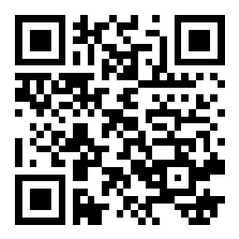
Slido
Please scan the QR Code on the screen. This will take you through to Slido, where you can interact with us.
1st November 2022- 08:00am – 15:30pm – Hatfield’s Conference Centre
Conference hosted by Convenzis Group Limited

Slide 3
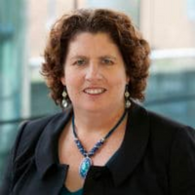
The NHS Patient Safety Conference 2022
Event Chair – Opening Address
Professor Maureen Baker CBE
PRSB Chair

Slide 4
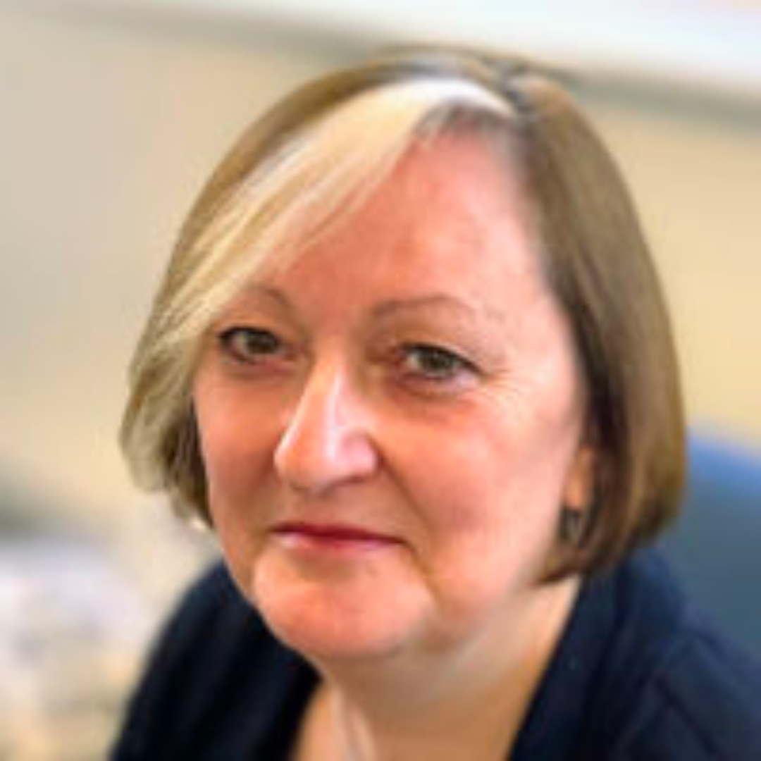
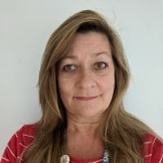
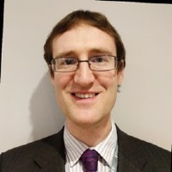
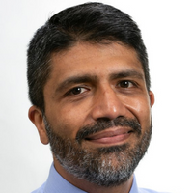
The NHS Patient Safety Conference 2022
SPEAKING NOW
We will be discuss…
“Patient Safety Transformation Change: A standards based approach and ‘how to’ Case Study with GOSH”
Helen Hughes
Dr Sanjiv Sharma
CEO Patient Safety Learning
Executive Medical Director - Great Ormond Street Hospital for Children NHS Foundation Trust

Slide 5
Improving patient safety through organisational transformation Convenzis: The NHS Patient Safety Conference Tuesday 1st November 2022

Slide 6
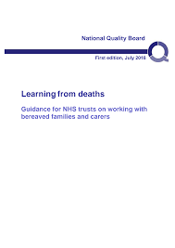
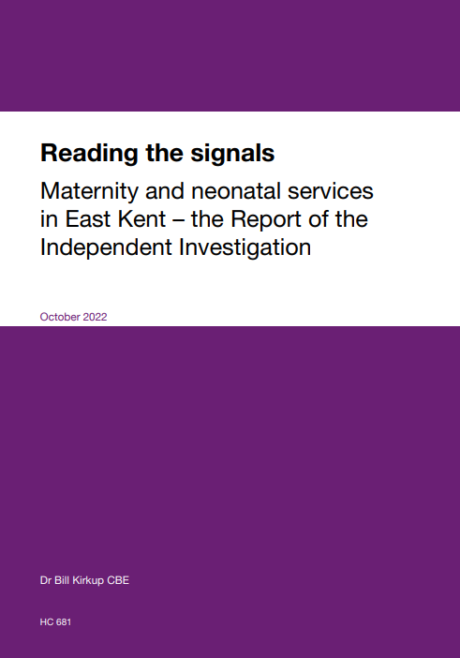
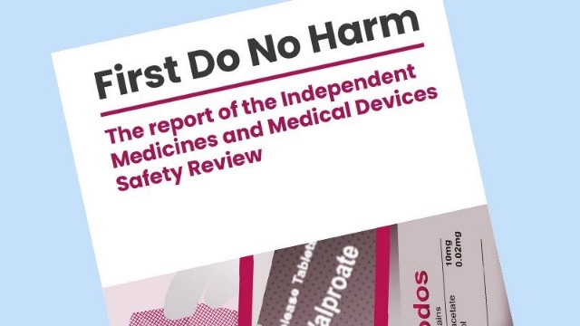
Why patient safety needs to be a core purpose?
11,000 + | avoidable deaths annually due to safety concerns (UK)
3 million | deaths each year worldwide as a result of unsafe care.
15% | of healthcare costs attributable to unsafe care
Have we normalised an unsafe system?

Slide 7
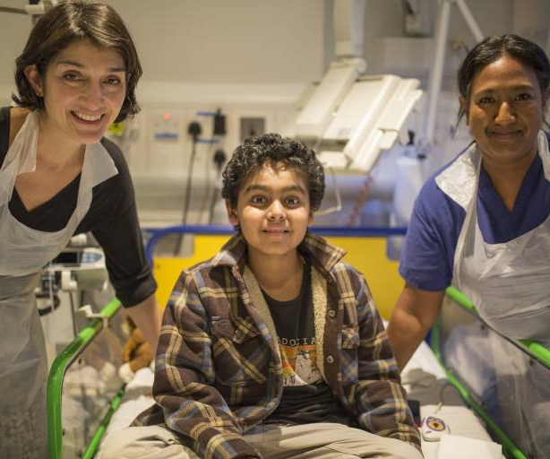
GOSH’s patient safety ambition & principles
“To provide the safest, kindest and most effective care for our children and young people with complex health needs”
Zero Harm is our aspiration
We all need to be concerned about safety all of the time
We need to be constantly aware of the potential for harm and learn from our experiences
It is our responsibility to ensure the safety of all our patients, families and staff

Slide 8
GOSH patient safety: drivers for change
Zero Harm for patients & families
Values led leadership commitment
Wanting a just and transparent culture
CQC ‘requires improvement’
Reputational concerns in the media
Charity support with investment
Opportunity to engage with experts

Slide 9
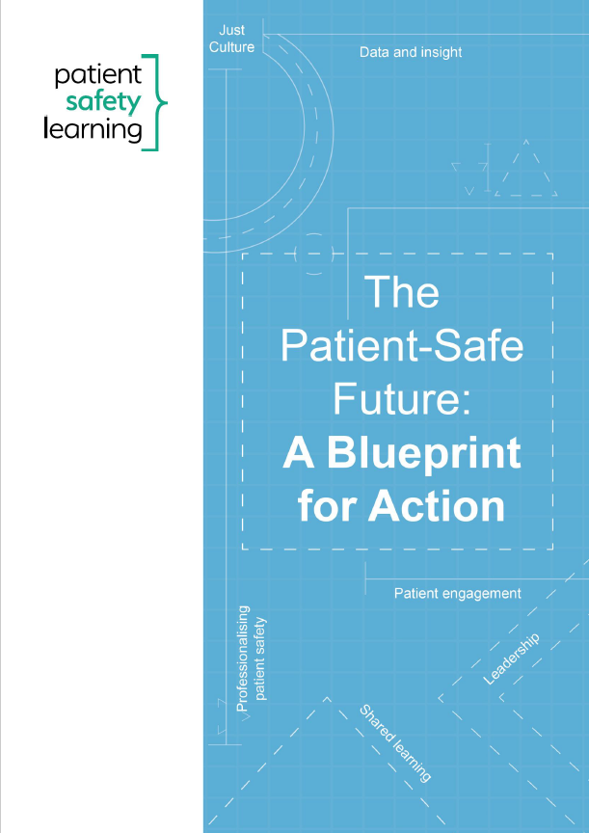
We need to design for safety, not just address harm
Safety is a core purpose
Leadership commitment to safety
Safety standards
Safety comparison data to drive out variation
Staff safety – physical & psychological
Patient safety and human factors expertise
Engage patients
Learn from errors & good practice for action
A Just Culture; psychologically safe
Safety as a core purpose; a safety management system
Notes:
What a patient-safe future looks like
Blueprint for Action published June 2019
Shared learning
Leadership
Professionalising patient safety
Patient engagement
Data and insight
PS Culture
https://www.patientsafetylearning.org/resources/blueprint
WHO consultation Action Plan 2021-2030 https://www.who.int/news-room/articles-detail/public-consultation-for-review-of-draft-global-patient-safety-action-plan-2021-2030/

Slide 10
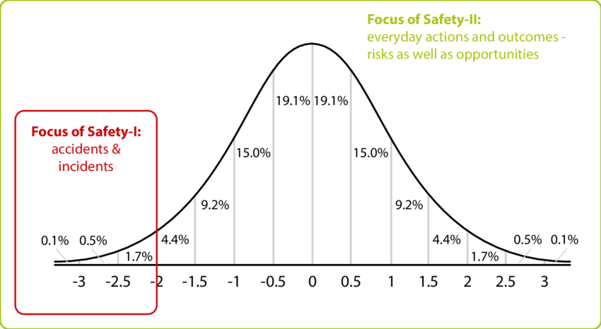
Safety I and Safety II
Learning from excellence

Slide 11
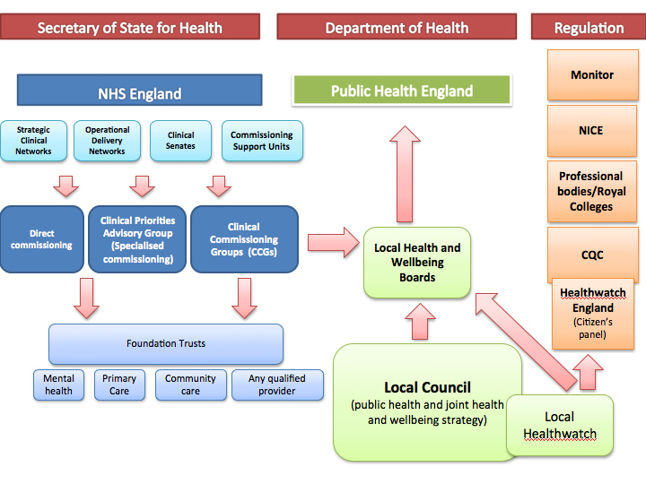
What support is there to help Trusts deliver?
Not our role:
NHSE, CQC, ICBs, HSIB, NICE, GMC/NMC etc
Complexity of specialist commissioning
Call for external experts
Patient Safety Learning – partnership
Veritas – review and advice on incident reporting and investigation

Slide 12
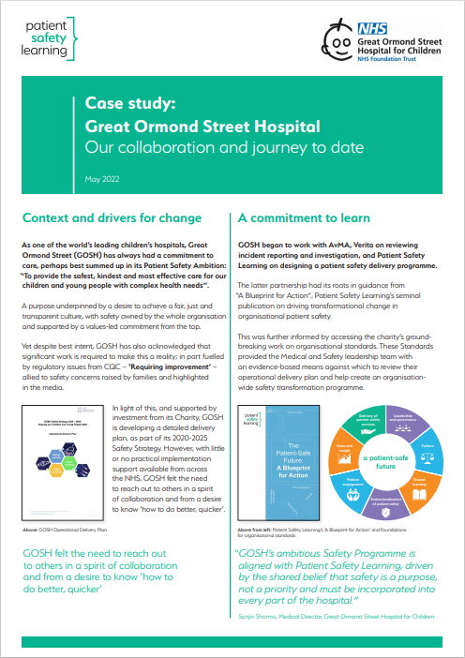
Partnership between GOSH & Patient Safety Learning
Advisory support to Programme Board
Team development programme
Mentoring of senior leaders
Critical and constructive friend
Sharing experience of designing and delivering change
Creating and supporting networks for learning

Slide 13
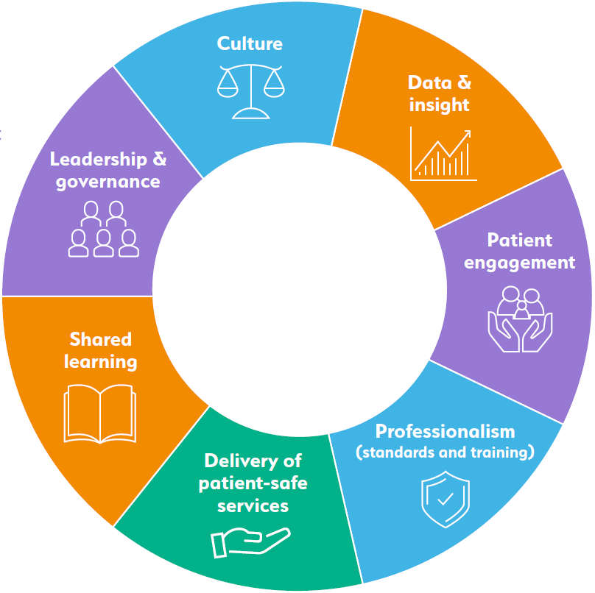
Organisational standards for Patient Safety
Based on a Blueprint for Action
Practical actions to address the foundations of safer care for patients
Underpinned by systemic analysis and evidence
7 foundations for action & safety priorities
26 aims that underpin these
144 standards of what good looks like
Evidence-based outputs
Outcomes, behaviours and actions for successful delivery
Accreditation levels: Essential, Enhanced, Exemplary
Notes:
Built on a 20 year evidence base from reports, Inquiries, policy guidance etc

Slide 14
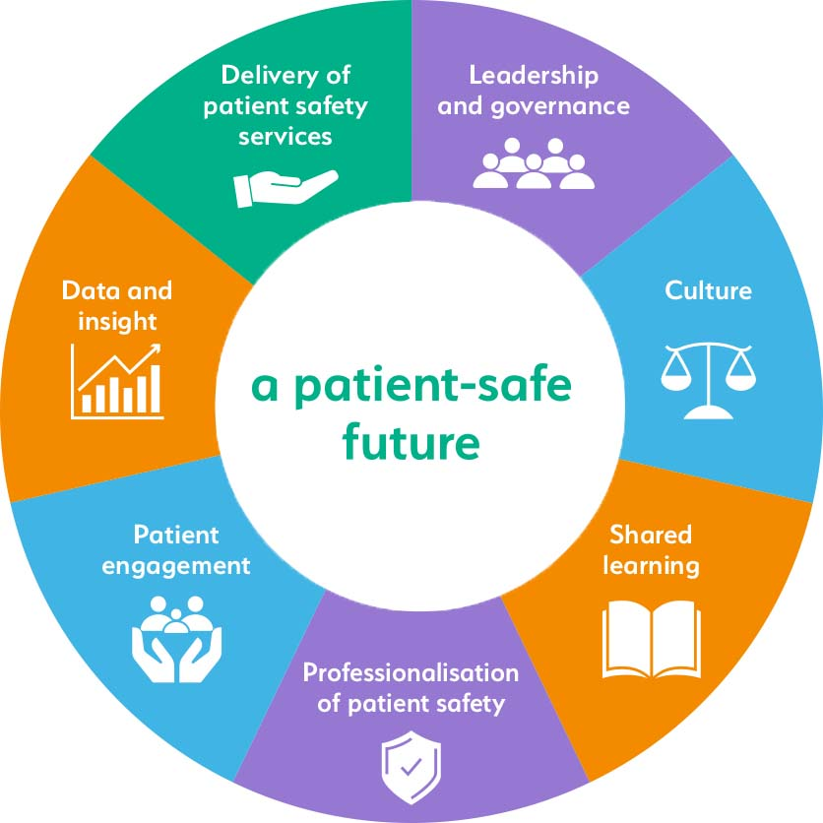
Agreed approach
High level assessment
Identify strengths & weaknesses
Agree goals for good practice, outcomes & behaviours
Agree priorities
Create transformational change programme
Deliver, evaluate, learn and improve
Notes:
https://www.patientsafetylearning.org/resources/blueprint

Slide 15
Self assessment findings
Strong commitment to change and patient safety improvement with focus on Learning and improvement Patient and staff engagement Increased capability and capacity for patient safety across the organisation Learning from incidents, complaints, staff and patient feedback Metrics, trends and vulnerabilities Post COVID-19 recovery
Detailed operational delivery plans with timelines
Plans go a significant way to meet essential level standards
Some plans at enhanced level
Reflections
Unclear what is the current baseline to inform planning are the ‘must do’ imperatives?
Some gaps at ‘essential’ level
Are the current plans resourced; are they deliverable?
Success measures are in development but need to be more outcome/impact focused
Need to focus on the ‘how to’ To turn plans into actions With staff and patient/family engagement Internal & External communication strategy Board and Exec ownership and leadership beyond strategy sign-off Leaders prioritising safety, to ‘walk the talk’ & culture

Slide 16
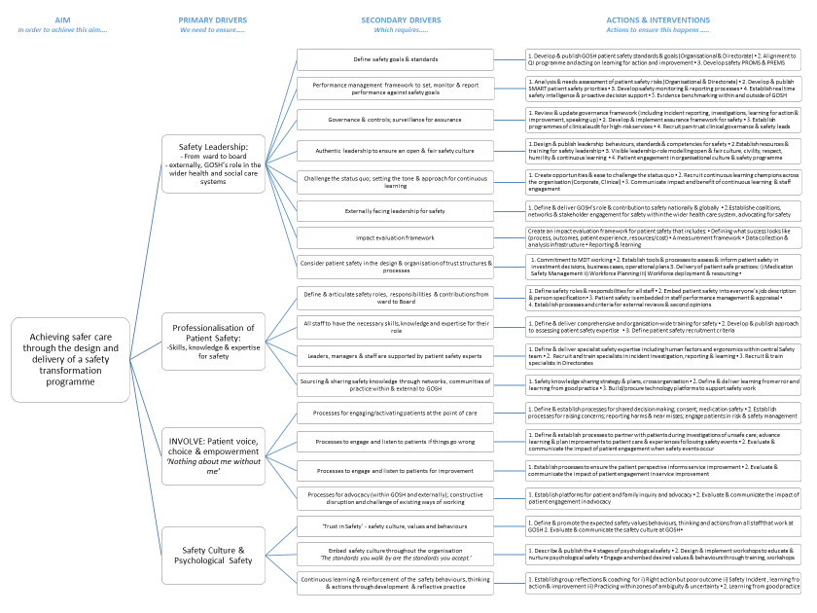
Prioritisation: Aim; Primary & Secondary drivers; Actions & Interventions S
Notes:
Non magic pill; comlexity

Slide 17
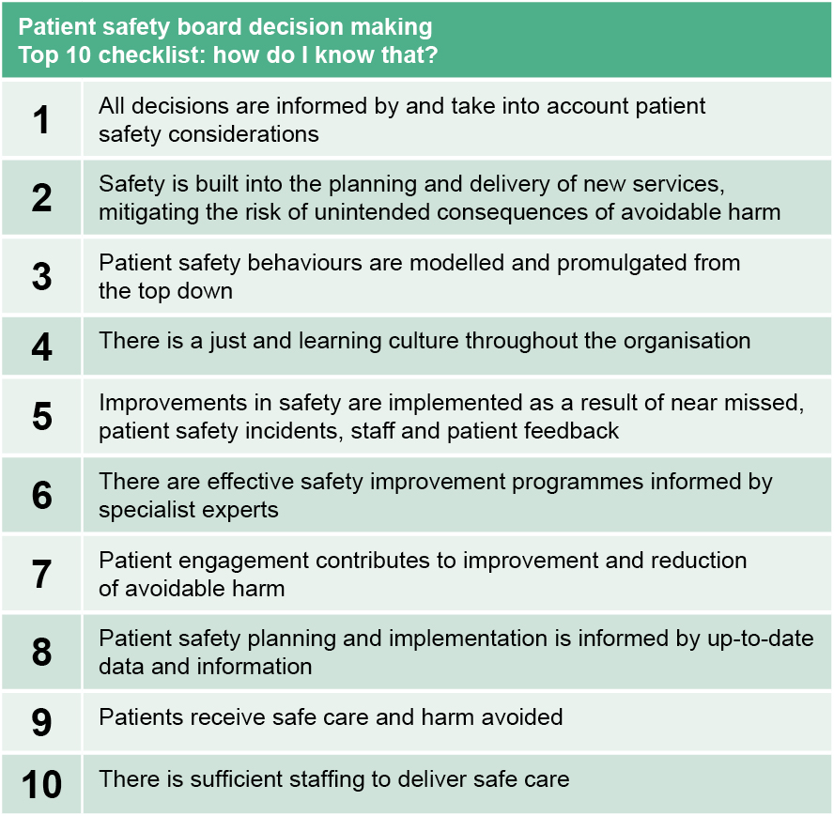
Board and Committee engagement & sign off
Board workshop on patient safety
Culture and conditions for success
Boards role
Build understanding & commitment
Sub Committee reviewed and endorsed:
Patient Safety Delivery Programme
Priorities and drivers for a patient safety transformation programme
An outcomes and measurement framework

Slide 18
Transformation Programme
Programme Board led by Medical Director
Design integrated delivery programme
SRO leadership and PM capacity
Investment in internal capacity
Central patient safety & QI teams
New PS surveillance team
PS roles in Clinical Directorates
New integrated delivery programme
Staff / patient engagement & communications

Slide 19
Safety Transformation Workstreams and Enablers
PSIRF
PS Specialists
LFPSE
Datix Rebuild
Education & Development
PS Partners
Safety Culture
Comms & Engagement
Improvement Programmes
External Learning Reviews
Enabling Programmes
Education and development
Communications
Analytics

Slide 20
Transformation Programme: Governance
Sanjiv Sharma
Medical Director
SRO
Sophia Varadkar
Deputy Medical Director
Deputy SRO
Business Manager
Programme Management and Support
Critical Friend (GOSH)
Chief Nurse
Critical Friend (GOSH)
Business Manager
PSIRF Implementation
Head of Quality
National Patient Safety Improvement Programmes
Director of Safety Surveillance
Patient Safety Specialists
Deputy Chief Nurse
External Learning Reviews
Director of Transformation
Critical Friend (GOSH)
Associate Medical Director
Safety Culture
Interim Head of Patient Safety
LFPSE Implementation
Director of Safety Surveillance
Patient Safety Partners
Interim Head of Patient Safety
Datix Rebuild
Clinical Quality Manager
Critical Friend (NHSE)
Chief Executive
Critical Friend (PSL)
Analytical Support and Development
Head of Education for Patient Safety
Patient Safety Syllabus
Head of Internal Communications
Comms and Engagement
Director of Quality
Critical Friend (NCL ICB)

Slide 21
Opportunities and challenges
Behavioural and culture change
Not just focus on governance, assurance, process
Clinical leadership and ownership
Staff engagement
Partnership with patients
Maintaining the pace
Won’t always get it right

Slide 22
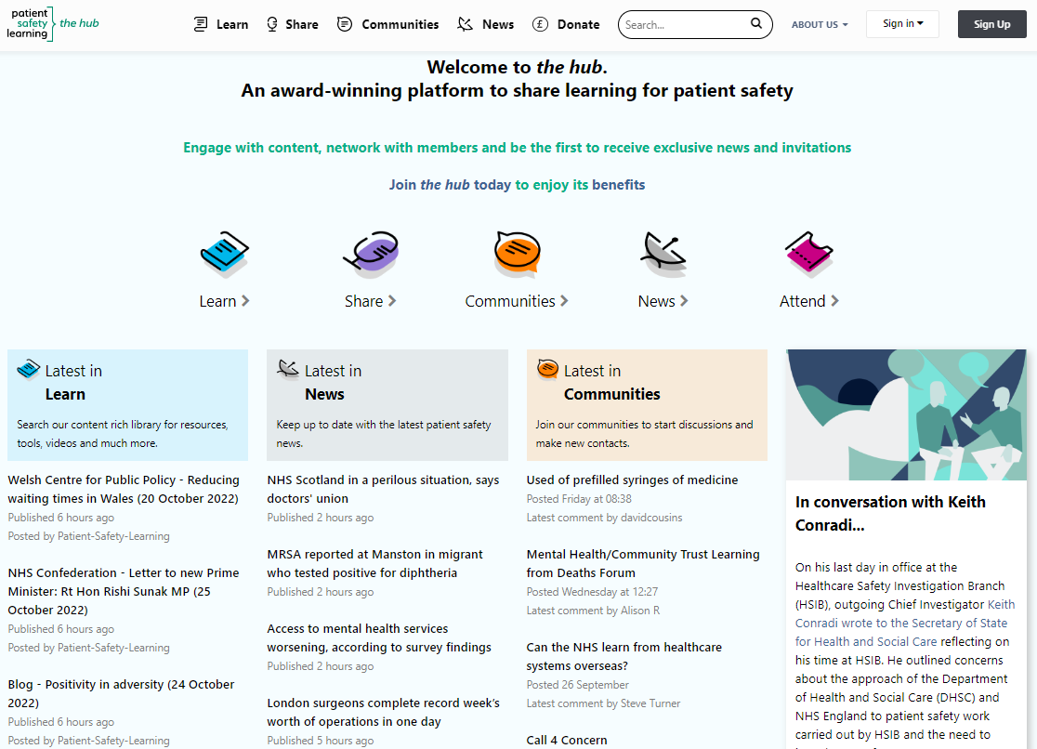
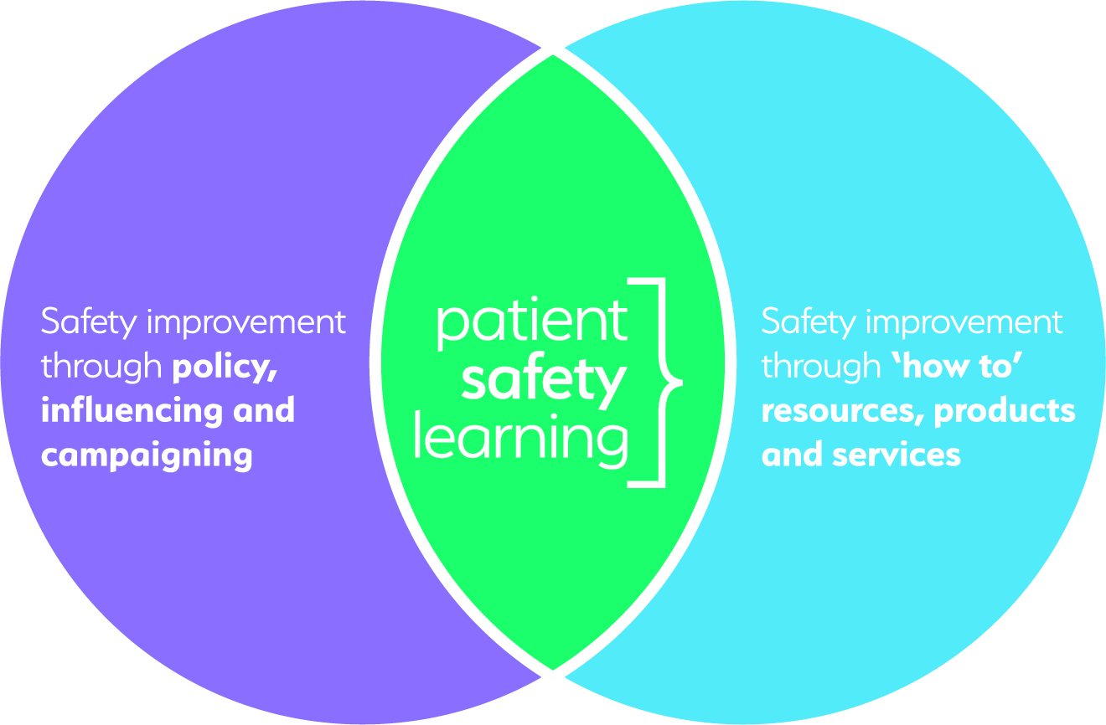
An independent charity for patient safety
Patient Safety Learning promotes systemic change and the reduction of avoidable harm
Sharing knowledge for learning and action through
our free patient safety platform
the hub www.pslhub.org

Slide 23
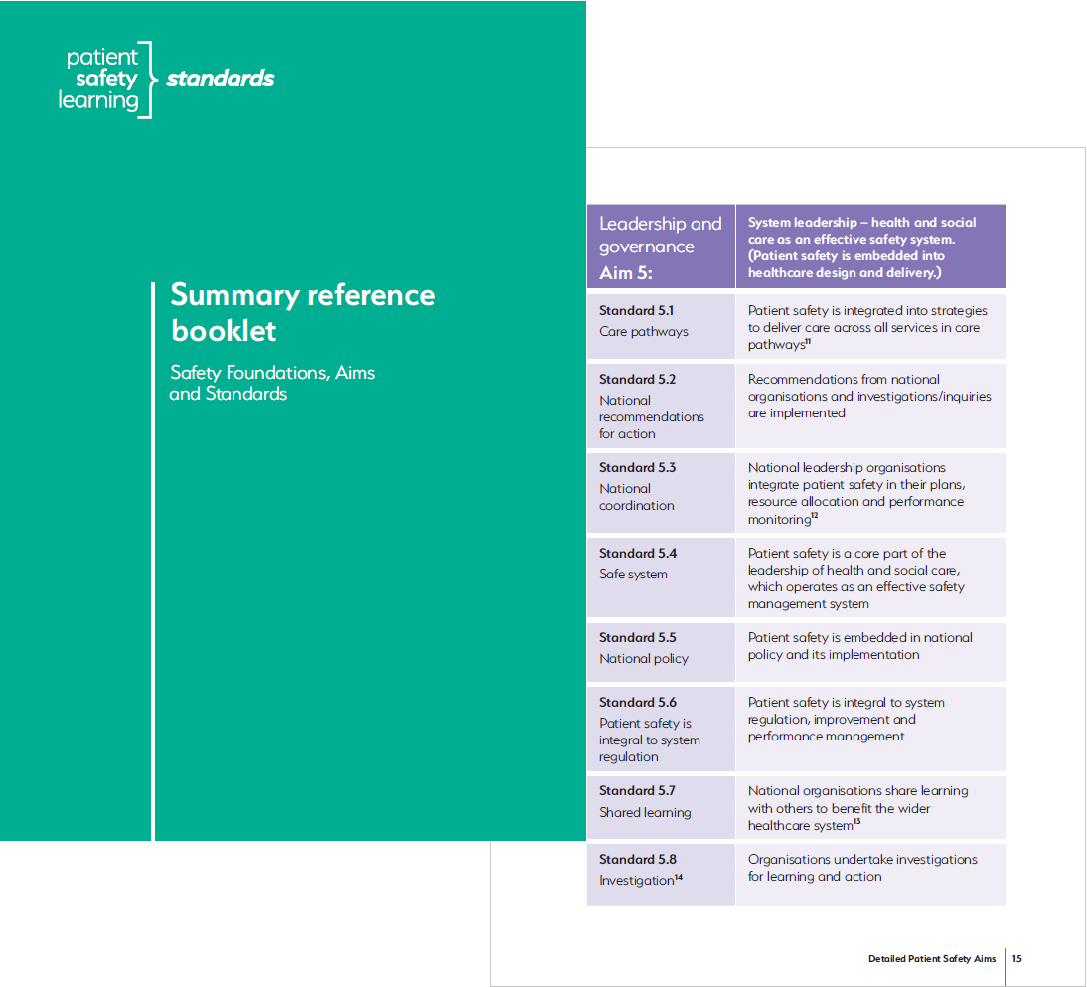
Patient Safety Learning’s patient safety standards
Based on 20 years of research, learning from inquiries, policy and good practice
Developed in partnership
Standards are quality assured, with ‘real world’ practicality

Slide 24
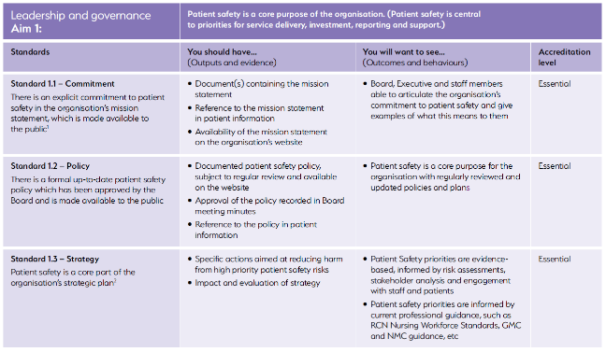
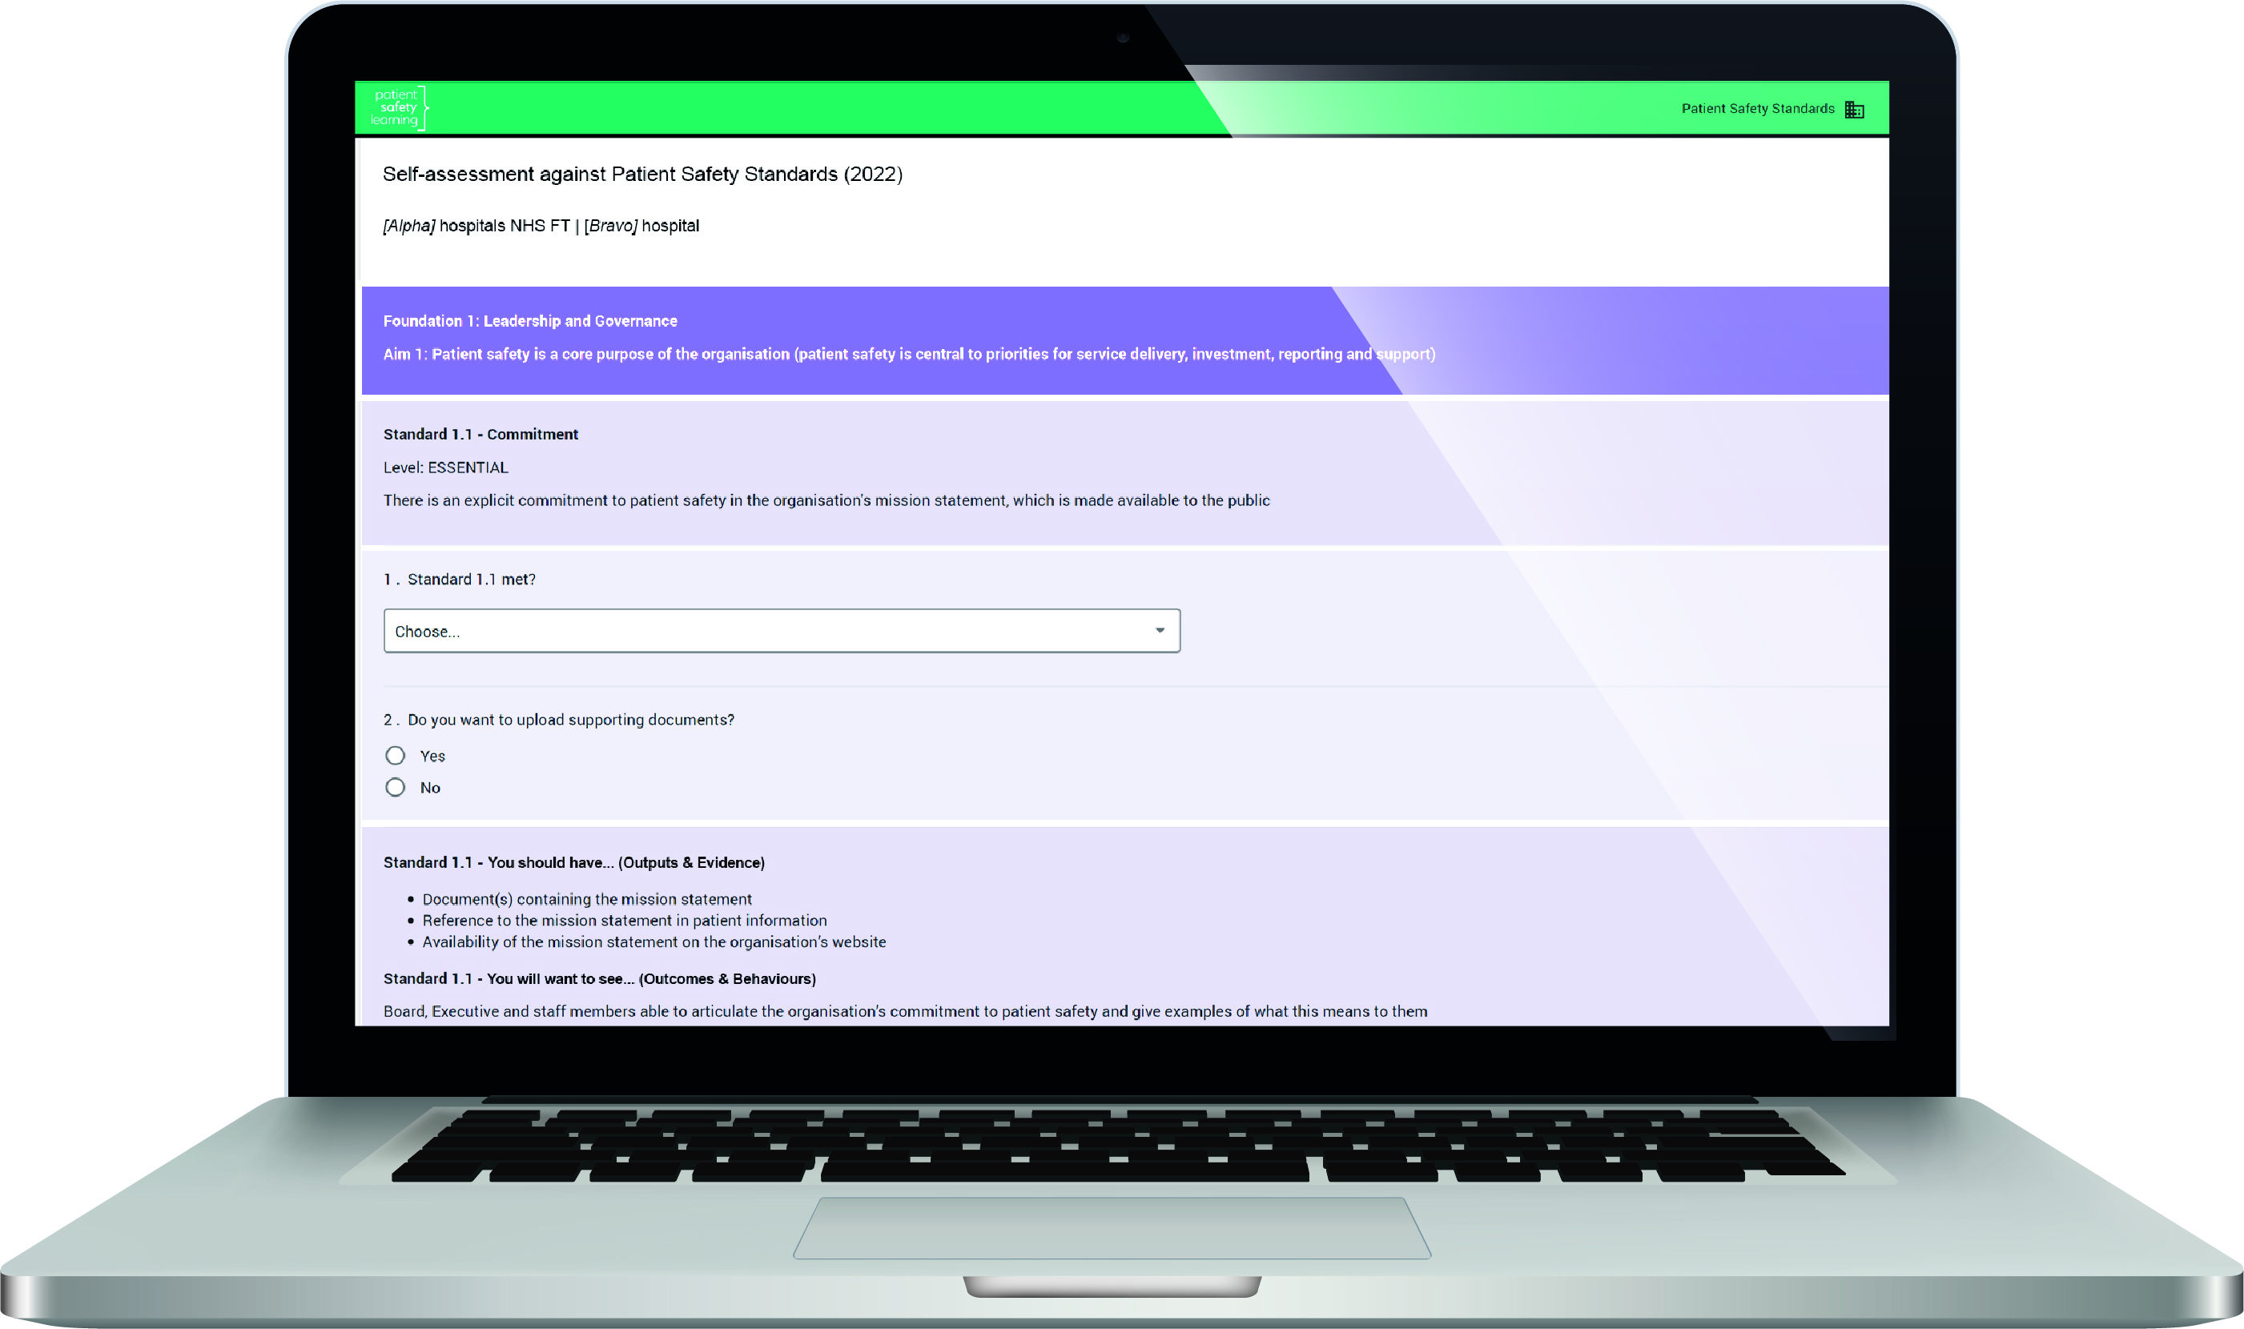
Standards ‘pack’ includes
Online self-assessment toolkit
‘What good looks like’ manual
Summary reference booklet
Experts for advice and support

Slide 25
Questions and discussion Helen@patientsafetylearning.org Sanjiv.Sharma@gosh.nhs.uk

Slide 26
Slido
Please scan the QR Code on the screen. This will take you through to Slido, where you can interact with us.
1st November 2022- 08:00am – 15:30pm – Hatfield’s Conference Centre
Conference hosted by Convenzis Group Limited

Slide 27
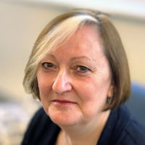
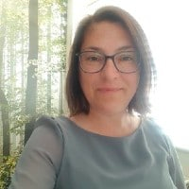
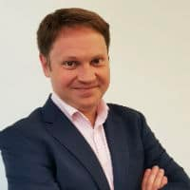
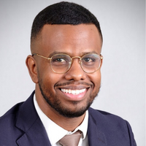
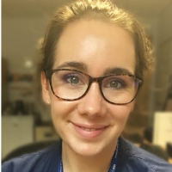
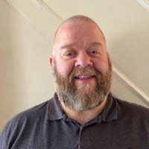
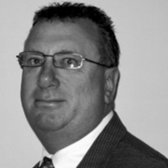
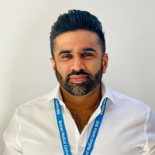
The NHS Patient Safety Conference 2022
Q&A Panel
Helen Hughes
Dr Sanjiv Sharma
Lisa Rickers
Mr P. Julian Owen
Martyn Hooper MBE
CEO - Patient Safety Learning
Executive Medical Director - Great Ormond Street Hospital for Children NHS Foundation Trust
Specialist Nurse/ Founder NHS/ The iCrowd
Consultant Orthopaedic Surgeon - Addenbrookes Cambridge University Hospitals NHS Trust
Executive Chairman Pernicious Anaemia Society

Slide 28
The NHS Patient Safety Conference 2022: Breaking a culture of defensiveness
MORNING BREAK, NETWORKING & REFRESHMENTS

Slide 29
The NHS Patient Safety Conference 2022
Chair Morning Reflection
Professor Maureen Baker CBE
PRSB Chair

Slide 30
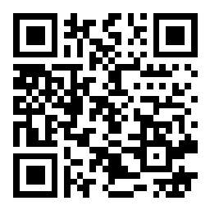
Slido
Please scan the QR Code on the screen. This will take you through to Slido, where you can interact with us.
1st November 2022- 08:00am – 15:30pm – Hatfield’s Conference Centre
Conference hosted by Convenzis Group Limited

Slide 31
The NHS Patient Safety Conference 2022: Breaking a culture of defensiveness
UP NEXT…

Slide 32
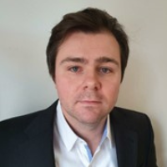
The NHS Patient Safety Conference 2022: Breaking a culture of defensiveness
SPEAKING NOW
I will be discussing…
“Improving Patient and Staff Safety through Technology and Real World Study”
Darren Sloof
Head of Research & Innovations Air Purity Ltd

Slide 33
How will this effect Patient & Staff Safety through Infection control
AAirDS
Addenbrookes Air Disinfection Study + Extensions

Slide 34
Disclosure
Air Purity is an independent R&D and Innovations company founded to facilitate the Addenbrookes Air Disinfection Study (AAirDS)
Air Purity designed and supplied the air filtration units and air sensors used in this study. Air Purity Ltd had no role in the study design or analysis of the data. Darren Sloof does however collect the data and liaise with other authors over its interpretation.
Study has both internal and external ethics approvals (South West - Central Bristol Research Ethics Committee)
Air Purity has no influence on the study and its results, only to facilitate the study.
Study is UKHSA approved and funded

Slide 35
90+ targets

Slide 36
Brief overview of study milestones
Pre Study
Technology & Commissioning Validation
Patient & Staff Acceptance
Study
Ethics Approval & UKHSA Funding
Successful implementation of study within elderly care ward with both Intervention and control wards
Extension Studies
New clinical groups & Trusts adopting extension studies
Further development and learning objectives set
1st Scientific Publication
First Study completed- Results May 2023 (further wards to complete respective 12 month study periods by Feb 2023)
Stronger focus on Staff

Slide 37
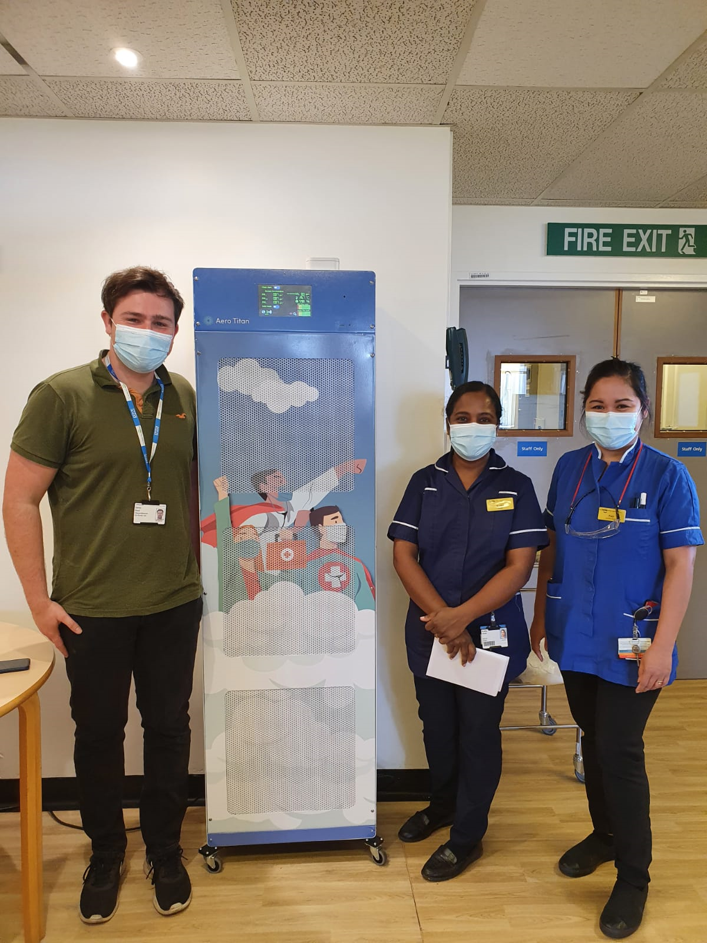
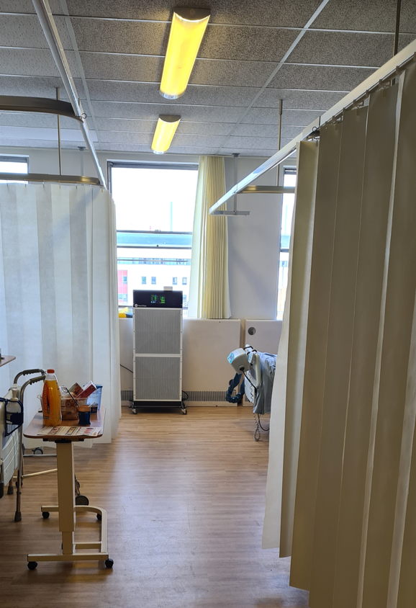
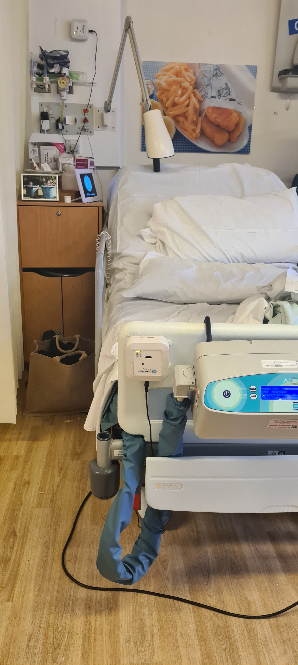
Visual Aids of Technology AAirDS
Environmental sensors (AeroSentinels)
Corridors and larger spaces
(AeroTitan 3000)
Patient Bays
(AeroTitan 2000)

Slide 38
NHS England Patient Safety Strategy AAirDS
Deliver the UK National Action Plan for AMR
Site air sampling through new technological means
Support Patient Safety Research and Innovation
Evidence based infection reduction monitoring through robust commissioning & planning

Slide 39
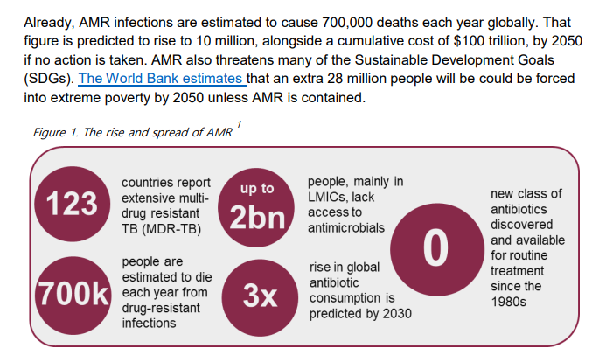
Tackling antimicrobial resistance 2019–2024 The UK’s five-year national action plan

Slide 40
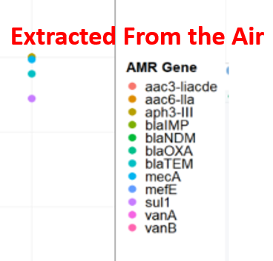
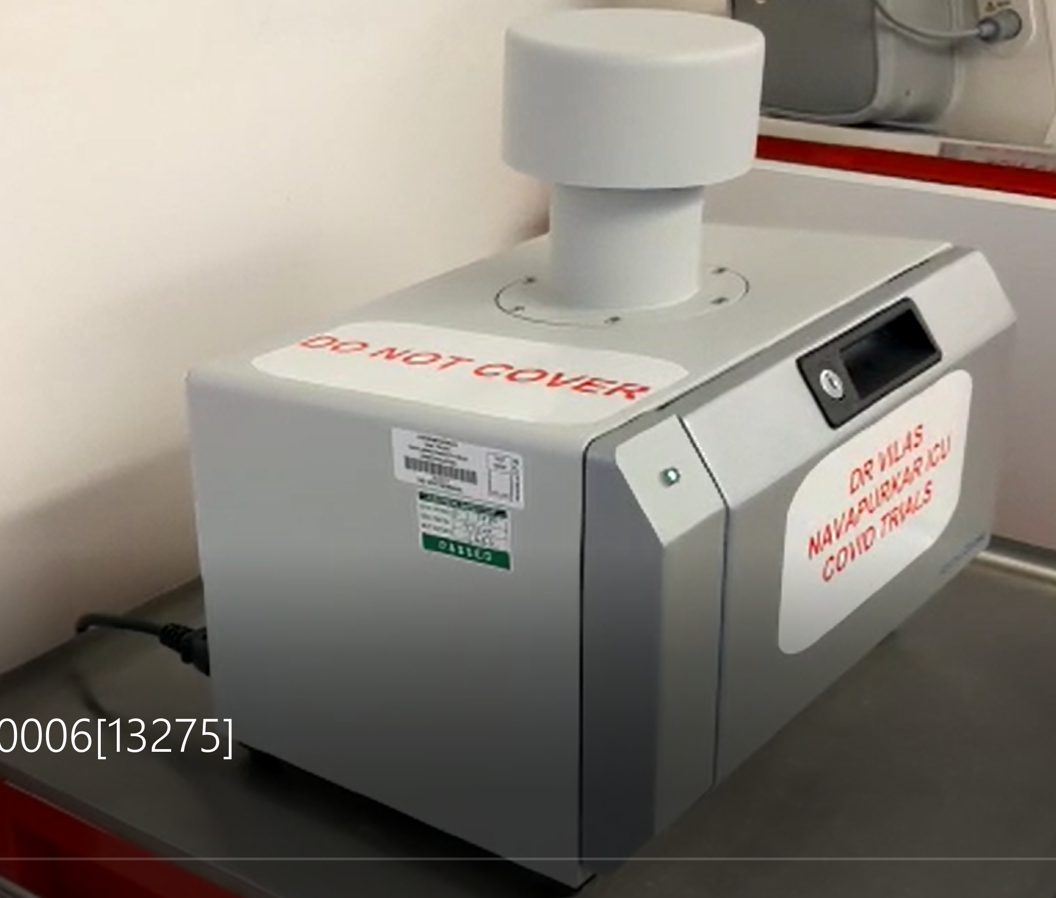
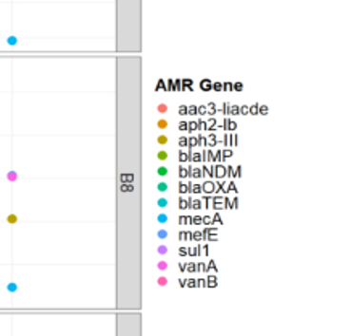
Prevention should start from the air
Surface Swab Samples
We extract almost the same organisms in the air as on surfaces throughout the ward

Slide 41
We can also track how aerosols move
Capabilities reference on a dedicated website for the study, developed by the lead clinician
www.AAirDS.com
Videos — AAirDS

Slide 42
WHO- Report on the Burden of Endemic Health Care-Associated Infection Worldwide
In many settings, from hospitals to ambulatory and long-term care, HCAI appears to be a hidden, cross-cutting problem that no institution or country can claim to have solved yet.
The risk of acquiring HCAI is significantly higher in intensive care units (ICUs), with approximately 30% of patients affected by at least one episode of HCAI with substantial associated morbidity and mortality.
According to published national or multicentre studies, pooled HCAI prevalence in mixed patient populations was 7.6% in high-income countries or 1 in 10 global average.
High frequency of infection is associated with the use of invasive devices, in particular central lines, urinary catheters, and ventilators.

Slide 43
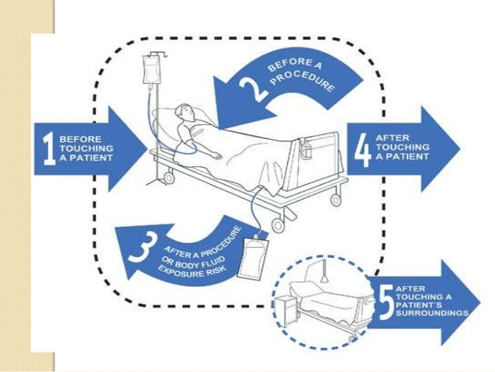
Long Road to De-stigmatise transmission
Contact transmission still likely the primary however we need to build a wider acceptance that more is happening then we currently understand
Biodiversity routes to various surfaces are via air, however not necessarily the mode of transmission.

Slide 44
Observations is the Intervention working?
We see significant positive reduction trends and are hopeful for statistical relevance, Sars-Cov2 will be a proxy
Jan 2021- Aug 2021
4 ward closures full outbreaks
WT, Alpha, Delta
Sep 2021- Sep 2022
0 ward closures
Omicron (more transmissible)
Worst performing ward to possibly the best within the trust regarding Sars-Cov2 transmission*
Secondary Sars-Cov2 transmissions thus far appear lower*
No more odours within the ward
Staff feedback positive with noticeable changes to ward environment and mental health
Est cost saving £205k-£1.2m
*Final study report/publication due spring 2023

Slide 45
Patient Safety Relevance?
Environments patients can be a route to infection
Poorly maintained environments create sickness, odour and uncomfortable environments
If staff sickness reduction is not also prioritised how can the best level of care be achieved with the current high vacancy rate?

Slide 46
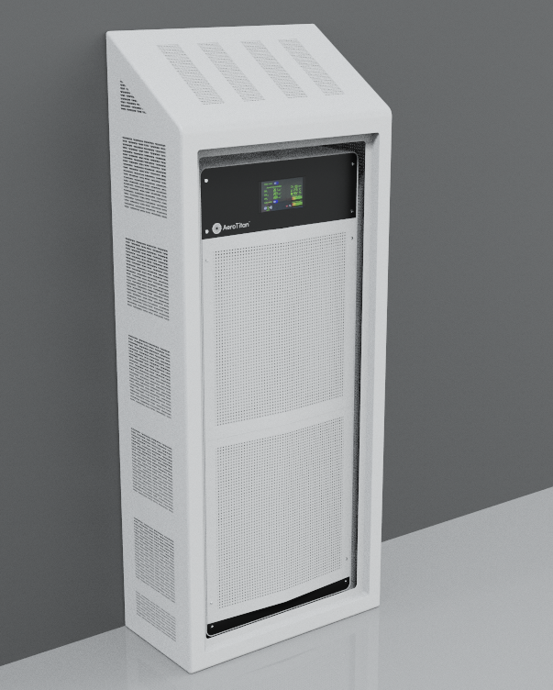
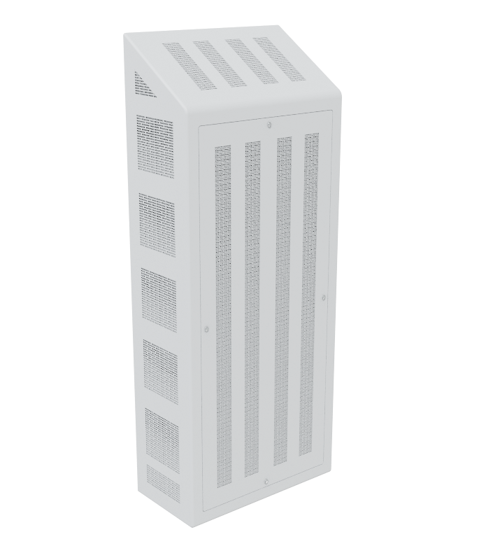
AAirDS – Extension Highlight
Extensions actioned in 9 more trusts however ELFT is an extension study highlight due to strong focus also on staff sickness and improvements and a strong focus on ligature risk.
Trust implementation scheduled for Dec 2022

Slide 47
Steps for patient safety and infection control improvement
1.Space
2.Clinical groups
3.Function
Pre-Assessment & Staff Engagement
1. Place sensor grid
2. Analyse aerosol movements and concentrations
3. Noise assessment
4. Initiate consultation for intervention planning
Aerosol & environmental assessment
1. Initiate steps 1&2 of Aerosol and environmental assessment
2. Adjust systems if required
3. Share with stakeholders and education pack
Installation of Re-circulation devices
1. Aerosol & environmental assessments to be ongoing to ensure compliance and duty of care
Continuous audit/compliance and service
System should not impede or increase workload in any function within the trust but work collaboratively to improve the environments patient, staff and visitors occupy

Slide 48
Cost/benefit Analysis Illustration
*Excludes
Re-admission, staff sickness, potential secondary care burdens after HCAI, partial or full ward closures, additional cleaning regimes and bed management
Assumption
HCAI % of total bed days x average bed day cost 26 Bed ward

Slide 49
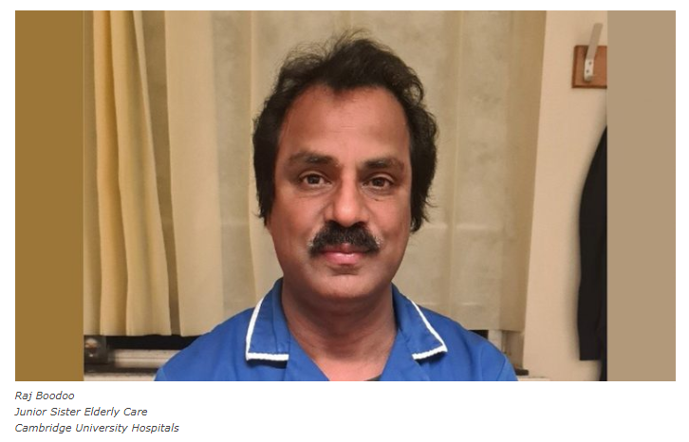
Testimonials
“From an infection point of view, it has been highly beneficial for the ward, both patients, staff, and visitations. During the Air Purity intervention, we noticed drastically reduced cases of C-diff, MRSA, Norovirus, and influenza. We see a noticeable change in reductions in our common infections such as UTIs as well. It is evident we are no longer closing bays or wards, the system is highly beneficial to save cost and improve the health of all occupants.”

Slide 50
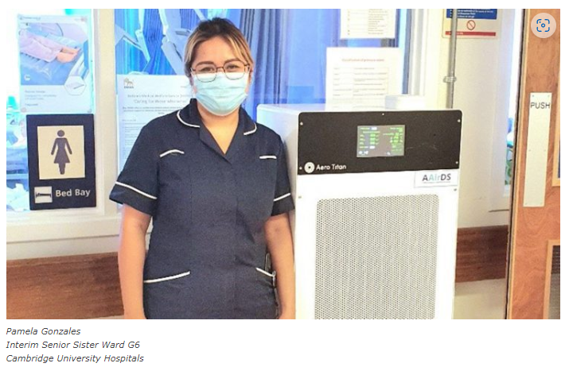
Testimonials
“The study with Air Purity has been in the ward for the last 12 months. Patient relatives were very happy as they can see that the hospital is actively trying to find ways to keep patients safe, especially when it first started, COVID was still a primary cause of concern. Our patients are elderly and some of them are confused. Initially, some of them thought it was a mailbox, but it did not further add to their confusion as it was eventually not emitting much noise.
“We feel that since the study started, we did not have as many outbreaks particularly respiratory type e.g. flu or COVID. I have been working in the ward for the last eight years and I can always expect that in a year we would always have a respiratory virus, such as flu outbreak, as our ward layout does not have doors on bays and only fire doors to divide the ward into three sections. It has really made a big difference based on my observation.”

Slide 51
Please follow AAirDS Any Questions Please contact Darren Sloof directly on
M: 07712116467
E: darrensloof@airpurityuk.com

Slide 52
Slido
Please scan the QR Code on the screen. This will take you through to Slido, where you can interact with us.
1st November 2022- 08:00am – 15:30pm – Hatfield’s Conference Centre
Conference hosted by Convenzis Group Limited

Slide 53
The NHS Patient Safety Conference 2022: Breaking a culture of defensiveness
SPEAKING NOW
I will be discussing…
“Mental Capacity Assessment”
Miss Simran Kang
Junior Doctor East & North Hertfordshire NHS Trust

Slide 54
Mental Capacity Assessment
DR SIMRAN KANG
SENIOR HOUSE OFFICER

Slide 55
Case Study - history
55 y/o male
PC: Abdominal Pain
HPC: 1/7 hx lower abdominal pain, anuria 12 hours, BNO 3/7
PMHx: down syndrome, postural hypotension, hiatus hernia
DHx: adcal d3, fludrocortisone
Allergic to penicillin
SHx: 24 hour careers
FHx: Nil

Slide 56
Case Study - examination
A: patent
B: Chest clear RR 17 O2 97%
C: HS I+II+0 CRT <2 HR 98bpm BP 135/85
D: GCS 15/15 PEARL Temp 37.6
E: Abdo soft, mildly distended, suprapubic tenderness, BS present, Calves SNT
Investigations: Bloods unremarkable, Bladder scan 942ml

Slide 57
Post Take Ward Round
Impression: Acute urine retention
Plan:
Analgesia
Catheterise
Laxatives +/- PR suppository
Re- review

Slide 58
Series of Events
Management plan agreed with family
Catheterisation attempted unsuccessfully
Discussion with registrars
Catheterisation reattempted with analgesia
Handed over case to night team
Further attempts refused by family
Plan:
catheter under GA

Slide 59
What went well
Team work
Escalating to seniors
Correct diagnosis
Issues
Patient and family distressed
Unsuccessful procedure
Consent

Slide 60
Outcome
Patient safely managed
Formal investigation on behalf of family concern
Statements and interviews conducted with staff involved

Slide 61
Mental Capacity Act
Two stage test
1. Is there an impairment or disturbance of the mind?
2. Does the impairment affect individual’s ability to make a decision?
Capacity assessment:
Understand information about the decision
Retain information
Weigh up the information
Communicate

Slide 62
Impact on the trust
“Approximately half of all deaths of people with a learning disability was deemed to be avoidable, compared to less than a quarter for people from the general population”
Training sessions provided
Support and advice given to staff
Learning disability liaison nurses
Principles of MCA covered
Debrief

Slide 63
Learning & Reflection
Maintain respect
Working within competence
Escalating to seniors
Correct documentation
Continue to practice procedural skills

Slide 64
Thank you
ANY QUESTIONS?

Slide 65
References
Healthline. 2021. Auscultation: Definition, Purpose, Procedure & More. [online] Available at: <https://www.healthline.com/health/auscultation> [Accessed 16 May 2021].
Chilcotts Law Solicitors Tavistock| Mental Capacity, C., 2021. Chilcotts Law Solicitors Tavistock| Mental Capacity, Mental Health, Deputyships, Community Care Law. [online] Chilcott Law | Solicitors Tavistock | It's All About You. Available at: <https://chilcottslaw.com/services/mental-capacity/> [Accessed 16 May 2021].
Cliniciansbrief.com. 2021. Sedation & Analgesia for Canine Emergencies. [online] Available at: <https://www.cliniciansbrief.com/article/sedation-analgesia-canine-emergencies> [Accessed 16 May 2021].
Health Research Authority. 2021. Mental Capacity Act. [online] Available at: <https://www.hra.nhs.uk/planning-and-improving-research/policies-standards-legislation/mental-capacity-act/> [Accessed 16 May 2021].
Kings College London. 202. 2021 LeDeR report into the avoidable deaths of people with learning disabilities [online] Available at: <https://www.healthline.com/health/auscultation> [Accessed 23 October 2022].
Mencap. 2021. How common is learning disability? [online] Available at: <https://www.mencap.org.uk/learning-disability-explained/research-and-statistics/how-common-learning-disability> [Accessed 23 October 2022].

Slide 66
Slido
Please scan the QR Code on the screen. This will take you through to Slido, where you can interact with us.
1st November 2022- 08:00am – 15:30pm – Hatfield’s Conference Centre
Conference hosted by Convenzis Group Limited

Slide 67
The NHS Patient Safety Conference 2022
Q&A Panel
Miss Samran Kang
Darren Sloof
Junior Doctor - East and North Hertfordshire NHS Trust
Head of Research and Innovations Air Purity Ltd

Slide 68
The NHS Patient Safety Conference 2022
Chairs Afternoon Address
Professor Maureen Baker CBE
PRSB Chair

Slide 69
Slido
Please scan the QR Code on the screen. This will take you through to Slido, where you can interact with us.
1st November 2022- 08:00am – 15:30pm – Hatfield’s Conference Centre
Conference hosted by Convenzis Group Limited

Slide 70
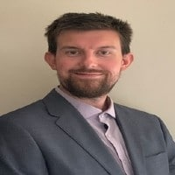
The NHS Patient Safety Conference 2022: Breaking a culture of defensiveness
SPEAKING NOW
I will be discussing…
“Utilising a systems approach to deliver the Patient Safety Improvement Programmes“
Daniel Hodgkiss
Patient Safety Assistant Programme Manager / Managing Deterioration National Co-Lead at West Midlands Academic Health Science Network

Slide 71
Slido
Please scan the QR Code on the screen. This will take you through to Slido, where you can interact with us.
1st November 2022- 08:00am – 15:30pm – Hatfield’s Conference Centre
Conference hosted by Convenzis Group Limited

Slide 72
The NHS Patient Safety Conference 2022: Breaking a culture of defensiveness
SPEAKING NOW
I will be discussing…
“Implementing Occupational Safety and Health (OSH) management in complex healthcare environments“
Peter Joseph John Bohan
Associate Director Occupational Health, Safety & Security Betso Cadwaladr University Health Board NHS

Slide 73
Implementing Occupational Health & Safety in complex healthcare environments
Peter Bohan CFIOSH

Slide 74
Aim and Objectives
Aim
To describe healthcare system failures. Define how to build a structured OH&S system.
Objectives
Describe how culture affects safety outcomes.
Outline recent cases where organisations or individuals are held to account due to lack of legislative compliance.
Describe the process of setting a vision and building a competent Team.
Define the key elements of a safety management system (Plan, Do, Check, Act).

Slide 75
Healthcare is extremely complex and potentially hazardous
Increased patient volume, acuity, aging population, pressures in care homes.
Growing therapeutic options with expanding knowledge and evidence.
Many sources of (incomplete) information with interruptions and multitasking.
Safety features, defences become degraded over time, checklists forgotten.
Environmental conditions, expectations and demands of patients change over time.
Behaviour of leaders that result in stress, anxiety and a blame culture.
Notes:
Patients seen by the NHS 1.5 Million per day
NHS Staff 1.3 Million work in sector
Drug prescriptions 1.9 Million per day
A&E attendance 50,000 per day
Eye Site tests 28,000 per day
Outpatients consultations 124,000 per day
GP consultations 836,000 per day
Cost per annum £116 Billion
Patient harm 1 in 10 (NPSA)

Slide 76
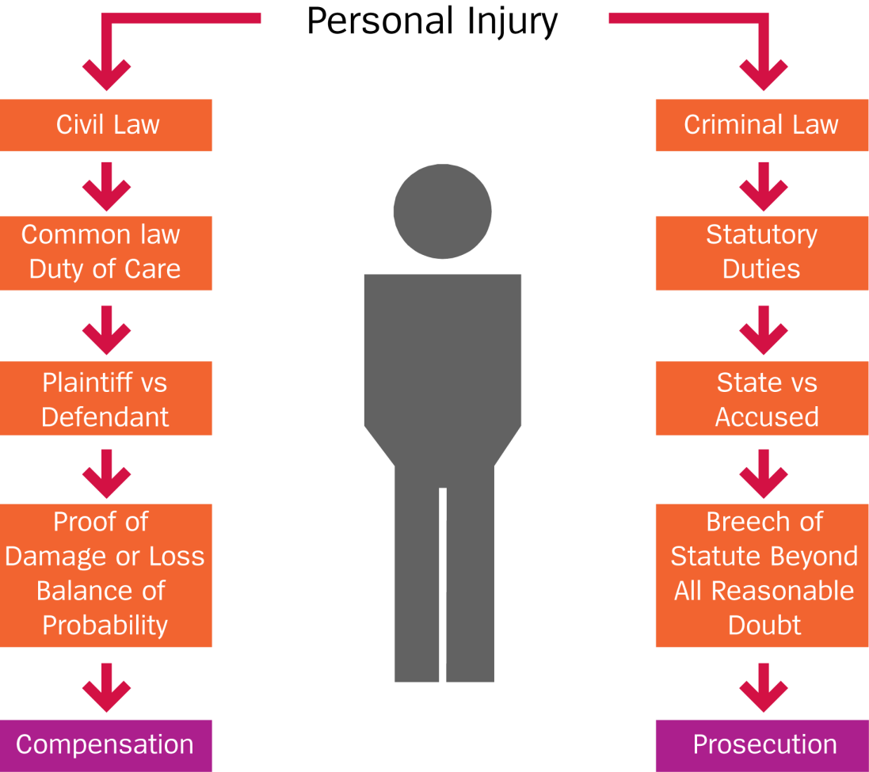
Civil & Criminal Law
Notes:
There could be two pieces of the justice system working at the same time usually if a criminal case is taken against an organisation and the employer is prosecuted a criminal case can use the evidence to support the civil action. We have also seen cases such as the Stephen Laurence case and OJ Simpson Case where the families have won civil cases against the perpetrator when the criminal action has failed. The employer is vicariously liable for the actions of the employee if they are carrying about the work within the scope of their employment. They will be vicariously liable unless the staff member is on a frolic of their own not doing something within the scope of their employment.

Slide 77
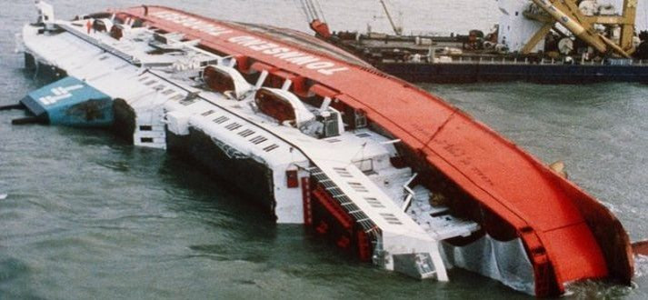
Herald of Free Enterprise 1987
Left Zeebrugge harbour with bow doors open.
188 people died the majority from hypothermia. Serious failings identified at senior level in safety management system.
Leadership focused on productivity and finance.
Prosecution for Corporate Manslaughter failed.
The judges conclusion:- ‘The organisational management was rife with the disease of sloppiness’

Slide 78
Corporate Manslaughter & Corporate Homicide Act 2007
‘‘Companies and organisations can be found guilty of Corporate Manslaughter as a result of serious management failures resulting in a gross breach of a duty of care. The Act, clarifies the criminal liability of companies including large organisations where serious failures in the management of health and safety result in a fatality.”
Notes:
Corporate Manslaughter is applicable if an organisation manages or organises its activities which subsequently cause a death of an individual and as such amounts to a gross breach of a duty of care to the deceased. A substantial part of the failure within the organisation must have been at senior level. The Act applies to all companies and other corporate bodies operating in the UK, in the private, public and third sectors. It provides an opportunity for those senior members of an organisation’s management structure to satisfy themselves that the systems and processes for managing health and safety are adequate. The organisation is at risk as a body corporate and will be prosecuted, not necessarily the individual director or senior manager, however they can still be prosecuted for gross negligent manslaughter or culpable homicide and for other health and safety offences such as Section 37 HASWA.

Slide 79
The Offence Corporate Manslaughter
Section 8 specifically includes:-
‘Wider cultural issues such as attitudes or practices that tolerated Health & Safety breaches’
Defendant owes duty of care to the deceased employees, contractors, patients, visitors and volunteers.
Was the organisation doing enough to reduce the risk of injury or death.
Prosecution to show the activity was ‘potentially deadly’ rather than ‘dangerous’ Defendant will need to show the difference.
Compare with HASWA ‘so far as is reasonably practicable’
Notes:
First corporate manslaughter case settled
18th February 2011
A Gloucestershire company, the first to be convicted under new corporate manslaughter laws, has been fined £385,000 after a 27-year-old man died when a pit collapsed on him.
Cotswold Geotechnical (Holdings) Ltd became the first firm to be found guilty under the Corporate Manslaughter and Corporate Homicide Act 2007, at Winchester Crown Court on Tuesday, following the death of Alexander Wright from Cheltenham.
Geologist and Imperial College graduate Mr Wright was working alone in a 2.6ft (3.8 metres) deep trial pit, which was unsupported, when it collapsed in Brimscombe Lane, near Stroud, in September 2008.
The company, which was described in court as in a “parlous financial state” can pay the fine back over 10 years at £38,500 per year, judge Mr Justice Field said.
He said the fine represented the gravity of the offence and deterrent effect it would have on companies to follow health and safety guidelines, as well as adding that a bigger fine would lead to the firm to be liquidated and four employees losing their jobs.
He said: “It may well be that the fine in the terms of its payment will put this company into liquidation. If that is the case it’s unfortunate but unavoidable. But it’s a consequence of the serious breach.”
No-one was in the dock for the three-week trial but the business denied corporate manslaughter.
The court heard that 61-year-old company director Peter Eaton is seriously ill with cancer and has just months to live.
He was unable to stand trial on a manslaughter charge but the jury was told to assess his conduct in reaching a verdict.
The judge said that Peter Eaton was in substance the company and his approach to trial pitting was “extremely irresponsible and dangerous”.
The penalty under the new legislation is an unlimited fine.

Slide 80
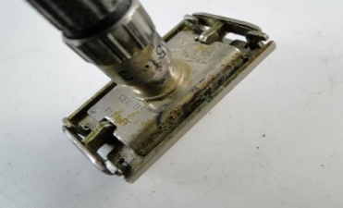
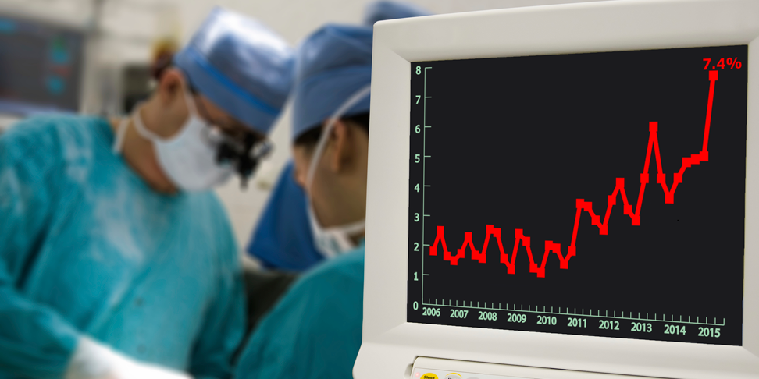
Notes:
Mid Staffs estimated between 400-1,200 unnecessary deaths 2004-2008. Occupational safety and health took the back seat in 2020 with budgets stripped, initiatives put on
hold and massive layoffs to avoid bankruptcy in many organisations, but 2.78 million people still die each year of workplace accidents or ill-health. The human cost of this
daily adversity is vast and the economic burden would more than warrant necessary safety measures. “Every €1 invested in occupational safety sees €2.20 return, while every €1 invested in mental health sees an incredible €4.20 return for organisations. These numbers are increasingly providing a foundation for organisations to put in place new, better safety management systems.
“Unfortunately, we’re seeing an increase in the penalisation of human error with even large organisations claiming it is ‘inevitable’. This makes the creation of a safety culture with emphasis on speak-up values very difficult for workers, as they perceive management telling them people are the problem after all. The obvious answer from a new wave of thinkers is Safety Differently or Safety II.

Slide 81
If the NHS were an airline 'planes would fall out of the sky all the time'
Chances of being involved in airline incident 1-15,000,000
NPSA estimate risk of harm in the NHS 1-10
Notes:
Healthcare is extremely complex
Increased patient volume, acuity
Growing therapeutic options
Expanding knowledge, evidence
Many sources of (incomplete) information
Interruptions & multitasking
Economic & funding pressures to deliver more for less
Sources of system error/failure
Multiple ‘players’ with potentially different goals & assumptions
Safety features, defences become degraded over time
Environmental conditions, expectations & demands change over time
Expectations that the system is safe & not compromised
Robert Francis QC said the public had been given a falsely positive impression about the quality of care being provided in many of the country’s hospitals.
Mr Francis told The Telegraph: “If we ran our airlines industry on the same basis, planes would be falling out of the sky all the time. We’ve got to change the attitude that because it’s provided by the state, it’s all right for a number of people to be treated badly; well it’s not. Airlines would go out of business very quickly if they worked that way.”
Giving his first interview since the Government’s response to his landmark inquiry into Mid Staffs last year, Mr Francis, now president of the Patients Association charity, said: “Because we’ve not had access to genuine information about how well things are done, the public have had a perception that things are better than they probably are.”

Slide 82
Cwm Taf health board fined £850,000 (2022).
Lyn Thomas, 74, died in November 2019 while at Hospital recuperating after a brain operation.
A Deprivation of Liberty Safeguarding order (DOLS) was in place due to her confusion and her risk of wandering. No risk assessment was undertaken.
Her son said it was "beyond belief" she had been allowed to wander out on different occasions.
The ward had no lock on the door to prevent patients from leaving. Previously served with an improvement notice on this issue.
Despite the DOLS in place Mrs Thomas left the premises and 20 minutes later she was found on the ground near the gateposts with a serious head injury.
She had crossed the road it was dark, wet and there was snow on the ground. The court heard that Mrs Thomas's condition deteriorated rapidly and she died from her injuries.
Notes:
A Health Board has been fined following the death of a vulnerable patient who left a hospital ward unnoticed through an unsecured door. The Health and Safety Executive (HSE) investigation concluded that Cwm Taf Morgannwg Health Board failed to act on previous absconding incidents, which would have better protected 74-year-old Lynwen Thomas, who went on to fall in icy conditions in the hospital grounds and suffer a fatal head injury. On 13 November 2019 Mrs Thomas, a patient on Llynfi Ward at Maesteg hospital, who was a known wanderer, left the hospital after 8pm unnoticed by hospital staff. That evening was very cold with snow on the ground. Mrs Thomas fell on a path resulting in her fatal injury. An investigation by the Health and Safety Executive found that despite previous absconding incidents, including one involving Mrs Thomas, no reasonably practicable measures were taken at Llynfi Ward until after the fatal incident to protect vulnerable patients from wandering and potentially coming to serious harm. Following another patient absconding incident at Princess of Wales Hospital, HSE served an Improvement Notice on the Health Board on 30 September 2020. The Notice applied to the Bridgend locality and required the Health Board to assess the risk to patients from escaping, absconding or wandering. The Notice was not complied with by the due date. Before Cardiff Magistrates’ Court, Cwm Taf Morgannwg Health Board pleaded guilty to charges of breaching Section 3(1) and Section 33(1)(a) of the Health and Safety at Work etc. Act 1974 and were fined £850,000 with full costs awarded of £10,627.30. Speaking after the hearing, HSE inspector Helen Turner, said: “Lynwen Thomas was a vulnerable patient, and known to abscond. Cwm Taf Morgannwg Health Board had a duty to protect her and other patients on Llynfi Ward, and they failed to identify or act on absconding risk. “Despite significant warnings, there was no risk assessment or physical security measures introduced to prevent vulnerable patients from leaving the ward unnoticed. This incident was easily preventable and the risks should have been identified.” A family statement issued on behalf of Lynwen Thomas said: “Our mother was the loving and kind heart of our family who always put others before herself, especially her children and grandchildren. She was an incredibly caring, loving, and selfless person. “We are devastated to lose her under such tragic and preventable circumstances. “Today’s prosecution by the Health and Safety Executive is the first step towards establishing what happened to our mother and we are grateful for their professionalism and engagement with us as a family. “We want everyone to know how wonderful, caring, and intelligent our mother was. She loved us all very much and we loved her in return. We miss her terribly and it’s only when this is all over that we can start to properly grieve for her.
​

Slide 83
Essex MH Trust fined £1.5m over deaths of 11 patients (2021)
The prosecution said the existence of "fixed potential ligature points" amounted to breaches of safety laws.
The judge described a "litany" of failings over a prolonged period of time, which led to the trust's failure to "prevent suicides".
The judge added: "There's no doubt the failures to remove ligature points were a significant cause in the deaths of 11 people and a number of near misses’’ (2004-2015).
"Time and time again opportunities to put measures in place were lost."
Notes:
Health and Safety Executive (HSE) action was taken against the NHS North Essex Partnership Trust after the deaths between 2004 and 2015.
The prosecution said the existence of "fixed potential ligature points" amounted to breaches of safety laws.
Melanie Leahy, whose son was found dead at the Linden Centre in Chelmsford, has called for a public inquiry.
Mr Justice John Cavanagh told Chelmsford Crown Court that a "litany" of failings had been identified over a prolonged period, which led to the trust's failure to "prevent suicides".
The judge added: "There's no doubt the failures to remove ligature points were a significant cause in the deaths of 11 people who died during the relevant time period, and of a 12th person who died just after, and a number of near misses.
"Time and time again opportunities to put measures in place were lost."

Slide 84
Sentencing Guidelines 2015
The guideline sets out the different levels of culpability (from very high to low).
The court needs to determine the harm category and turnover. Most NHS organisations would be in the large category £50M plus category. Aggravating factors include: Cost-cutting at the expense of safety.
Breach of Health and Safety regulations
Health and Safety at Work Act 1974 (section 33(1)(a) for breaches of sections 2 and 3
Offence range: £50 fine – £10 million fine
Corporate Manslaughter and Corporate Homicide Act 2007
Offence range: £180,000 fine – £20 million fine
Notes:
Large company (turnover of £ 50 million and over)
Medium company (turnover between £10 million and £50 million)
Small company ( turnover between £2 million and £10 million)
Micro company (turnover of not more than £2 million)
For example, for a Large company being sentenced for a harm category 2 offence with medium culpability, the starting point is a fine of £600,000 with a range of £300,000 to £1.5 million. In most fatality cases there is likely to be a high risk of death so the harm category will be harm category 1 with medium culpability the starting point would be £1.3 million with a range of £800,000 to £3.25 million. However, as death actually resulted the court would need to consider moving up within the range of fines from the starting point.
Next, and still as part of step two, the court has to consider the aggravating and mitigating factors.
47. The prosecution should identify what it sees as aggravating and mitigating factors.
48. The guideline contains a non-exhaustive list. Aggravating factors include: Cost-cutting at the expense of safety, deliberate concealment of illegal nature of activity, breach of any court order, obstruction of justice and a poor health and safety record.

Slide 85
Vision
‘To be a world class Occupational Health, Safety, Security and Wellbeing Service; that provides comprehensive, appropriate and competent advice to the Board with systems and processes that develop a learning culture. To continually improve the OHS, Security and Wellbeing for staff, patients, visitors, volunteers and contractors’.
The objectives to achieving the vision include:-
Creating a positive OH&S & Security culture.
Reducing unacceptable risky behaviours that are detrimental to health and safety.
Ensure the workplace is secure and free from the risk of violence.
Develop policies, procedures and safe working practices that become embedded within the working practices of the organisation.

Slide 86
Plan - Think about where you are now and where you need to be. Gap analysis of law, develop the Policy and how you plan to deliver it. Project leads and team rules established. Develop KPI’s for Team and Organisation.
Do - Identify your risk profile. Assess the risks, identify what could cause harm in the workplace, involve Unions and communicate, develop positive attitudes and behaviours. Provide adequate resources, including competent advice.
Check Measure your performance. 'paperwork' on its own is not a good performance measure. Assess how well the risks are being controlled through formal audits/inspections.
Act Review your performance. Learn from accidents and incidents, ill-health data, errors and relevant experience. Revisit plans, policy documents and risk assessments to see if they need updating. Take action on lessons learned, including from audit and inspection reports.

Slide 87
Notes:
Example of KPI’s and measuring performance.

Slide 88
OHS Strategy benefits in theory
Sickness absence rates reduced.
Work-related stress evaluation and management implemented.
Identify work-related injury moving and handling; needle sticks, slips, trips or falls; or exposure to dangerous substances.
Health Surveillance undertaken to minimise ill health conditions developing.
Number of staff kept in work by OH Health interventions.
Fairness and effectiveness of incident reporting procedures and HR policies.

Slide 89
My take away messages!
Keeping staff happy, healthy and here, is the biggest issue in health and social care services.
Health and Safety culture matters, if not you may end up in court.
Don’t compromise on safety, it needs to be pushed constantly.
H&S needs to be part of the leadership agenda, normal business not an add on, don’t make it difficult to implement.
It is not the responsibility of the OH&S Team to implement the safe system of work.
Keep it simple and keep learning and developing skills at whatever level you are at!!

Slide 90
Thank you

Slide 91
Slido
Please scan the QR Code on the screen. This will take you through to Slido, where you can interact with us.
1st November 2022- 08:00am – 15:30pm – Hatfield’s Conference Centre
Conference hosted by Convenzis Group Limited

Slide 92
The NHS Patient Safety Conference 2022
Q&A Panel
Daniel Hodgkiss
Peter Joseph John Bohan
Patient Safety Assistant Programme Manager / Managing Deterioration National Co-Lead at West Midlands Academic Health Science Network
Associate Director Occupational Health, Safety & Security - Betso Cadwaladr University Health Board NHS

Slide 93
THANKS FOR ATTENDING
The NHS Patient Safety Conference 2022

Slide 94
REGISTER FOR OUR UPCOMING EVENTS!

