Slide 1

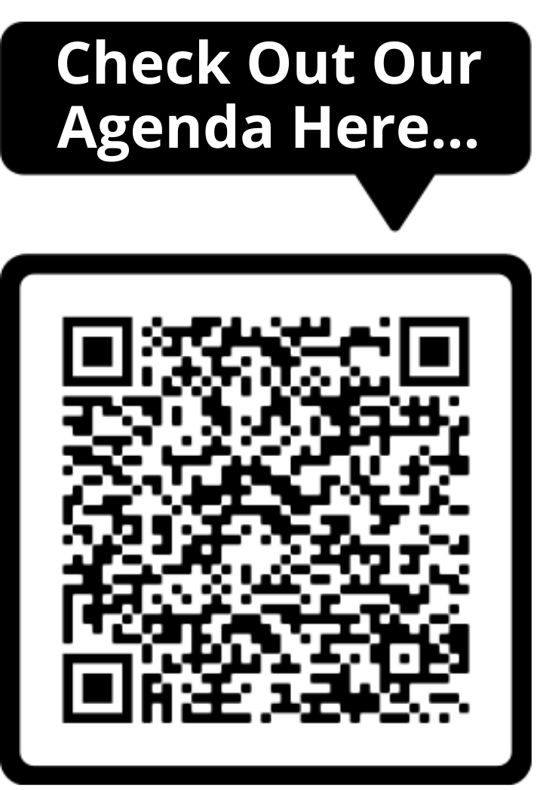


WELCOME TO
NHS POPULATION HEALTH MANAGEMENT CONFERENCE 2022
2nd November 2022- 08:00am – 15:30pm – Hatfield’s Conference Centre
Conference hosted by Convenzis Group Limited

Slide 2


For Each Delegate Attending Our In-Person Event Today, we
will be planting 1 tree with our Key Sustainability Partner

Slide 3
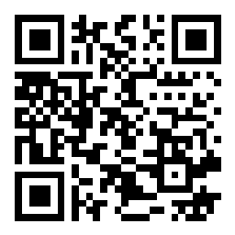
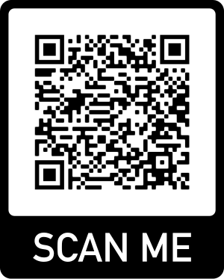
Slido
Please scan the QR Code on the screen. This will take you through to Slido, where you can interact with us.
2nd November 2022- 08:00am – 15:30pm – Hatfield’s Conference Centre
Conference hosted by Convenzis Group Limited

Slide 4
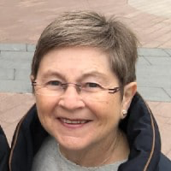
The NHS Population Health
Conference 2022
Event Chair – Opening Address
Christine O’Connor
Independent Consultant
Population Health

Slide 5
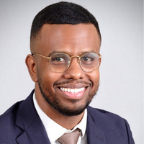
The NHS Population Health
Conference 2022
SPEAKING NOW
I will be discussing…
“Innovative training opportunities to increase population health management at the front-line”
Dr Maslah Amin
National Clinical Advisor & Associate Director
Health Education England

Slide 6


Bringing PHM to the front-line
Dr Maslah Amin
National Clinical Advisor & Associate Director
November 2022

Slide 7

We need more population health approaches
Evidence is clear
Policy is clear
NHS principles are clear
We cannot leave it all to our public health colleagues: COVID-19 reminded us!

Slide 8
Benefits
Aimed at improving the health across a population
Addresses physical and mental health outcomes and wellbeing of people, whilst reducing health inequalities
Includes action to improve prevention, whilst also addressing wider determinants of health, and requires working with communities and partner agencies

Slide 9
Skill-mix
Enhanced level practice
Advanced level practice

Slide 10
National Population Health Fellowship
First national population health fellowship (PHF) – truly multiprofessional across the health and care workforces
Launched to develop a sustainable model for increasing the number of healthcare professionals who have the skills and capabilities required to support ICS and
  Improve health outcomes for populations
  Improve the wellbeing of populations
  Prevent long term conditions through population level interventions
  Reduce health inequalities and unwarranted variation in health outcomes.

Slide 11
What happens on the fellowship?
Fellows undertake a population health placement for 2-days/week for 1 year to work on a health inequalities project
Fellows undergo a formal taught programme
It is an intense year and learning is set at the enhanced level practice

Slide 12
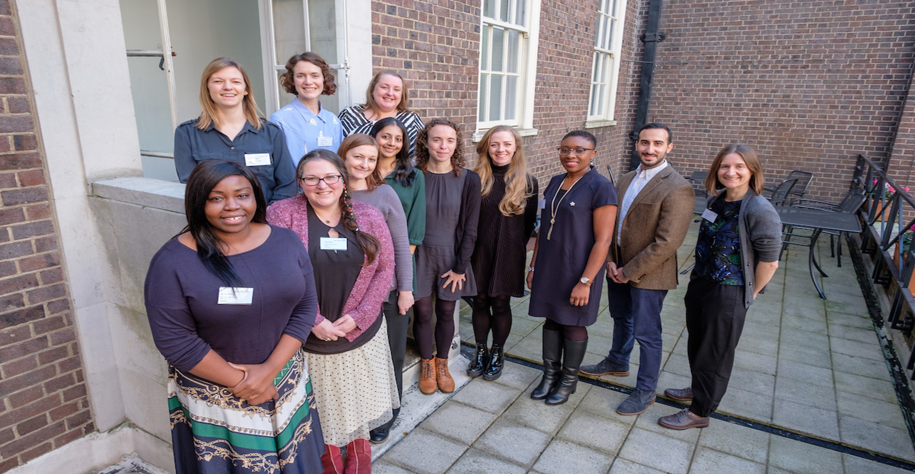
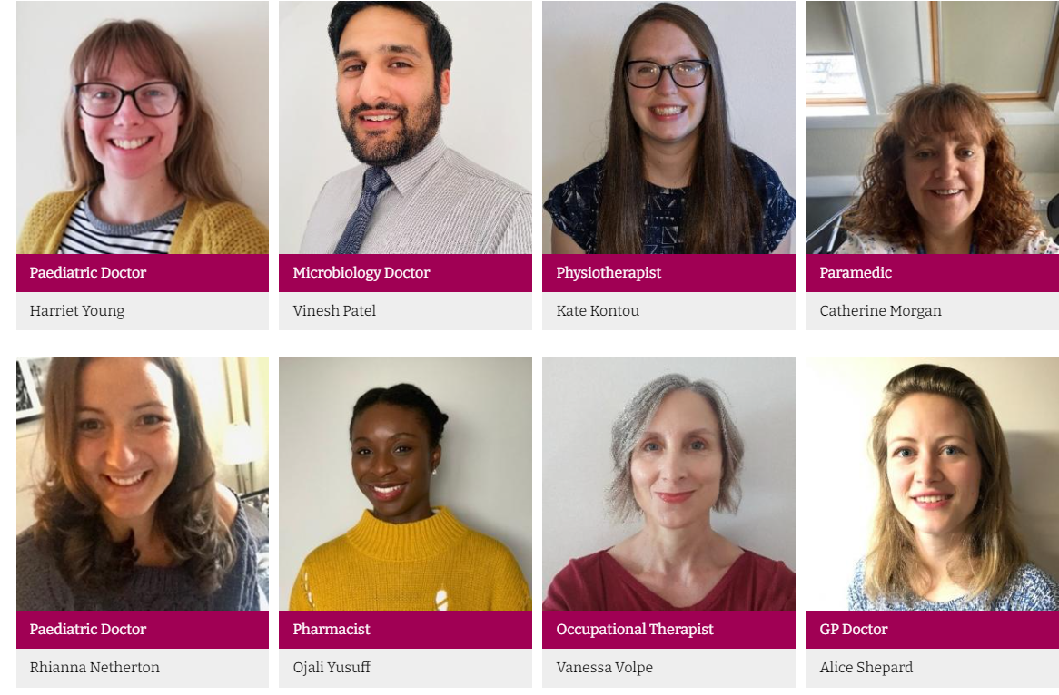
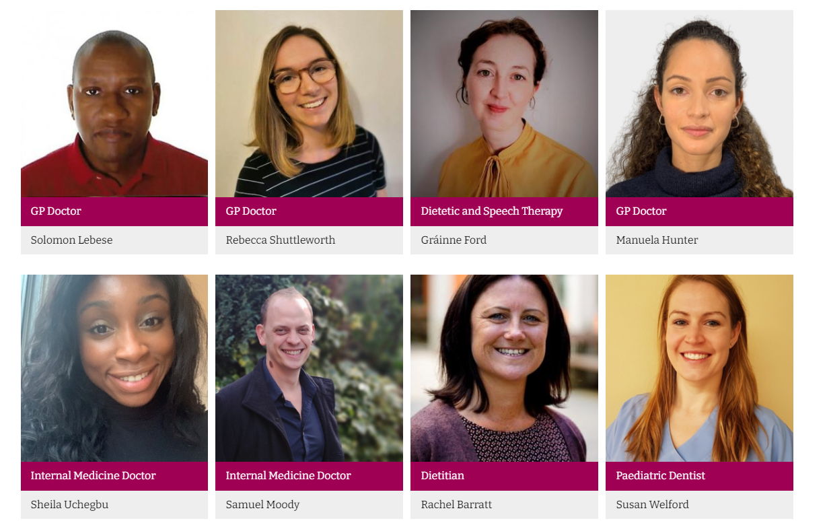
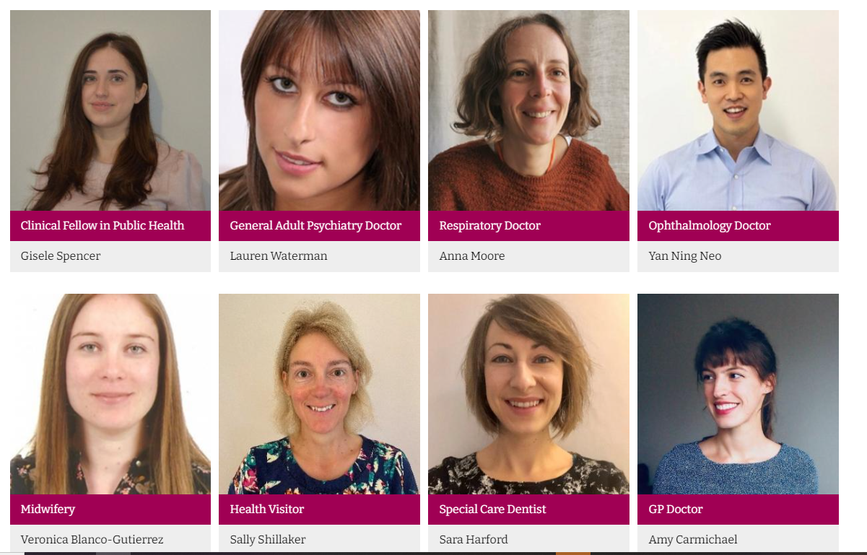


Slide 13

Pharmacy
Dentistry
Speech & Language Therapy
Orthotics
Nursing
Paramedicine
Dietetics
Managerial
Midwifery
Physiotherapy
Medicine

Slide 14
Further developments
The PHF is very popular, particularly among GPs, pharmacists and AHPs.
We now have a pilot where GP trainees are doing the fellowship as part of their GP training to developed enhanced population health skills.
Increasingly we have systems sponsoring their own staff to join the fellowship

Slide 15
Advanced Clinical Practice (ACP) in Public Health
HEE has developed a Core Capabilities Framework for healthcare professionals to work at the advanced clinical practice level with expertise in public health.
The ACP is characterised by a high degree of autonomy and complex decision making
It is set a higher level than the PHF and develops healthcare professionals to master’s level award

Slide 16
ACP Aims
Incorporate population health into their local work systems to improve outcomes
Develop capability to promote and influence healthcare policy
Encourage and support the development of PH strategies and approaches within relevant organisations and systems (e.g., integrated care systems).

Slide 17
The vision
Because of the great overlap of subject matter between the PHF and ACP, after completing the PHF, individuals will be able to progress to the ACP
Together (i.e. fellowship and ACP) they can demonstrate one part of a population health development pathway for healthcare professionals and potential careers escalator, sitting within a wider suite of population health development opportunities and careers.

Slide 18
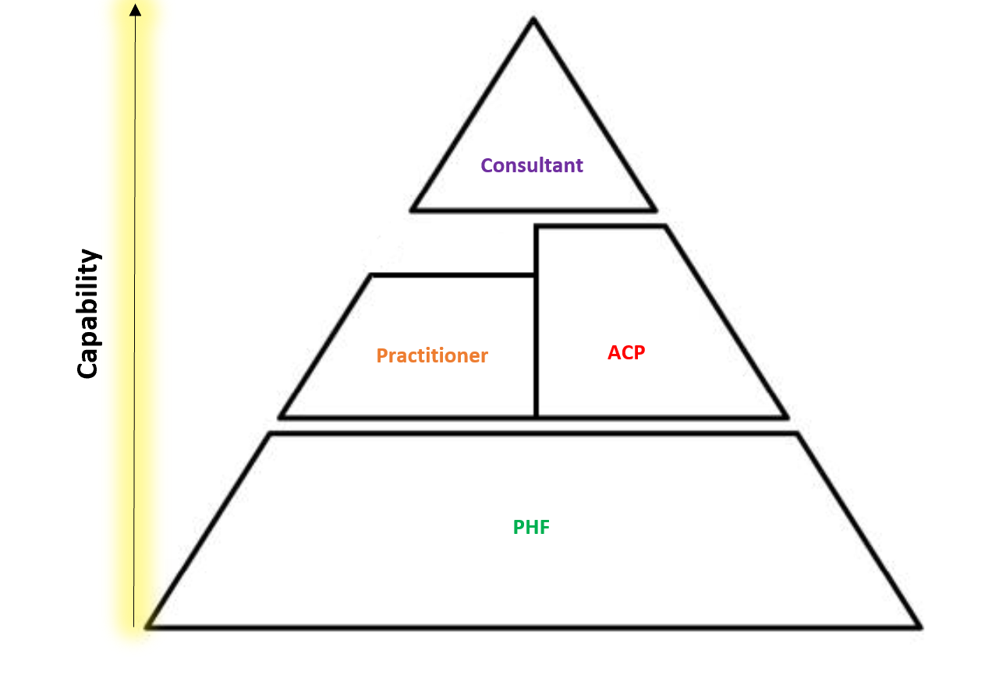
Pathways for clinical practitioners

Slide 19
Population Health Toolkit - ELfH
  A free, inclusively accessible, blended suite of e-learning modules and complementary online resources for all health and social care staff on e-LfH Hub
  Launched November 2021
  Ongoing evaluation to inform future development

Slide 20


Slide 21
Slido
Please scan the QR Code on the screen. This will take you through to Slido, where you can interact with us.
2nd November 2022- 08:00am – 15:30pm – Hatfield’s Conference Centre
Conference hosted by Convenzis Group Limited

Slide 22
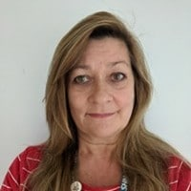
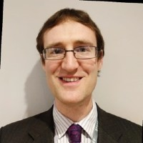
The NHS Population Health
Conference 2022
SPEAKING NOW
We will be discuss…
“Population Health Management and Impact Ability Modelling”
Jane Johnston
David Howell
Head of PHM & Executive Director - Surrey Heartlands ICS & AphA
Joint Director for Strategic Business Intelligence and Analytics
Surrey Heartlands ICS

Slide 23

Population Health Management and
Impactability Modelling
Population Health Management Conference
2nd November 2022

Slide 24
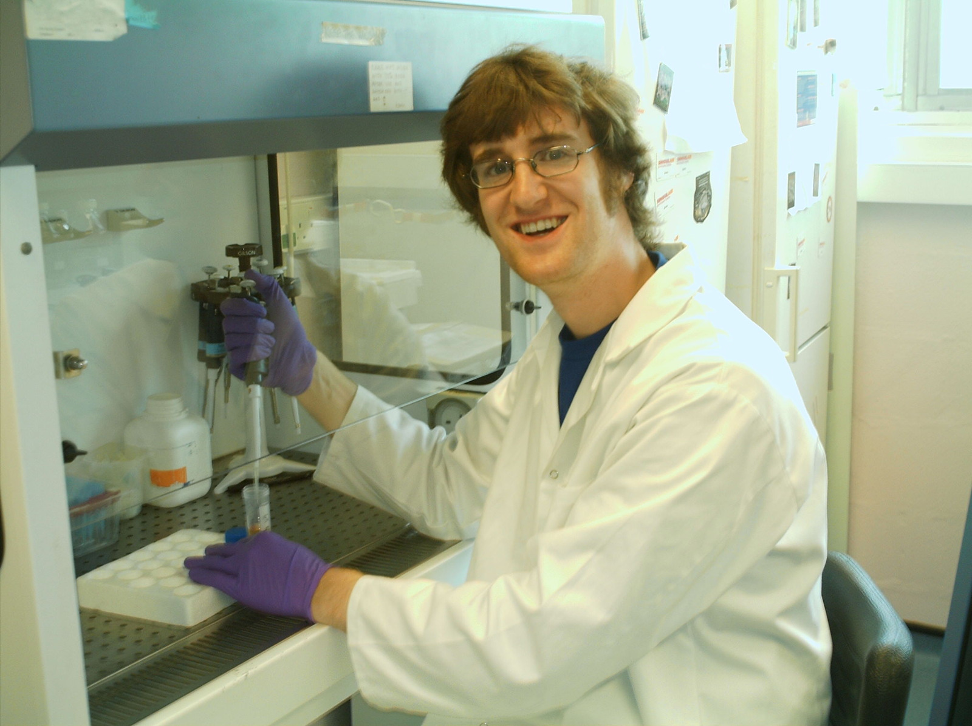
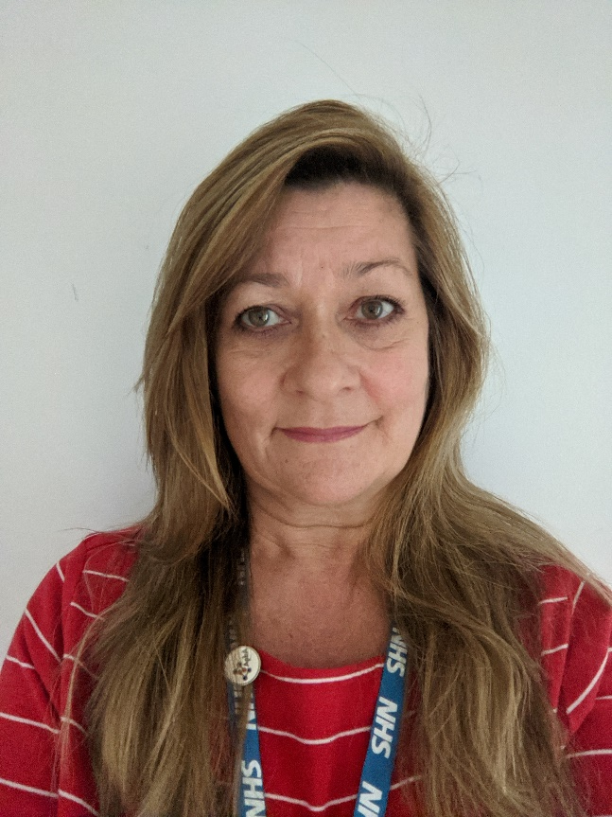
Who we are:
David.howell5@nhs.net
Jane.johnston7@nhs.net
Notes:
Introductions – 1 min

Slide 25
Lets start with the situation to date:
Healthcare interventions were often designed for non-specific populations (e.g. reduce 10% of A&E)
Lack granularity of detail.
Often not generalisable or scalable.
Not based upon future health and care needs, but rather based on now/historical; focus on health priorities rather than health & care
Narrow use of monitoring: Assessments made typically by looking in only one or two areas. Patient experience rarely monitored
Notes:
DAVID – 2 mins
Mention at this point that populations do not stand still. They are constantly changing
The problems that this results in is lack of confidence to invest to save.
Usually based on QIPP/CIF targets – and our population sizes do not stand still, they are constantly changing.
Tend to target a generic condition, there is no stratification of the identified cohort
Because we are not considering the wider picture
Reactive to situations we already know about – e.g. frailty and diabetes. We need to look more at preventative measures
Trend analysis or linear regression used to evaluate – no evaluation of individuals – we don’t have controls, we often don’t take into account regression to the mean

Slide 26
The challenge this creates for systems:
Difficulty understanding why a scheme or intervention is going off track:
  Monitoring at aggregate level is confounded with other factors in the chosen cohort (e.g. RTT initiatives)
  Target population has changed by the point of intervention (typically takes 12 months from idea to implementation)
Narrow use of monitoring means that costs may shift from one place within the system to another, so may not realise financial/quality benefits
Lack of confidence to invest to save in the future
Can result in money not being invested in the right areas
Notes:
DAVID – 2 mins
Difficulty
A waiting list initiative might give an inflated picture of Service usage so future evaluation may give a skewed picture of the efficacy of an intervention
Target population Is constantly changing and by the time an initiative has been embedded within the system it might be too late for it to have any demonstrable effect
We also turned to just do our analysis based on one part of the system e.g. healthcare and do not take into consideration that the costs may shift within the system
All of the above then leads to a lack of confidence to invest to save in the future and subsequently…..
Can result in money not being invested in the right areas – And actually all too often the problem is being used as a starting point rather than the cause
However we have increased our complexity by working beyond health now and have started to widen the data sources that we use through initiatives such as population health management

Slide 27
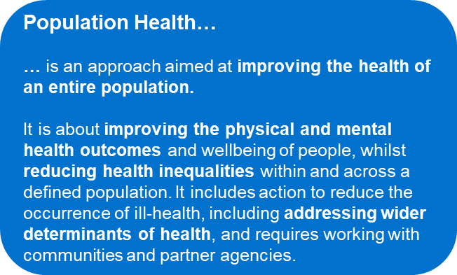
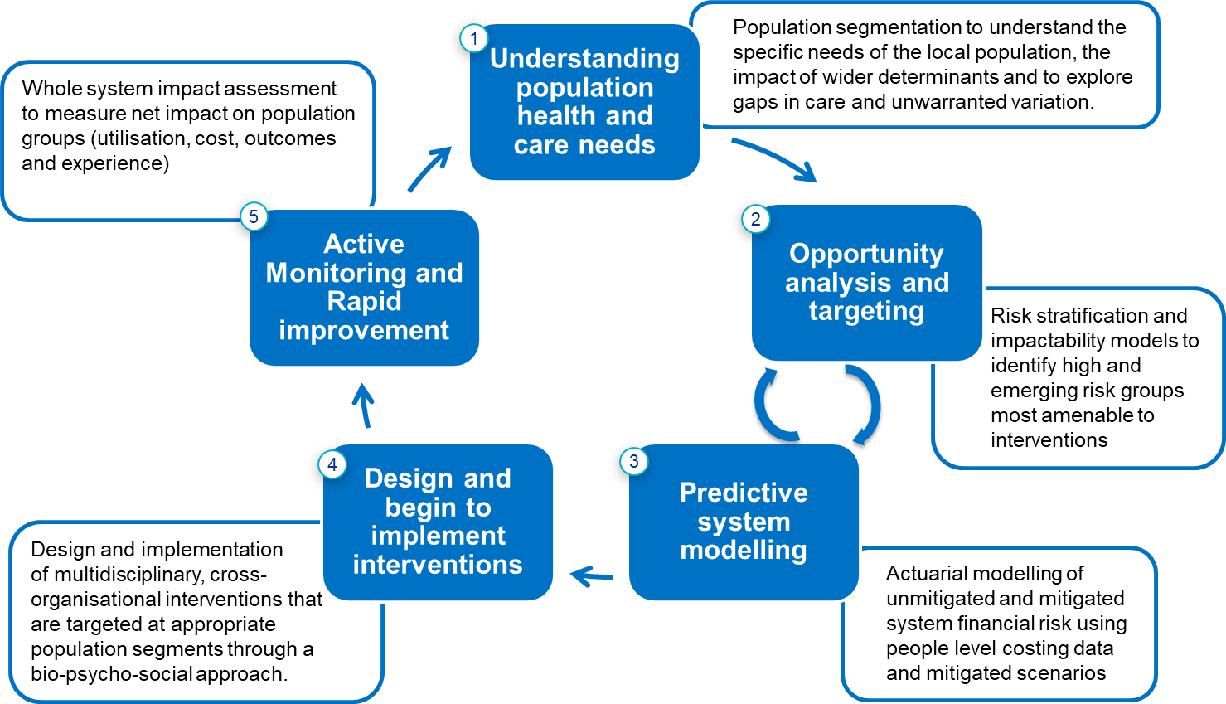
What is Population Health Management?
Population Health Management is about:
Using data-driven insights and evidence of best practice to inform targeted interventions to improve the health & wellbeing of specific populations & cohorts
The wider determinants of health, not just health & care
Making informed judgements, not just relying on the analytics
Prioritising the use of collective resources to have the best impact
Acting together – the NHS, local authorities, public services, the VCS, communities, activists & local people. Creating partnerships of equals
Achieving practical tangible improvements for people & communities
Population Health Management…
…improves population health by data driven planning and delivery of proactive care to achieve maximum impact.
It includes segmentation, stratification and impactability modelling to identify local ‘at risk’ cohorts - and, in turn, designing and targeting interventions to prevent ill-health and to improve care and support for people with ongoing health conditions and reducing unwarranted variations in outcomes.
Notes:
Jane to talk through (1.5 mins) (12 mins total)
Pop health = the goal
Pop health management = the tool using data driven insights evidenced base practice, wider determinants – push the qualitative as well as the quantitative
Data essential for pop health, but cultural change needed to fully embed and deliver
Not just data driven approach – building trust – a collaboration.
need to get intelligent about how we use data to data driven interventions, test and learn – more time for reflecting and learning
Incentives not always financial – consider service providers and users.

Slide 28
Population health analytics supports interventions at all levels of the System
Population
Insight
Interventions
Economic modelling & actuarial projections to look at changes in population health and care needs, implications for future demand across different settings and how to displace this demand through LTP reforms, new contracting and financial arrangements.
Resource allocation between commissioners and providers through outcomes based contracts and increasingly capitated budgets.
System
Segmentation of population groups across places to identify high and rising risk population cohorts and exploring what this means for existing clinical pathways and new models of care across Integrated Care Partnerships (ICPs).
Resource allocation within Integrated Care Partnerships (e.g. capitated budgets and alliance agreements for population groups)
Design of new risk/ reward incentive schemes for different population groups
Place
Identifiable information – De-identified information
Understanding bio-psycho-social risk drivers within selected population cohorts across PCNs to develop and implement new anticipatory care models and deploy MDTs (and VCSE partnerships) optimally.
Care pathway
audits
PCN service specifications (e.g. anticipatory care)
PCN MDT priorities
Neighbourhood
Patient level theographs to understand patient journeys, identify care gaps, support pathway redesign and personalised care.
Person
Impactable cohorts
Notes:
Jane to talk through this slide – 3 mins – I can maybe cut this down (15 mins running total)
Not just about direct patient care. This is just one level , a very important aspect of PHM, but in order to become a thriving system with shared budgets we must be able to ultimately do economic modelling and strategic commissioning
From a financial management perspective population health management will only work if you have genuine meaningful budget delegation at place.
The funding must be cascaded down to place whether it be ICP or PCN or LA for them to manage.
We need to consider every citizens touch point within the system as a use of resource with an associated cost .
If we're going to manage financially using a horizontal lens, i.e. a linked longitudinal record, then it is only ever going to work if all the budgets for all those touchpoints are in one place and managed jointly because then you can start to create genuine incentives within a system .
If you can do something more efficiently that has a better financial outcome you can reinvest that money and close the circle. It’s a bit of a road to travel to really make population health management one of the primary tools in how we manage our business.

Slide 29
Why Population Health Management
Key component of NHS Long Term Plan
develop integrated local healthcare systems that provide the right care at the right place and at the right time
development of interventions tailored to local at-risk population cohorts, aiming for improved outcomes with reduced unwarranted variation between cohorts.
Not just healthcare, the system wide data can be used to support any part of the system
Notes:
JANE (1 mins) (10.5 mins total)
So population health management is a key component of a long term plan it's about developing integrated systems to provide the right care at the right place at the right time and also at the right cost
We need to look at developing interventions tailored two local at risk populations aiming for improved outcomes but also bearing in mind we want to reduce unwarranted variation between the cohorts.
But it's not just healthcare the systemwide data can be used to support any part of the system for example the police service may find that certain cohorts within healthcare dependent on how they are progress through the healthcare system could ultimately lead to have an impact on the prevalence of crime

Slide 30
So what is Impactability Modelling?
Impactability: defines the degree to which different sub-populations will benefit from a range of interventions;
And
Impactability modelling: uses this information to tailor appropriate interventions within agreed boundaries for the 'value' gained from resources spent.
Source: ‘A review of current concepts and practices’ by the IFoA PHM Working Party. 4 June 2020
Notes:
Jane 1 min (6 mins running total)
Impactability – what is the aim, is it financially viable? Not just economic forecasting which calculates a cost saving using an average tariff for a percentage reduction. This is far more specific, mitigation of risk
PHM uses data to inform the development of interventions tailored to local at-risk population cohorts, aiming for improved outcomes with reduced unwarranted variation between cohorts. Tackling inequalities

Slide 31
Why Impactability Modelling for Systems:
Whole system approach – involve the community, voluntary sector, charities etc
More focused and targeted intervention can provide greater control over management and evaluation
Can better put spend where it is needed, assure increased spend isn’t occurring elsewhere
Improved system confidence in invest to save schemes
Alignment of different organisational and community priorities
Better health and care outcomes for citizens and patients - inclusivity
Caution – health inequalities – Core20Plus
Notes:
JANE (1.5 mins) – 7.5 mins total
Data gets you so far but doesn’t show lived experience – co-creation, health & care provider local/ instinctive knowledge
We need targets but need to keep focus open and not labelled or may miss impactable cohorts – e.g. the 5 clinical priorities in core 20 plus 5 gives focus, evidence based greatest disparity, but same populations probably also at risk of diabetes, obesity etc.

Slide 32
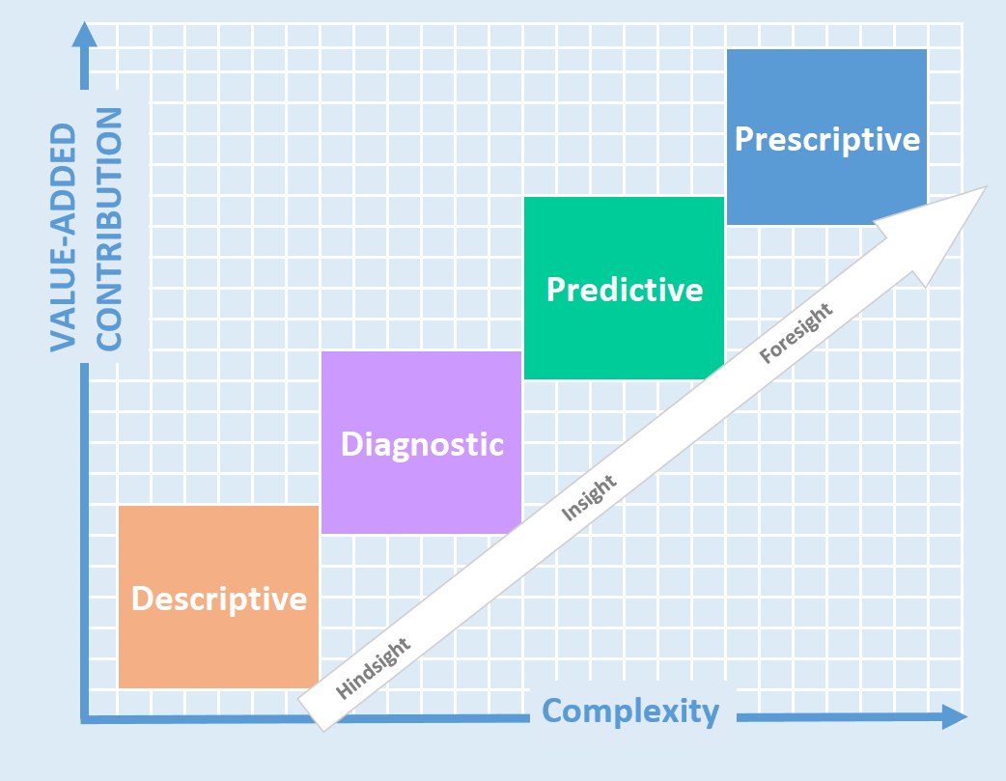
What do we need to put this into Practice?
Work from a patient/Citizen level upwards – Cannot meaningfully target interventions on aggregate data.
Integrate Health and Care data, incorporating Wider Determinant's of health to understand patient behaviours
Move to predictive and prescriptive analytics
Need an infrastructure that is fit for purpose and flexible for cutting and slicing data
Notes:
DAVID 2 mins (9.5 mins total)
Some of the key components are…
So what do we need to do to put this into practise
we need to start at the bottom from a patient citizen level and work upwards we can't get meaningful targeted interventions using aggregated data
We need to make sure we start to integrate our health and care data bringing wider determinant such as police housing education so we can understand patient behaviours citizen behaviours
We want to move to more predictive and prescriptive analytics, Using our collected data to come up with future outcomes and then taking that data and going even deeper into the potential results of certain actions and that is moving towards impactability modelling
We need an infrastructure that's fit for the purpose is flexible for us to be able to cut and slice the data. we need our analysts across the systems to be able to access this rich data to support more complex actuarial modelling
…Helpfully there is already a major programme of work aiming to achieve this called Population Health management…

Slide 33
PHM – The Data Science Approach to Impactability
Data
|
Can be from single or multiple linked sources
|
The richer the better
Run Descriptive Analytics
What has happened already?
Undertake Deep Dives
Why did it happen? Is it a one-off or is there a consistent pattern?
Develop Predictive Models
How can we best predict what may happen in future?
Jointly Consider Prescriptive Models
What are our options for action and the impact of each scenario?
Kick-off Pilots & Use Learning to Refine Algorithm
What service is our first priority? How can we initiate a pilot? and capture outcome to feed algorithm for refinement
Develop Process, Models & Documentation for BAU
How can move the tools and techniques developed for regular use by BAU colleagues?
Notes:
David this slide onwards
2 mins – 17 mins total

Slide 34

PHM – The Data Science Approach to Impactability
HES Hospital Episode Statistics
+
NDA National Diabetes Audit
+
NDFA National Diabetes Foot Audit
+
NADiA
National Diabetes Inpatient Audit
Run Descriptive Analytics
26,378 lower limb amputations, 19% increase over 3 yrs., £1 in every £140
Undertake Deep Dives
Type1 and 2 at increased risk, direct link between ulcers and foot infections to LLAs
Develop Predictive Models
Link best available GP data with acute, community and national sources, cleanse and run modelling to develop predictive tools
Jointly Consider Prescriptive Model Options
Does the current service offer across ICS differ, how do other areas address the gaps, are their results any better? How can we best flag at risk patients? Can we apply for additional funding from NHSE?
Kick-off Pilots & Use Learning to Refine Algorithm
Which locality needs the most support to improve? Lets kick-off joint clinically led work programme and use the model and results to further refine algorithm
Develop Process, Models & Documentation for BAU
Use existing best practice with new tools developed to set up BAU process across ICS
Notes:
David – 2 mins – 19 mins total

Slide 35

Questions?
david.howell5@nhs.net
Jane.johnston7@nhs.net
Notes:
Leaves 1 min for questions!!

Slide 36
Slido
Please scan the QR Code on the screen. This will take you through to Slido, where you can interact with us.
2nd November 2022- 08:00am – 15:30pm – Hatfield’s Conference Centre
Conference hosted by Convenzis Group Limited

Slide 37
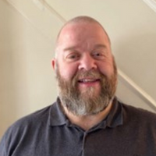
The NHS Population Health
Conference 2022
SPEAKING NOW
I will be discussing…
“Nothing About us, without us, is for us”
Craig Chapman
3rd Sector Consultant
Population Health

Slide 38

Nothing about us, without us, is for us
NHS Population Health Management Conference
Craig R. Chapman
2nd November 2022

Slide 39
Agenda
3rd Sector Collaboration
VCFSE
Foundations
A Perfect Fit
Our Community
Money, Money, Money
Criteria

Slide 40

A few Qs – 3rd sector collaboration
What works well and what does not
How third sector activity is commissioned and resourced
What would improve collaboration
What would improve inclusion and participation
How do we best work alongside communities
What changes does the public sector need to make
What is needed to support these changes

Slide 41

The 3rd Sector (VCFSE)
A valuable resource
  Often under-used and under valued
    Depending on size of 3rd sector organisation
Not an additional staff team
3rd Sector Organisations have their own priorities
    How can you fit in and support?
A world of lived experience, and they know it!!
41
NHS Population Health Management Conference - Craig R. Chapman

Slide 42

Foundations
Chat! Go and drink tea or coffee!
  This is a resource (and at times can be hefty)
Shared Aspirations (3rd Sector, Public Sector), common goals etc
  Different approaches and work cultures (even within)
  How are differences addressed?
    Decision Making and timelines
Shared set of Values
  Not a SLA – a pledge or ToR with clear plans and allocated resources.
    Accountability begins a contract/SLA
  Reviews

Slide 43
A perfect fit?
There is a perception among many in the 3rd sector that larger organisations do not value their work and seeks to lead rather than support it.
  This may be because the third sector is often involved in early intervention and prevention work, where outputs are harder to measure.
  Not able to influence priorities, simply there to answer to others, forgotten voice when it comes to detail.
Community Council
CVS is just a starting point.
  Asset Mapping
Organisations are being ‘hand-picked’ to be included in representative structures and this then being regarded as third sector representation.

Slide 44


Our community
‘of the community’ and not an initiative or tick box
There are ‘communities’ ready, willing and waiting to take on greater responsibility – but there is a reluctance from public bodies to let go of power.
Covid – 3rd sector education
Community Language
Hard to reach people Vs Hard to reach services
Access to information / data is essential for good community empowerment, but communities don’t always have easy access to data that would help them understand issues.
Nothing about us, without us, is for us

Slide 45




Money, Money, Money
Silo Mentality
Competition
Strategic Approaches & Direction
Bureaucracy
Refusal to share information
Undermine relationships & trust
Maximize funding opportunities
Jumping through hoops
support

Slide 46

Criteria
Work with groups of people who face specific and proven barriers to good health i.e. class, ethnicity, sexual orientation, immigration status, gender
Work with residents to improve their access to transportation, good quality housing and healthcare
Work with residents to improve their life chances by accessing learning & training and employment
Support residents to receive all of the income support they are entitled to
Support residents to address factors that put their health at risk e.g. smoking, alcohol misuse, drug misuse, low physical activity
Support residents whose health is affected by others putting them at risk e.g. domestic abuse, sexual abuse
Support families to help them provide a healthy environment for pregnant women and children under five
NHS Population Health Management Conference - Craig R. Chapman

Slide 47




Thank you
Craig R. Chapman
craigrchapman@outlook.com
07815 756586

Slide 48
Slido
Please scan the QR Code on the screen. This will take you through to Slido, where you can interact with us.
2nd November 2022- 08:00am – 15:30pm – Hatfield’s Conference Centre
Conference hosted by Convenzis Group Limited

Slide 49

The NHS Population Health
Conference 2022
UP NEXT…

Slide 50
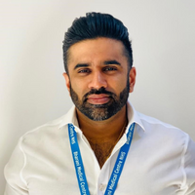
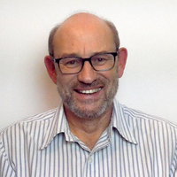
The NHS Population Health
Conference 2022
SPEAKING NOW
We will be discuss…
“Actioning Insights from Population Health”
Dr Bharan Kumar
Markus Bolton
GP Lead Clinical Director for SHAPE Primary Care Network & GP Lead Bharani Group Practices
Director - System C & Graphnet

Slide 51
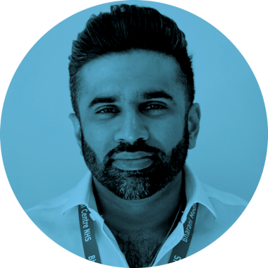
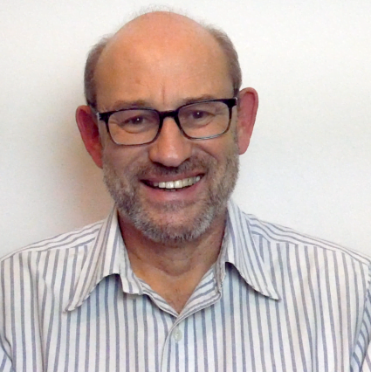
Population Health In Action
Dr Bharan Kumar
General Practitioner and Clinical Director of SHAPE PCN
Markus Bolton
Director of Graphnet and Founder of System C Healthcare
Autumn 2022

Slide 52







Collaborative Pop Health
It is a data-driven transformation programme covering 10 ICSs and 17m patients
NORTHEAST
NORTH CUMBS
HUMBER
COAST
VALE
1
HEALTHIER
LANCS
S CUMBS
W YORKS
HARROGATE
GR MANCHESTER
4
S YORKS
BASSETLAW
It is 7 data stores (some ICSs combine) holding 9.5 terabytes of data
CHESHIRE & MERSEYSIDE
DERBYSHIRE
NOTTINGHAM
NOTTS
LINCOLNSHIRE
STAFFS
STOKE ON TRENT
LEICESTER
LEICESTERSHIRE
RUTLAND
NORFOLK
WAVENEY HCP
SHROPSHIRE
TELFORD
WREKIN
BC&WB
17 million
B&S
NORTHANTS
CAMBRIDGESHIRE
PETERBOROUGH
HEREFORDSHIRE
WORCS
COVENTRY
WARKS
SUFFOLK
NE ESSEX
BEDS LUTON & MILTON KEYNES
GLOUCESTERSHIRE
BUCKS, OXFORDSHIRE & BERKS WEST
HERTS
W ESSEX
MID & SOUTH
ESSEX
Unprecedented collaboration between ICSs
BNSSG
BATH & NE SOMERSET, SWINDON & WILTS ICS
FRIMLEY H&C
2
SURREY
HEARTLANDS
H&C P
KENT
MEDWAY
SOMERSET
HAMPSHIRE
ISLE OF WIGHT
SUSSEX
H&C P
TOGETHER FOR DEVON
DORSET
KERNOW
driving
Population Health
Patient Engagement
It is a closed loop service which provides insights, produces action lists, supports actions and monitors outcomes.
3
Analytics
Shared Care Records
An initiative enabling and driving serious transformation
5

Slide 53














CIPHA combines a wide range of detailed and mostly real-time data
REAL-TIME OPERATIONAL DATA FEEDS
EXTERNAL DATASETS
DHSC Test & Trace
NIMS (Vaccinations)
GP Practices
GP Practices
Commissioning datasets
Record-Level Secondary Uses Service (SUS) data
Patient / Citizen
Administration
Contraception & HRT
Smoking
Problems List
Diabetes Diagnosis
Alcohol Exercise Diet
ECG Pulmonary
Urinalysis
Social History
Contraindications
SITREP (Strategic Information Platform)
Survey data
Allergies
Family History
Immunisations
Physiology Tests
Recent Tests
UK Health Facts published data
About me
Glucose / HbA1C
Heamatology
Active Problems
Investigation Admin
Active Problems
Summaries
Blood Chemistry
Height & Weight
Encounters
OTC Prophylactics
Encounters
Community and bed-utilisation
Blood Pressure
Medication Issues
Obstetric Procedures
Medication Admin
Repeat Medications
Cancer
Cervical Cytology
Other Diagnostics
Operations
Referrals
Microbiology
111 queries
Urgent Care
Child Health Data
Other Therapeutics
Cytology
Admissions
ANONYMISED
DATA
Mental Health
Chronic Disease Data
Pregnancies.
Other Pathology
Past Problems
Reference
PSEUDONYMISED
DATA
Care home bed availability
MPI
Theatre Visits
Alerts
MPI
MPI
MPI
Contacts
IDENTIFIED
DATA
Social determinants
Waiting Lists
Orders / Results
Contacts
CPA Details
Immunisations
Referrals
Professionals
ADT
Reports
Diagnoses
Diagnoses
Care Plans
Events
Services
Johns Hopkins’ risk assessments
Referrals
Medications
Procedures
Clinical Notes
Problems
Case Details
Care Plans
Appointments
Correspondence
Involved Professionals
MH Act
Interventions
Risks/Hazard/Alerts
Disabilities
MPI
A&E Attendances
Clinical Summary
Risks
Diagnoses
Protection Notices
Clinical Summary
H
Acute Care
EIP
Medications
Social Care
OOH / ITC
Mental Health
Community
53

Slide 54

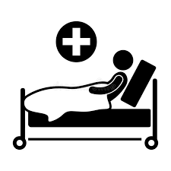














CIPHA Use Cases
There are currently over 50 use cases across the
10 ICSs …. for example
HYPERTENSION
ELECTIVE RECOVERY
PULSE OXIMETRY
END OF LIFE
BP@HOME
ANTIVIRAL RX
COVID RESEARCH
MENTAL HEALTH REGISTER
1
2
3
4
5
6
7
8
VACCINE UPTAKE
OOH DEMAND
A&E INSIGHTS
COVID EARLY WARNING
NHS HEALTH CHECKS
SERVICE INDICATORS
FUEL POVERTY
HIGH INTENSITY USERS
9
10
11
12
13
14
15
16
50+
… and plenty more …

Slide 55
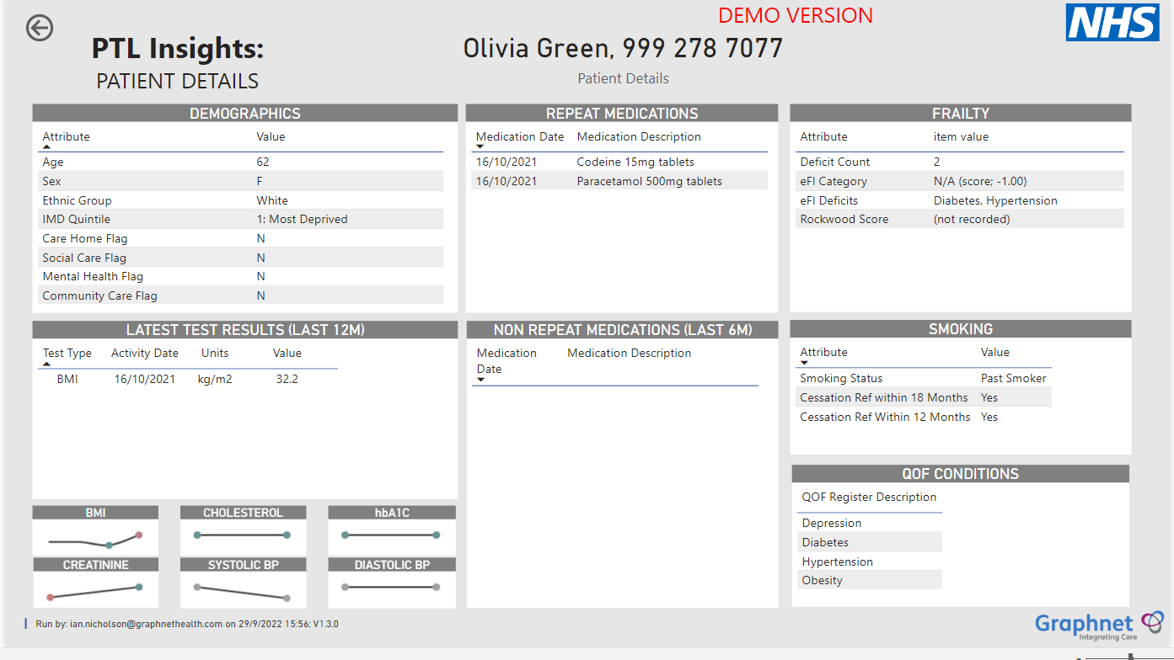

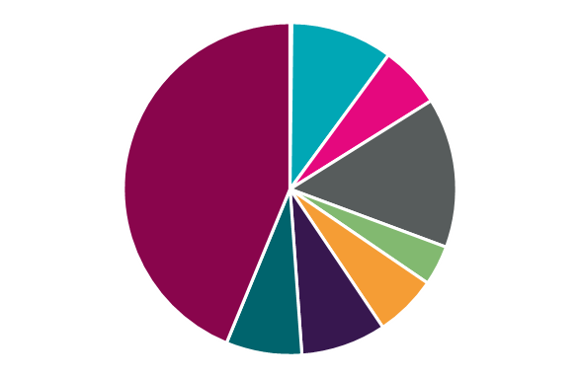
Elective Recovery
A tool to cleanse waiting lists using data from all care settings in a care community
01
Identifies people who:
  are deceased
  have potential duplicate entries across ICS
  have already been treated
  no longer require treatment
  did not attend (DNA) or cancelled
  are declining health wise
  can be moved to a different pathway
  are suitable for elective recovery coaching
02
The elective waiting list dashboard gives an overview of (and insights into) the waiting list across one or more Trusts.
It helps clinicians to manage and cleanse their lists.
Patients on list: 333,457
03
Multiple Entries: 32,898
Deceased: 587
No contact for 12m: 19,986
03
Some Initial Stats from a large ICS
Other Patients:
146,539
Patient Cancelled: 48,493
Patient DNA: 12,891
HBA1C>47: 24,470
Emergency Adm: 20,091
BMI>35: 27,502

Slide 56
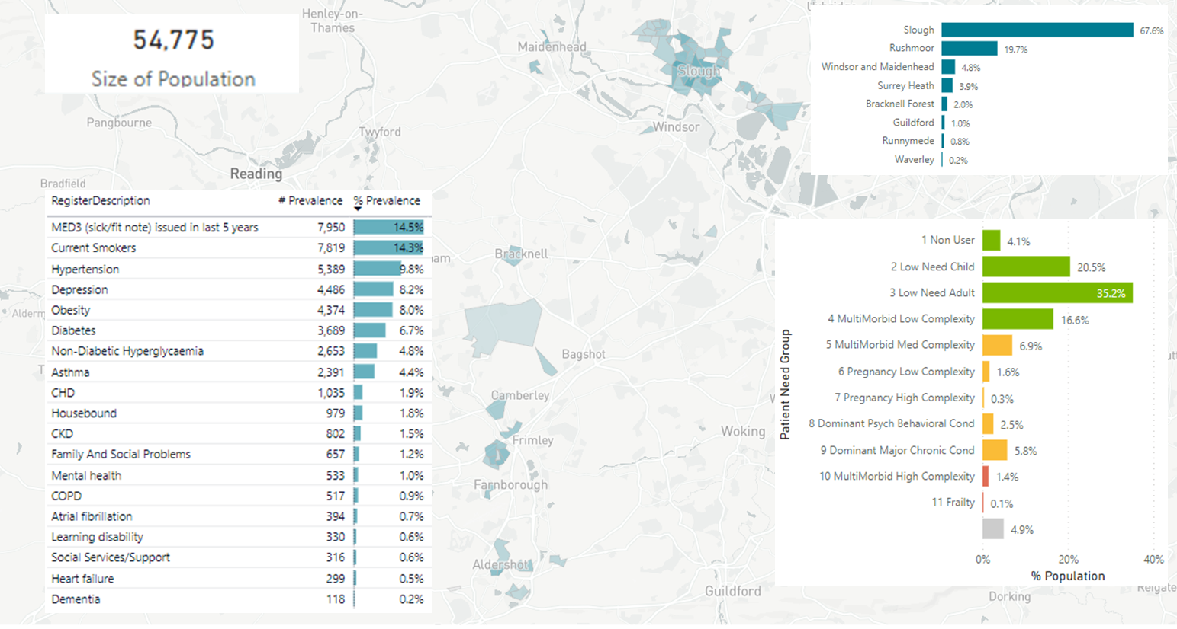
Equity: Fuel Poverty
01
1.5% are in the highest patient need health segments
17.2% are in moderate patient need heath segments
76.4% are in lower patient need health segments
55k residents in Frimley ICS living in deprived areas (Deprivation deciles 1-4) and poorly insulated homes (Energy Performance Certificate (EPC) rating of D,E,F or G)
02
0.9% (517) have COPD and 4.4% (2,391) have Asthma – conditions which can be exacerbated by cold homes
8,121 under 10’s
4,404 patients who look like they live by themselves
837 with LD or SMI
4,439 with depression
2,797 with COPD or asthma
03

Slide 57


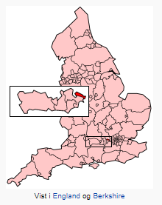
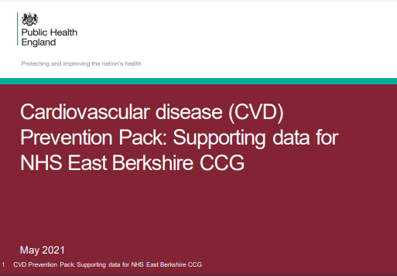
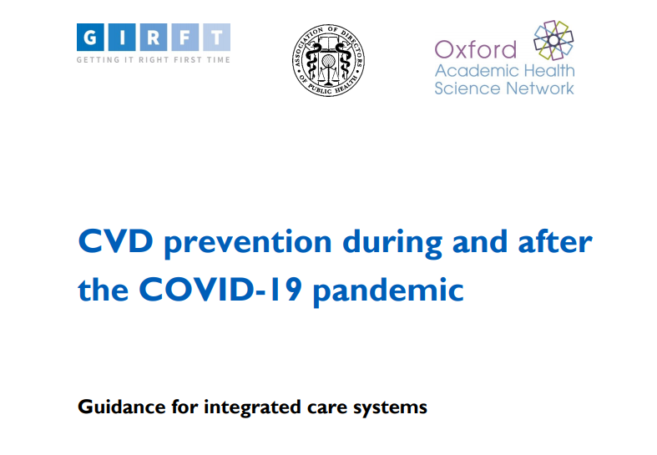
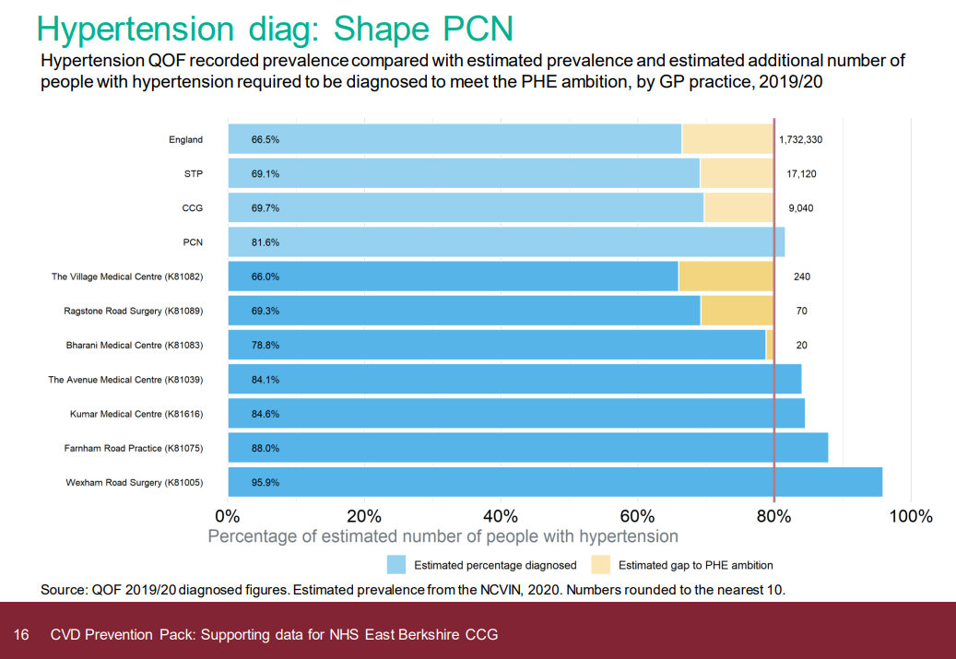


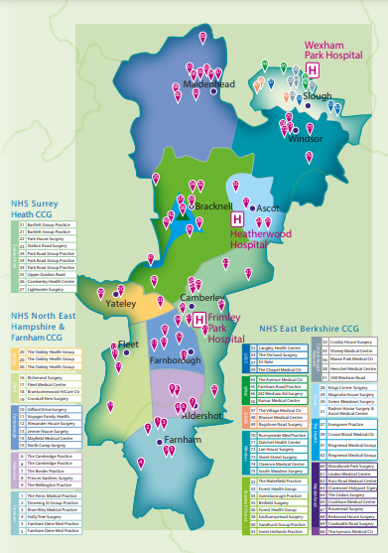
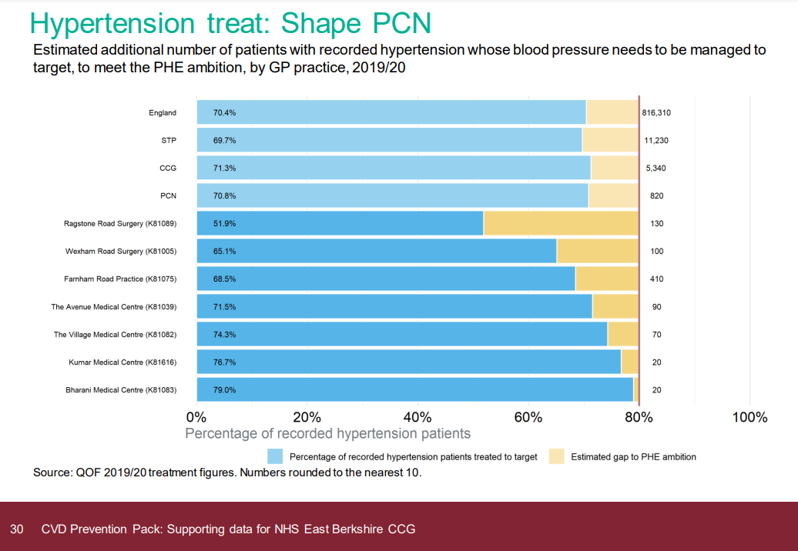
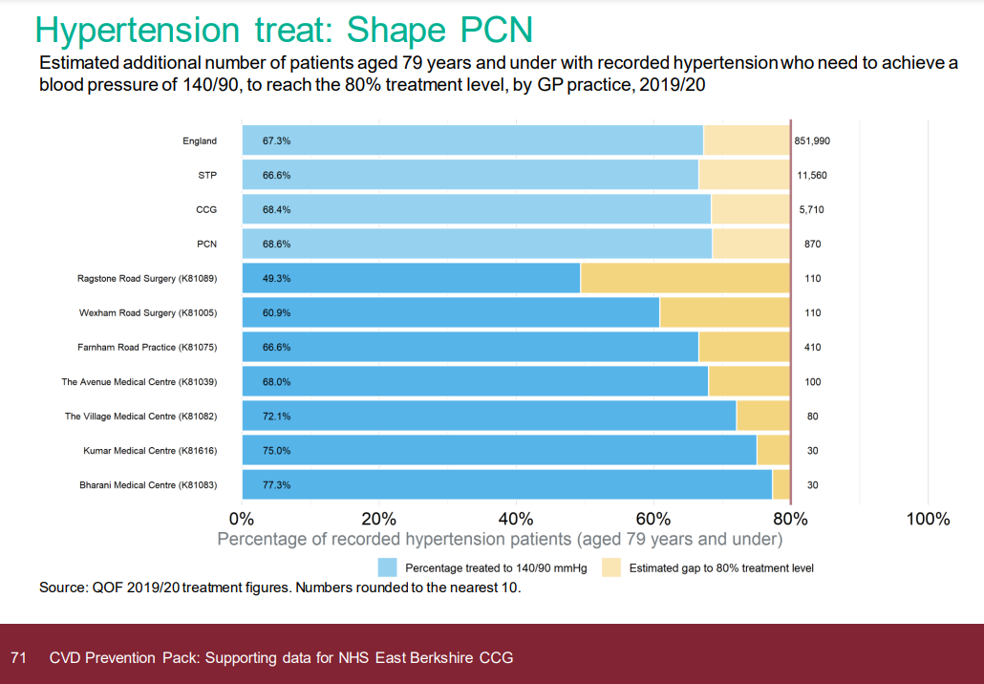

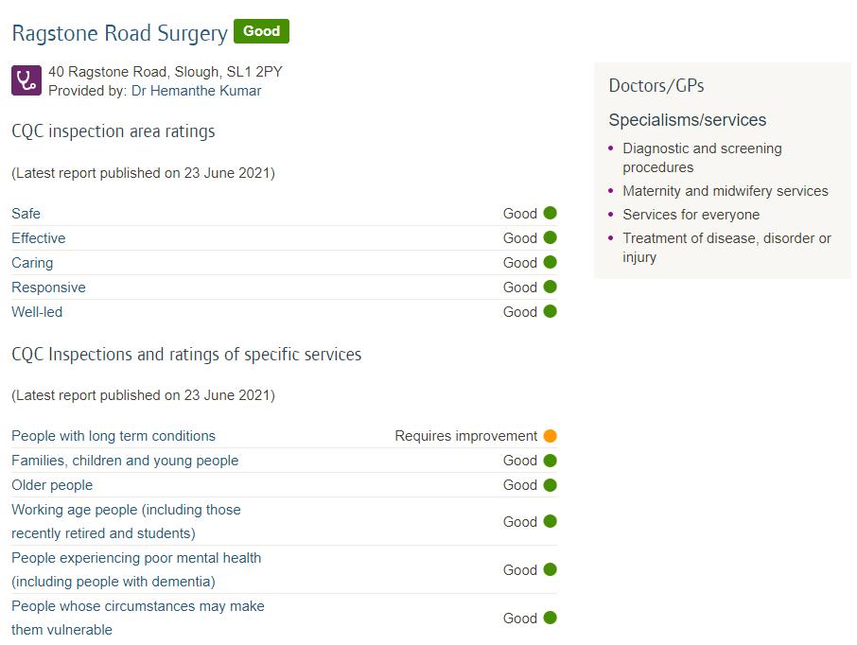
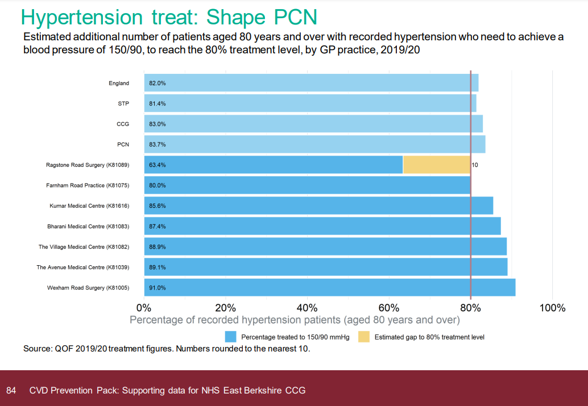
Context
6 General Medical Services (GMS) contracts across Berkshire
300 Beds in Nursing Homes being owned, run and developed
Numerous ventures in Assisted Living
3 GP practices in the SHAPE Primary Care Network (PCN) are the focus of this case study
Slough
Berkshire
Population very deprived and lots of ethnics e.g. Bharani Medical Centre
99% Pakistani
SHAPE PCN
Practice | Patient Population
Bharani Medical Centre | 13,022
The Village Medical Centre | 11,867
Ragstone Road Surgery | 3,510
 | Total: 28,399
2019/20 statistics
All practices, high numbers with CVD risk factors:
Asian
Diabetic
Hypertensive
High cholesterol
 | Opportunistic contacts
 | New diagnoses
 | Reviews
 | Healthy behaviours
 | Health inequalities
 | Hospital admissions
 | CVD related dementia
 | Severe illness + death
And had higher numbers experiencing CVD events – MI/Strokes
Ragstone Road Surgery
A small surgery in Chalvey
Chalvey is 2nd most deprived ward in the ICS
1 of 5 most deprived in the UK
Ground zero for immigration
We took over the practice (Ragstone Road) in 2013.
Historically they’d struggled to get patients to attend numerous times for Hypertension and Diabetic reviews, primarily as patients weren’t trained and the practice didn’t have the resources, the recall systems in place.
Even pre-Covid, with staff available, we still struggled.
19/20 QOF year we were only achieving 50% not meeting the QOF targets for patients who were hypertensive.
Led to high numbers of exception reporting – we’d call patients and they just wouldn’t respond.
CQC pulled us up – we had a visit from them day before 1st national lockdown – how you’re managing Long Term Conditions (LTCs) needs to be improved.
Notes:
background of shape pcn, size, care home beds,
area – transient population, ethnic, deprivation, immigrant hub
Ragstone, - not fit for purpose, qof calling, exception reporting, resources calling, cqc

Slide 58


A Phased Approach
1
Proof of Concept
For the first time in General Practice, everything stopped.
We didn’t have huge cues of patients waiting in the morning for face-to-face consultations – we began switching communication and engagement channels – using telephones, and things like e-consult.
These changes continue to be a big part of our practice now – our population has learnt, responded and we’ve firmly embedded it in our BAU activity.
So, our focus has now shifted to how we optimise LTC management.
I then sent an accuRX bulk text message out to all these people:
If you’ve got a BP machine at home, send us your reading.
The response was phenomenal. 150 in the first week.
Quickly increasing to 500.
I started texting patients from the list who weren’t responding saying:
Please send us your BP reading.
I was running this project, texting people between patients.
I was texting patients back, changing the accuRx message and the appropriate Floreys questionnaire link.
If the initial reading was ok, I sent a message to say thank you.
If initial reading was high Your blood pressure is high - check it 3 times…
If still high Your blood pressure is still high check it for 7 days.
An optimised process:
The approach allowed patients to directly respond to me – entering their BP readings through the link provided
Readings and responses were coming into my accuRX inbox (avoiding the surgery) and I could look into that live as they came in
I not only got the readings but got the average reading, all SNOMED coded, and could make a decision from there
I could also assign these messages to others in my team to follow the process through
…We started with Hypertension.
We began with the assumption that some of the people we wanted to reach out to were probably monitoring their BP at home. We didn’t know how many.
Our Hypertension patient list was compiled across various domains:
People who were known to have hypertension
People who were Diabetic and needed their BP checked
Those who’d previously had a CVD event - MI/Stroke and needed their BP checked
We identified hundreds of people:
Bharani Medical Centre | 1500
Ragstone Road Surgery | 500
We were diagnosing hypertension, having never ever met the patient, and we were being able to just start the medication.
The effect was magical.
Notes:
Slide 3 – bp.
E-consult and access
BP What did you do? Why?

Slide 59
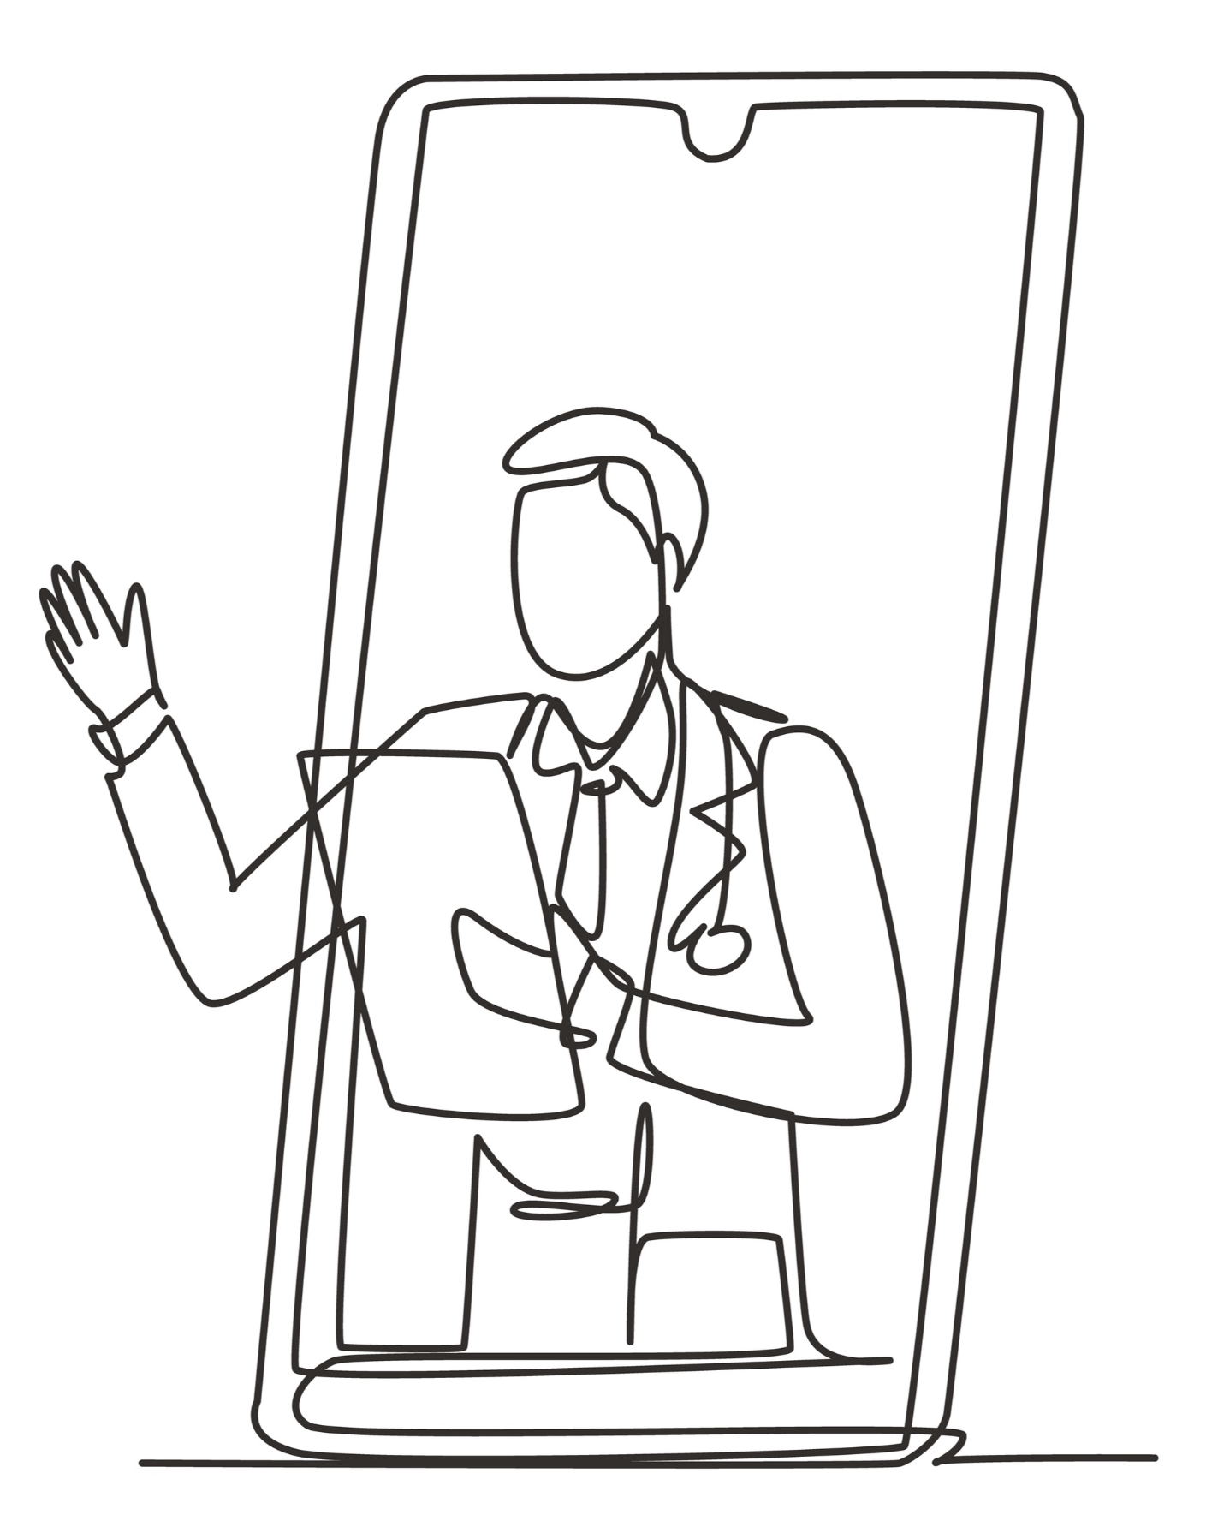

A Phased Approach
2
Creating a sustainable model - Diversification of our workforce
Immediate aim:
To create a number of metabolic pharmacists; people who can help us with the management of CVD risk for our population
Through the Accelerated Access Review (AAR) scheme, we employed a pharmacist and had his independent prescribing focus on Hypertension.
This was to ensure he could confidently manage Hypertensive patients. This pharmacist is still with us and we’re now on-boarding another.
Our pharmacists have a dedicated clinic to crack on with this work 4 days a week.
At the start of each financial year – beginning this April 22 – we’ll be sending a huge number of these batch messages to kick start the next year’s worth of reviews with the aim to having these completed by the end of the calendar year.
Allowing GPs to focus their time on those patients that need to be called in.
Going forward, we’ll continue to refine and expand our approach. Using a combination of the Connected Care platform to help us to identify cohorts and remotely monitor them and accuRx Plus to engage with people, we look to tackle Diabetes and Lipid Management, then move on to Asthma and so on; looking at a spectrum of Long-Term Conditions (LTCs), in a defined, standardised way using remote monitoring.
Every year there should be recalls happening QOFs or no QOFs…
Our Long term vision?
Ultimately, I foresee these professionals managing our long-term conditions for our population, remotely from their laptop at home, and discussing the more complex patients with us (GPs) using online meeting/consultation tools.
Notes:
Slide 4 – creation of a metabolic pharmacist, roll out 22, sustainability,

Slide 60
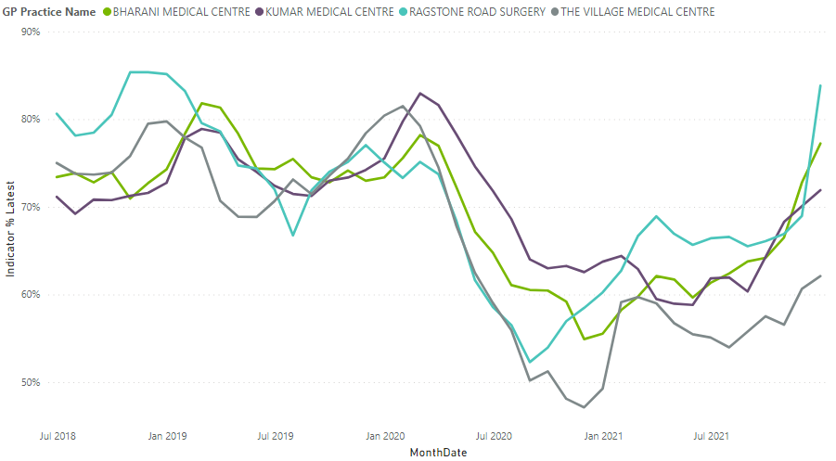
Evaluation
3
Evidence the Impact
We’ve got to learn to live with Covid. We’re just not going to see the same footfall into our practices – so we’ve got to reach people in a new, novel ways.
Combining the power of accuRx Plus (bulk messaging and targeted questionnaires) with e-consulting enabling the uploading and sharing of photo – all these things are changing the way we deliver General Practice.
We’ve so much more information at our hands to make decisions
We’ve more capacity to call in and spend more time with people who really need to be seen
It’s more cost effective for both us and our patients
It results in better outcomes for our patients
And is far more satisfying for me/us as clinicians
The NHS needs to get to the state where we’re seeing the right people at the right time by the right clinician.
You do this by doing exactly what we did - gathering the data, triaging, gathering more focussed data to enable better decisions, better planning.
It’s not for everyone – but for those who can use it, it gives you the opportunity to manage them well; remotely and safely.
This is the new normal for us.
We love it. Patients love it.
This is where we are – this is the future.
Case Study
Benefits
I had a 47-year-old lady with CVD risk factors, who hadn’t attended at the practice for a long time if at all.
She’s Polish, very busy with her work/career
And typically, wouldn’t respond to phone calls.
We reached out through our new process.
We sent her a blood pressure monitor and link to submit her readings.
Her blood pressure was high. And she recorded that she was in fact having headaches.
We messaged to ask her to send us her BP readings for 7 days and found her average reading was high.
We needed to start her on medication.
We tried calling her, but she wasn’t responding – was in fact out of the country - in Poland.
We texted her to prompt her to get blood tests done and start medication on her return. Which she subsequently did.
We were able to diagnose and treat her and have it all documented on her record – without ever having actually spoken to her.
***
It made it clear to us that we could support people who had busy lives, worked or lived far away, who didn’t want or need to come to the practice.
Bharani, Ragstone and Village Medical Centre took an accuRx Plus approach
All practices seeing significant improvement in BP recording in last 3 months
Ragstone Surgery
Pre-pandemic with the footfall to the surgery 50% of our Hypertensive patients were controlled, now with remote monitoring we’re at 80% despite it not being a QOF year (it’s payment protected).
Our Diabetics are currently at 77% and we continue to actively drive this up.
We’ve had to do very little to enable the patients – very few needing BP monitors to be provided.
Notes:
Slide 5 – results and case study
We’ve got to learn to live with Covid. We’re just not going to see the same footfall in to our practices – so we’ve got to reach people in a new, novel ways.
Combining the power of accuRx Plus (bulk messaging and targeted questionnaires) with e-consulting enabling the uploading and sharing of photo – all these things are changing the way we deliver General Practice.
We’ve so much more information at our hands to make decisions
We’ve more capacity to call in and spend more time with people who really need to be seen
It’s more cost effective for both us and our patients
It results in better outcomes for our patients
And is far more satisfying for me/us as clinicians
The NHS needs to get to the state where we’re seeing the right people at the right time by the right clinician.
You do this by doing exactly what we did - gathering the data, triaging, gathering more focussed data to enable better decisions, better planning.
It’s not for everyone – but for those who can use it, it gives you the opportunity to manage them well; remotely and safely.

Slide 61
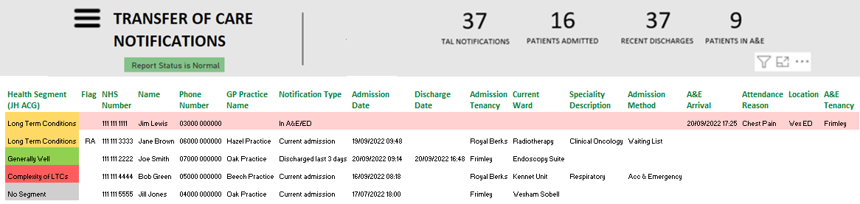

A&E Study – summary
03
They now work with A&E leads to ensure that when a patient attends A&E they are informed they are likely to be called or texted by their GP
01
Clinicians use the Transfer of Care Notifications on CareCentric to identify Live Notifications of patients who are currently inpatient at Berkshire Healthcare, Frimley Park, Heatherwood, Royal Berkshire and Wexham Park hospitals, or in A&E
02
Using connected care, they contacted patients by text or phone while they were in the A&E department.
16% were pulled out of A&E
28% were in A&E inappropriately
04
They determine what patients were there for and whether they can bring them back to primary care to reduce the number of patients in the A&E department.
60% were in A&E appropriately

Slide 62
0
Thank You
https://cipha.nhs.uk

Slide 63
Slido
Please scan the QR Code on the screen. This will take you through to Slido, where you can interact with us.
2nd November 2022- 08:00am – 15:30pm – Hatfield’s Conference Centre
Conference hosted by Convenzis Group Limited

Slide 64

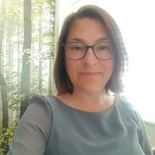
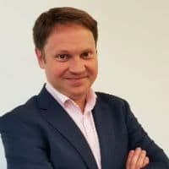
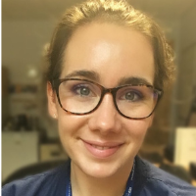
The NHS Population Health
Conference 2022
Q&A Panel
Dr Maslah Amin
Jane
Johnson
David
Howell
Craig
Chapman
Dr Bharan Kumar
Markus Bolton
National Clinical Advisor & Associate Director - Health Education England
Head of PHM & Executive Director - Surrey Heartlands ICS & AphA
Joint Director for Strategic Business Intelligence & Analytics - Surrey Heartlands ICS
3rd Sector
Consultant
Population Health
GP Lead Clinical Director for SHAPE Primary Care Network & GP Lead Bharani Group Practices
Director - System C & Graphnet

Slide 65
The NHS Population Health
Conference 2022
MORNING BREAK, NETWORKING & REFRESHMENTS

Slide 66
The NHS Population Health
Conference 2022
Chair Morning Reflection
Christine O’Connor
Independent Consultant
Population Health

Slide 67

The NHS Population Health
Conference 2022
UP NEXT…

Slide 68
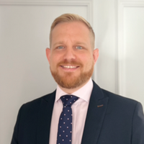

The NHS Population Health
Conference 2022
SPEAKING NOW
I will be discussing…
“Delivering National and Regional Patient Engagement”
Luke Wyatt
Sales and Marketing Director
iPlato

Slide 69
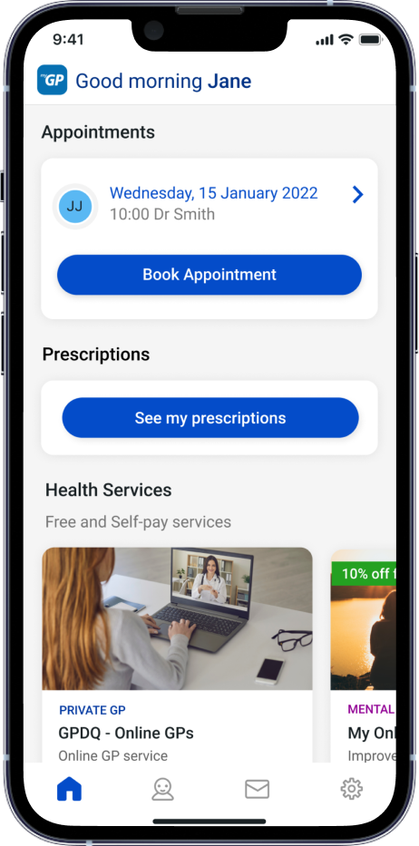


Delivering National & Regional Patient engagement
Luke Wyatt
Director of Marketing & Sales

Slide 70
What is myGP Population Health Service?

Slide 71
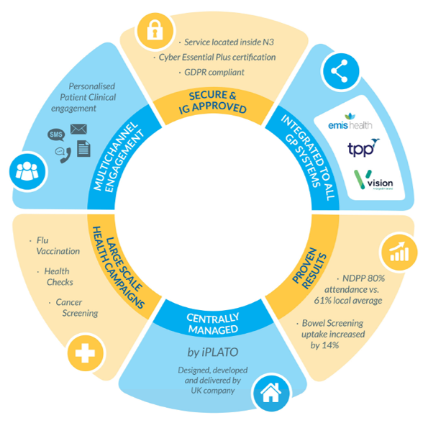


myGP Population Health Service
Solution
Cause
Issue

Slide 72
Project Approach
How we deliver your programme

Slide 73
myGP Population Health
Team
Project Preparation
Delivery and Management
Project design
Design data flow
IG guidance
Patient & Care system guidance and engagement
Project outline
Share lessons from other projects
Managed Service
Dedicated Project team
Simple onboarding
Custom live reporting
Care provider support
Engage with key stakeholders
Regular project updates

Slide 74






myGP Population Health Service
Web Forms → Identify Target Groups & improve data quality
Signpost → Engage with hard to reach groups
Videos/Material → Improve Education Awareness
Web Booking → Improve Access to booking
Care coordination → Prevent Digital Exclusion

Slide 75
myGP Web Forms
Supporting better data capture

Slide 76


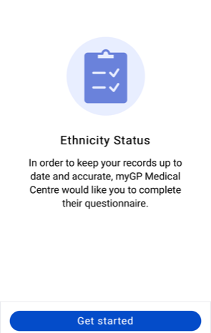
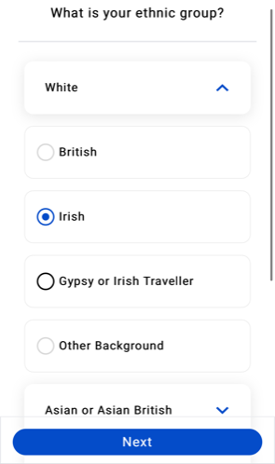

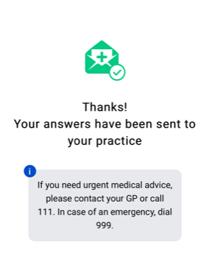


myGP Web Forms
Digital data capture
Region / ICB-wide delivery
Patient authentication
Clinical coding
500,000 questionnaires sent
Growing template library & education/advice

Slide 77
myGP Web Booking
Enabling online booking for screening services

Slide 78








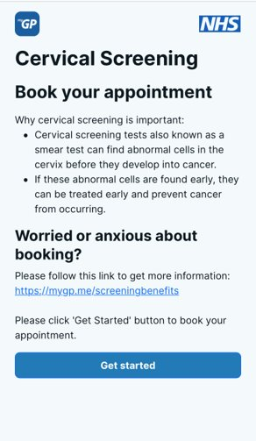
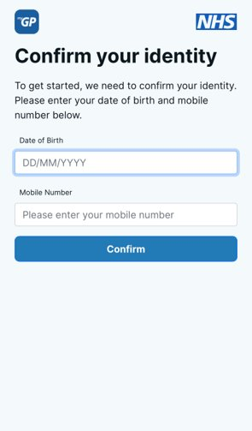

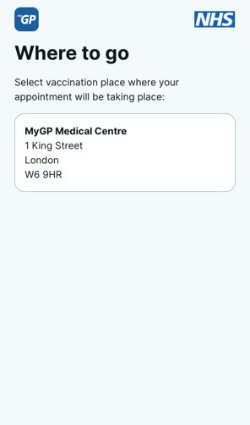


myGP Web Booking
Increase Uptake
Centralised booking system
Unlimited locations
Location restrictions
Patient authentication
Patient education
Videos and guides
Real-time booking information
Automatic or manual bookings

Slide 79
myGP Other services
Additional services available

Slide 80





Other Services
Supplemental support
Care coordinator team
Custom Chatbot
Development
Home
testing
Virtual
Or
Face to Face
Clinical staff
Data support
AI
Search's

Slide 81
Examples Case Studies
How we have delivered impact

Slide 82



NDPP
Increasing uptake
Programme Aims
The NHS England Diabetes Prevention Programme NDPP is a proactive programme that aims to reduce diabetes by using a behavioural change programme to help patients identified to be at risk of type 2 diabetes to reduce their risk. The myGP Population Health Team partnered with NHS North Central London CGG to increase uptake to the NDPP Programme.
Programme Approach
Primer SMS sent to patients identified at risk of diabetes, a couple of days later these patients received a letter asking them to partake in the programme which was followed by a chase text message two weeks later. The SMS messages and letters contained links the preventing diabetes self-referral page.
Programme Outcomes
All adults classified as pre-diabetic had been invited to sign up for NDPP programme
35% of patients clicked on link sent via SMS​ directing them to digital registration form
33% signed up for the service
95% increase uptake

Slide 83

Cancer Screening
Engagement

Slide 84
Outcomes
Demonstrated impact
6.3% increase in uptake and attended 17 days earlier London Cervical Screening
5.6% increase in uptake London Bowel Screening Text Reminders
47% contacted booked an appointment Breast Screening Telephone Outreach
100% increase in uptake East of England cancer screening service
6% increase in flu vaccine uptake through using educational material
Notes:
Key points:
Messages are GP & NHS endorsed
Complements & will be integrated within the national bowel screening programme
Integrated to the patient’s clinical record
Evidence
iPLATO’s London-wide text reminder programme for cervical screening resulted in an increase of 4.8% in women aged 25-49 and 5.9% in women aged 50-64 attending their cervical screening appointment, equating to an extra 13,000 women being screened. Improving uptake across all age ranges and deprivation scales, this solution has also decreased the time between first invitation and screening by 17 days on average. Recent data shows that uptake has increased further to 6.3%. We have extended the London-wide cervical screening invitation process with a further follow-up targeted SMS for non-responder patients in North Central London CCG. It achieved an 11% increase in uptake in women who did not previously attend their cervical screening appointment, with 3,435 women screened over a 6-month period.
A randomised controlled trial across London, supported by iPLATO, found that GP-endorsed text message reminders to non-responders improved the uptake of bowel screening among first-time invitees by 5.6%
A study in Australia investigated the behavioural patterns among patients who received a bowel screening test kit (Myers et al, 2021). It found that there were distinct subgroups of non-responders, which suggests that different interventions are required to encourage participation, e.g. information awareness and clearer instructions. Furthermore, enhanced reminders to restate the screening offer and general practice endorsement have both already been shown to significantly reduce the socioeconomic gradient in bowel screening uptake (Wardle et al, 2016)
Myth busting
Fears of digital exclusion are not justified by the data.
We don’t hold patient data

Slide 85
Thank you
Any Questions?

Slide 86
Slido
Please scan the QR Code on the screen. This will take you through to Slido, where you can interact with us.
2nd November 2022- 08:00am – 15:30pm – Hatfield’s Conference Centre
Conference hosted by Convenzis Group Limited

Slide 87

The NHS Population Health
Conference 2022
UP NEXT…

Slide 88

The NHS Population Health
Conference 2022
SPEAKING NOW
I will be discussing…
“Population Health Management of non-communicable diseases: measuring the impact of interventions”
Laura Webber
Co-Founder
HealthLumen

Slide 89
Population Health Management of non-communicable diseases:
Measuring the impact of interventions
2 November 2022
Laura Webber, PhD
COO, Co-founder
Notes:
What’s the best way to make decisions about interventions

Slide 90

A modeller’s perspective…
Formerly Director of Modelling at the UK Health Forum
– an alliance of professional and public interest bodies working to help prevent non-communicable diseases (NCDs).
Co-founded HealthLumen in 2019:
Specialists in quantifying the health and economic burden of NCDs
Modelling the impact of proposed interventions before real-world implementation to assist decision-makers
Notes:
We focus on quantifying….

Slide 91





Global burden of NCDs
8.2m
All other NCDs
Unhealthy eating
Tobacco use
1.6m
Diabetes
CVD alone accounts for
44%
of NCD deaths
4 NCDs caused
80%
of all NCD deaths
17.9m
CVD
Physical inactivity
3.8m
Respiratory diseases
Excess alcohol
74% of all deaths worldwide
9.0m Cancer
Notes:
Ref: World Health Organization: Noncommunicable Diseases: Key Facts (2018). https://www.who.int/news-room/fact-sheets/detail/noncommunicable-diseases.
Give you some context
NCDs are a huge problem worldwide – (don’t read the numbers)
Common risk factors
Most of interventions are targeted at these risk factors

Slide 92
Burden of NCDs - UK
NCDs cause over
80%
of all deaths in the UK [1,2]
Most common cause of death in males in England was heart disease (13.6%), in females it was dementia and Alzheimer’s disease (16.6%)[3]
6.4 million people in England are living with cardiovascular conditions [4]
These conditions are to a significant extent, preventable by reducing common risk factors
(e.g. Tobacco use, harmful use of alcohol, obesity)
Thus costs are avoidable
Respiratory disease cost £6B [6],
CVD-related costs £7.4B [7]
to the NHS
Notes:
Bring a couple of thing to attention
Costing billions

Slide 93
NCDs and health inequalities
Disproportionate number of NCDs in deprived groups.
Deprivation increases the likelihood of having multi-morbidity, and on average people in the most deprived fifth of the population develop multiple long-term conditions 10 years earlier than those in the least deprived fifth.[1]
In the most deprived 20% of areas in Scotland, the rate of avoidable mortality was 3.9 times as large as in the 20% least deprived areas. For all causes of death, the rate of mortality is 1.9 times as high in the most deprived areas [2].
Wales’s healthy life expectancy is only 61.7, the lowest in the UK reaching as low as 50.7 in the most deprived communities.
Avoidable mortality rate by SIMD quintile
Most deprived
20% of areas
Level of deprivation
Least deprived
20% of areas
SIMD, Scottish Index of Multiple Deprivation
Notes:
Massive problem with health inequalities, high on the political agenda

Slide 94
Impact on the NHS
NCDs place a significant burden on patients and the health system threatening the sustainability of the NHS [1]
Ageing
  1 in 4 people have ≥ 2 long-term conditions
  2/3rds of individuals aged ≥65 years have 2 or more long-term conditions
  About a third of all deaths are classed as premature [2]
It is estimated that 40% of the burden on health services in England may be preventable through action on the determinants of avoidable chronic conditions [3]
Notes:
SO what impact does this have on the NHS?
If the number really is 40% (last bullet point) and the NHS budget is now £157Bn a year; that means that over £60Bn of that spending is avoidable

Slide 95





What types of interventions should be implemented?
Policy interventions
Prevention/ screening
Management/ treatment
COLA
Tax?
Notes:
So what can we do about this?

Slide 96



How do decision makers decide which interventions are most effective?
One example is on digital solutions
Currently the NHS has no way of quantitatively comparing the impact of different (digital) solutions on return on investment and long-term health impacts
This is important in order to make informed decisions on the best care pathway
For example, take two COPD digital applications:
MyCOPD Breathe
88% ORCHA score
Level 4 regulated
Which one provides best LT ROI, health savings?
Which one has the lowest carbon footprint?
Notes:
Challenge is – how do you know which interventions have maximum impact? – you’re being bombarded with lots of digital solutions which ones shall we choose. How do I decide?
It’s really difficult.
Which one has the lowest carbon footprint?

Slide 97
Considerations for decision-makers
Peer
recommendations
Subjective judgement / gut instinct
Political
expediency
Quality of relationship between vendor and purchaser
Price point
Presence on relevant procurement framework(s)
Relationship of new vendor with existing (partner) vendor
Business case/demonstrations
of PoC
Procurement / Implementation
Notes:
How do we decide? Summarise here to the best of our knowledge, there are a range of considerations e.g. what do you peer think? Is the vendor already on the framework? What is the cost? Can I afford it?
Political expediency – political pressures to use one solution over another – it’s being used in neighbouring trust
Quality of relationship – it could be that they are mates, it could be that they’ve supplied other solutions in the past and so are known to that NHS organisation. It may be (heaven forfend) that one of the NHS clinicians actually has a commercial interest in that supplier.
Price point – worked out on an absolute basis. If this patient monitoring solution costs me £10/ patient/ month, and the other one costs me £20/ patient/ month, I (as the NHS org) may go for the first one as it is cheaper, even if the second one has more than twice the functionality. I have a limited budget, I need to spend my money on some other solution too, and taking the first option will give be the budgetary headroom to do that. Even though it is better, option 2 will use up all my money so I can’t do anything else. looking at value per n£ will also have to be able to balance various other input criteria. Those criteria might include “I want to be able to treat x patients over y months with an improvement/ impactability score of at least z%
Procurement fwk – the solution/ vendor is listed on the fwk and it is therefore straightforward to procure it.

Slide 98
How can modelling assist decision makers?
Risk stratification
Patient cohort identification
Impactability modelling
  Provides comparative assessment of proposed interventions and impact measurement of a new intervention.
  Modelling: Using virtual populations to quantify, and plan for, future events
  Impactability: defines the degree to which different
  sub-populations will benefit from a range of interventions
  Impactability modelling: uses this information to tailor appropriate interventions within agreed boundaries for the 'value' gained from resources spent.
  Strategic imperative for the NHS (refer to IFoA report)
Notes:
Give you some background about what we mean about modelling here.
Refer to impactablity report – institute and faculty of actuaries

Slide 99


Using virtual populations to plan for future events
What?
  Microsimulation produces a virtual population of many millions of individuals each with an age, sex, disease status, social determinants of health, medical history
  Can be used to quantify changing trends in diseases into the future and estimate how demographic, behavioural, and policy changes might affect health and economic outcomes
How?
Using national health survey and population data to build a ‘virtual’ or ‘synthetic’ population
These virtual populations are representative of those in the real world and simulate the effect of interventions on these populations.
This provides the freedom and flexibility to complement and augment clinical trial and real-world data.
vs
Notes:
Use visual – carry out intervention in these people here in your ICS/Trust – may take months/ years
they which of a range of interventions that have been carried out compare.
Do need RCT – but is complementary
1. Baseline current interventions around a specific NCD.
2. Add in current risk stratification and any target populations
3. Gather potential new interventions and test them against this baseline - impact of new intervention compared to existing one(s) for target population(s) with a defined available budget over a specified period of time.

Slide 100
Modelling process
Baseline current interventions around a
specific NCD
Current risk stratification and any target populations
Gather potential new interventions and test them against this baseline
- impact of new intervention compared to existing one(s) for target population(s) with a defined available budget over a specified period of time
1
2
3
Notes:
This is the principle of the process
Baseline – in the absence of change
Understand the risk profile of our pop
Introduce an intervention amongst a range.

Slide 101


Smoking cessation in primary care: results
Notes:
Some examples of how modelling can help decision makers – to support the case for change
How effective is 3 different type of very brief intervention for smoking cessation.

Slide 102

Screening for Chronic Kidney Disease in primary care
Screening of the 40-75 (at risk) age group is predicted to result in:
140,000
6% fewer patients
with advanced stage CKD (3b-5) between
2022-2025
Healthcare costs saved
as a result of screening in 2025
£15m
Earlier diagnosis and proactive management reduces patient burden and NHS cost
Notes:
Huge problem – RRT – is screening and earlier management effective.

Slide 103
Modelling long-term cost-effectiveness of the BWeL trial [1]
Group
Support Group
By 2035:
Baseline
- given advice about how to
lose weight
Support group given brief advice and referral to weight management
Assumptions based on trial data
52% accept and attend
25% accept and don't attend
23% do not accept
Account for weight regain
in year 1
64,470
Pre-diabetes
1
24,587
CHD+Stroke
2
79,764
Hypertension
34,824
Type 2 Diabetes

Slide 104




Policy modelling:
Health impacts of air pollution policies in London by 2050
London Environ Strategy
All polices in the London Environment Strategy including ULEZ
over 300,000 new cases of NO₂ and PM_{2.5} related diseases
1.2million hospital admissions
£5billion healthcare costs
Notes:
Decision not done within the NHS but illustrates the principle. LES was expanded. Showed decision makers that this policy was effective.

Slide 105

Conclusion
Modelling is a powerful technique to help decision makers improve health outcomes by assessing the impact of proposed interventions before implementation in the real world.
Even the best models have some limits because:
“It would be very remarkable if any system existing in the real world could be exactly represented by any model” George Box (one of the great statistical minds of the 20th century)
However:
It’s better to foresee with uncertainty than not foresee at all…
Henri Poincaré, 1913
Notes:
To do a complete replication of reality is very difficult.

Slide 106
Thank you
Laura Webber laura.webber@healthlumen
Simon Lande simon.lande@healthlumen

Slide 107
References
Slide1: [1] World Health Organization: Noncommunicable Diseases: Key Facts (2018). https://www.who.int/news-room/fact-sheets/detail/noncommunicable-diseases.
[2] World Health Organization: Noncommunicable Diseases https://www.who.int/health-topics/noncommunicable-diseases#tab=tab_1
Slide 5:
[1] https://www.bhf.org.uk/what-we-do/in-your-area/northern-ireland/campaigning-and-influencing-in-northern-ireland/ncd-prevention-report
[2] https://www.bhf.org.uk/what-we-do/in-your-area/scotland/ncd-prevention-report
[3] Public Health England. ‘Health Profile for England: 2019. Chapter 2: trends in mortality (data tables).
[4] British Heart Foundation. ‘England factsheet.’ 2021 (accessed 22 September)
[5] Institute for Health Metrics and Evaluation. ‘Global burden of disease, cause of death, England.’ 2019
[6] Office for National Statistics (2009). Statistical Bulletin. General Lifestyle Survey - Health Tables 2009. Tables 7.11
[7] https://www.kingsfund.org.uk/projects/time-think-differently/trends-disease-and-disability-non-communicable-diseases, https://ukhsa.blog.gov.uk/2019/02/14/health-matters-preventing-cardiovascular-disease/
Slide 6:
[1] https://www.kingsfund.org.uk/publications/what-are-health-inequalities
[2] https://www.nrscotland.gov.uk/files//statistics/avoidable-mortality/2020/avoidable-mortality-20-report.pdf
Slide 7
[1] Chapter 6: Public health, prevention and patient responsibility https://publications.parliament.uk/pa/ld201617/ldselect/ldnhssus/151/15109.htm
[2] Bramley D, Moody D. Multi-morbidity - the biggest clinical challenge facing the NHS? 2016. Available from: https://www.england.nhs.uk/blog/dawn-moody-david-bramley/. 6. Barnett K, Mercer SW, Norbury M, Watt G, Wyke S, Guthrie B. Epidemiology of multimorbidity and implications for health care, research, and medical education: a cross-sectional study. Lancet. 2012;380(9836):37-43.
[3] https://publications.parliament.uk/pa/ld201617/ldselect/ldnhssus/151/15109.htm estimates from The Health Foundation
Slide 14: [1] Coker et al, (2021) Making Conversations Count for All, https://www.cancerresearchuk.org/sites/default/files/making_conversations_count_part_for_all_august_2021_-_full_report_0.pdf
Slide 15 [1] Retat et al, Estimating the future burden of chronic kidney disease through microsimulation methods American Society of Nephrology Abstract: PO0524 http://www.healthlumen.com/wp-content/uploads/ 2021/06/Poster-3444991_Retat-et-al_CKD_Kidney.pdf Supported by AstraZeneca
Slide 16: [1] Screening and brief intervention for obesity in primary care: cost-effectiveness analysis in the BWeL trial https://pubmed.ncbi.nlm.nih.gov/30705390/
Slide 17: [1] https://www.london.gov.uk/sites/default/files/modelling_the_long-term_health_impacts_of_changing_exposure_to_no2_and_pm2.5_in_london_final_250220_-4.pdf

Slide 108

Slido
Please scan the QR Code on the screen. This will take you through to Slido, where you can interact with us.
2nd November 2022- 08:00am – 15:30pm – Hatfield’s Conference Centre
Conference hosted by Convenzis Group Limited

Slide 109



Can AI support population health – Experience from the frontline
A panel debate, chaired by Christine O’Connor
Speakers:
Chris Tackaberry
Chief Executive Officer
Clinithink Ltd
Mr. Sandip Sarkar FRCS, MA, PhD
Consultant Vascular Surgeon Bart's Health NHS Trust
David Brown
Chief Information Officer Herefordshire & Worcestershire Health & Care NHS Trust

Slide 110
The NHS Digital Hospitals
Conference 2022:
NETWORKING & LUNCH

Slide 111
The NHS Population Health
Conference 2022
Chair Afternoon Address
Christine O’Connor
Independent Consultant
Population Health

Slide 112
Slido
Please scan the QR Code on the screen. This will take you through to Slido, where you can interact with us.
2nd November 2022- 08:00am – 15:30pm – Hatfield’s Conference Centre
Conference hosted by Convenzis Group Limited

Slide 113


The NHS Population Health
Conference 2022
SPEAKING NOW
I will be discussing…
“Tackling Health Inequalities - The rising STAR. Using allocative efficiency to tackle Inequalities”
Andi Orlowski
Director
Health Economics Unit

Slide 114
Tackling health inequalities – The rising STAR.
Using allocative efficiency to tackle inequalities
Andi Orlowski
Director of the Health Economics Unit
Senior Population Health Analytics Advisor – NHS England (Data and Analytics Directorate)

Slide 115
Notes:
Medical care accounts for only 20 per cent of modifiable contributors to population health.⁴ These social determinants of health (SDH) ‒ the conditions in which people are born, grow, live, work and age ‒ also contribute. Individual health behaviours contribute around 30 per cent of modifiable factors, socioeconomic factors roughly 40 per cent, and physical environment around 10 per cent.
Hood CM, Gennuso KP, Swain GR, Catlin BB. County health rankings: relationships between determinant factors and health outcomes. Am J Prev Med 2016; 50: 129‒135. https://doi.org/10.1016/j.amepre.2015.08.024.

Slide 116


Slide 117


Slide 118


Slide 119


Slide 120

Notes:
https://www.health.org.uk/publications/reports/the-marmot-review-10-years-on?gclid=Cj0KCQjwppSEBhCGARIsANIs4p4nVCcdS0PiX95rtP9jf1xFK1ulwxESqp6QfZUH1Y0KWZR1jvy8cj4aAtkCEALw_wcB

Slide 121

Notes:
https://www.health.org.uk/publications/reports/the-marmot-review-10-years-on?gclid=Cj0KCQjwppSEBhCGARIsANIs4p4nVCcdS0PiX95rtP9jf1xFK1ulwxESqp6QfZUH1Y0KWZR1jvy8cj4aAtkCEALw_wcB

Slide 122


Slide 123
Integrated care systems are the answer… right?

Slide 124
Collaboration between health care, social services, and other sectors is often espoused as the route to improving population health

Slide 125
There is little convincing evidence to suggest that collaboration between local health care and non-health care organizations improves health outcomes
Notes:
Alderwick, H., Hutchings, A., Briggs, A. et al. The impacts of collaboration between local health care and non-health care organizations and factors shaping how they work: a systematic review of reviews. BMC Public Health 21, 753 (2021). https://doi.org/10.1186/s12889-021-10630-1
Aunger, J.A., Millar, R., Greenhalgh, J. et al. Why do some inter-organisational collaborations in healthcare work when others do not? A realist review. Syst Rev 10, 82 (2021). https://doi.org/10.1186/s13643-021-01630-8
https://assets.publishing.service.gov.uk/government/uploads/system/uploads/attachment_data/file/265503/ih.pdf

Slide 126

Alderwick, H., Hutchings, A., Briggs, A. et al. The impacts of collaboration between local health care and non-health care organizations and factors shaping how they work: a systematic review of reviews. BMC Public Health 21, 753 (2021). https://doi.org/10.1186/s12889-021-10630-1
Notes:
Alderwick, H., Hutchings, A., Briggs, A. et al. The impacts of collaboration between local health care and non-health care organizations and factors shaping how they work: a systematic review of reviews. BMC Public Health 21, 753 (2021). https://doi.org/10.1186/s12889-021-10630-1
Factors influencing collaboration functioning and example interactions between themNotes: The interactions between factors are examples identified in the studies reviewed. They are not an exhaustive list of all interactionsbetween the factors identified. The relationships may move in both directions (eg involving staff may help create a shared vision, while having ashared vision may help with the task of engaging other partners), and may support or constrain collaboration in different contexts (eg nationalpolicies can help or hinder)
Alderwicket al. BMC Public Health (2021) 21:753

Slide 127

Aunger, J.A., Millar, R., Greenhalgh, J. et al. Why do some inter-organisational collaborations in healthcare work when others do not? A realist review. Syst Rev 10, 82 (2021). https://doi.org/10.1186/s13643-021-01630-8
Notes:
Aunger, J.A., Millar, R., Greenhalgh, J. et al. Why do some inter-organisational collaborations in healthcare work when others do not? A realist review. Syst Rev 10, 82 (2021). https://doi.org/10.1186/s13643-021-01630-8

Slide 128
We share our population we share what they value

Slide 129
Effective (personal) value
Is each patient in the health economy receiving interventions that addresses their personal preferences?
  Preference-sensitive conditions (e.g. back pain, prostate cancer)
Are patients offered decision support to help them make a joint decision with their clinician?

Slide 130
Efficient (technical) value
Are the services delivered as efficiently as possible?
Is there a way of improving the outcomes it achieves for the same or lower cost?

Slide 131
Population (allocative) value
Is the health economy investing in the right mix of services to address the needs of its population?
  Between services
  Within services
How to divide resources between different levels of health care?
How to promote equal access for equal need in the supply of health services?
equity / efficiency trade-offs? – acceptable inequalities?
Who decides?

Slide 132
VfM
Total Value
QALY gain
/ Case
Numbers who benefit
Fixed costs
Costs / case
Variable costs
Numbers treated

Slide 133




INTERVENTION SPEND
OF £4.5m
SPEND ON FALLS
VISION
ASSESSMENT
& REFERRAL
£6,986
0.2%
HOME HAZARD
ASSESSMENT
£7,369
0.2%
MEDICATION
REVIEW
£58,800
1.5%
STRENGTH &
BALANCE
TRAINING
£81,868
2.1%
RAPID
RESPONSE
£60,979
1.6%
HOSPITAL
ADMISSION
£3,685,290
94.5%

Slide 134
VALUE FOR MONEY OF INTERVENTIONS
POPULATION HEALTH GAIN
3.9%
3.8%
19.7%
17.2%
6.9%
48.5%
VISION
ASSESSMENT
& REFERRAL
£6,986
0.2%
HOME HAZARD
ASSESSMENT
£7,369
0.2%
MEDICATION
REVIEW
£58,800
1.5%
STRENGTH &
BALANCE
TRAINING
£81,868
2.1%
RAPID
RESPONSE
£60,979
1.6%
HOSPITAL
ADMISSION
£3,685,290
94.5%

Slide 135

HOW FAR DOES A POUND GO
VISION ASSESSMENT & REFERRAL
14 HOURS
HOME HAZARD ASSESSMENT
13 HOURS
MEDICATION REVIEW
8 HOURS 24 MINS
STRENGTH & BALANCE TRAINING
5 HOURS 18 MINS
RAPID RESPONSE
2 HOURS 48 MINS
This chart tells us how much ‘quality-adjusted life time’ we get from every intervention for every pound spent.
HOSPITAL ADMISSION
18 MINS

Slide 136
Stakeholders and engagement is key

Slide 137



Update
Started but not complete
Complete or nearly complete
Setting expectations, developing project plans and stakeholder mapping
Activities:
Setting up stakeholder groups
Kick-off session
Liaising with project teams
Collecting evidence on interventions, costs, populations and patient choice for the ICS/Place and the wider context
Understanding local context
Literature review
Discrete choice experiments
Data analysis
Preparation for decision conferences
Face-to-face sessions within systems to discuss the allocative efficiency of the COPD pathway, supported by evidence and data
Commitment to action
2 decision conferences for each ICS/Place
Evaluating the programme and sharing learning across the ICS/Place and beyond
Evaluation
ICS/Place report
MDSN training programme
Support with implementation of results
1: Programme set-up
2: Data collection
3: Decision conferences
4:dissemination and implementation
Group 1
Apr - Sep
Aug - Oct
Sep - Nov
Jan - Mar
Group 2
Apr - Sep
Aug - Jan
Jan - Feb
Mar - Apr

Slide 138

Systems update
Four Systems from the Midlands have now been onboarded onto the SSPH programme, plus three ICSs and one Place. These cover Northamptonshire, Nottinghamshire and Birmingham and Solihull (BSol), plus Coventry Place. In June, Gloucestershire ICS became the fifth system to pilot the SSPH programme.
By this stage, all systems have managed to provide their own project team and identify all necessary stakeholders. BSol is due to commence their programme this month, on 29 September, while all other systems have work underway, with the stakeholder engagement phase about to launch for three of the five systems by October.
The Commitment to Action session and the two decision conferences will follow stakeholder engagement work, with Nottinghamshire already having piloted the Commitment to Action session on 14 September, followed by Coventry and Northamptonshire on 15 September. The same three systems will soon pilot the Decision Conferences, and BSol and Gloucestershire will follow on in January to February to avoid the flu peak season.
To ensure we get insights and representations from across the COPD pathway, we have worked with systems to guarantee inclusion of representatives from the following areas:
The participation of patient representatives is key to the success of the SSPH programme, and the programme team is in contact with both Asthma and Lung Foundation UK and participating systems to ensure their inclusion.

Slide 139
andi.orlowski@nhs.net
https://healtheconomicsunit.nhs.uk/

Slide 140
Slido
Please scan the QR Code on the screen. This will take you through to Slido, where you can interact with us.
2nd November 2022- 08:00am – 15:30pm – Hatfield’s Conference Centre
Conference hosted by Convenzis Group Limited

Slide 141

The NHS Digital Hospitals
Conference 2022
SPEAKING NOW
I will be discussing…
“Delivering the aims of the NHS Long Term Plan”
Christine O’Connor
Independent Consultant
Population Health

Slide 142

DELIVERING THE AIMS OF THE
NHS PLAN
Christine O’Connor
christine@acuitas.uk

Slide 143

3 YEARS ON IS THE NHS PLAN AN AMBITION, AN ASPIRATION OR SIMPLE FANTASY?

Slide 144

A far-reaching programme of transformation
to ensure the NHS can sustainably provide
the highest quality and safest
care to everyone…
[free at the point of delivery]
Transformation: a complete change in
the appearance or character of
something or someone

Slide 145



GRIDLOCKED
Hypothesis: The traditional model of healthcare needs revision or replacement
Reality re transformation: it has happened at infrastructure level not at service delivery level

Slide 146

Let’s be clear:
The reinvention of the NHS infrastructure will not deliver the required change unless accompanied by a paradigm shift in thinking across the health and care system!
Change the culture

Slide 147




Connection not Fragmentation

Slide 148

THE REALITY!!

Slide 149


Quadruple aim….
Improve population health and wellbeing
Address health care
inequalities
Increase well being
and engagement of the
workforce
Enhance an
individuals experience
of care once it is needed
Reduce per capita cost of
health care and improve
productivity
Sustainability agenda

Slide 150



The overarching goal is for the whole population to be the healthiest version
of themselves, even with a chronic condition
Once in the system take shared ownership for the outcome
The system to stop counting widgets and focus on outcomes

Slide 151





Key NHS Plan deliverables
Population health management
Digital, digital, digital !
Outcomes:
major diseases
Prevention
Maternity
services
Primary Care at the heart of transformation
Mental
Health

Slide 152

Integrated/interconnected
Interoperability
Workforce and
Estate
Collaboration
££££…

Slide 153

We must shift from a hospital centred model of care….requires progressive shift in resources away from acute hospitals. £1 in every £5 spent on maintaining the status quo. Integration is key
ICS delivery programme:
  Prevention of ill health
  Supportive self care
  Enhanced Primary Care: less reliance on clinicians practicing autonomously/networks
  Coordinated and integrated health and social care
  High quality safe specialist care: hospital no longer the comprehensive provider of care; centres of excellence/community
  Development of the digital patient

Slide 154


General practice: the reality
2009: 8230 practices: 6487 list: av per GP 224
2013: 8106 practices: av per GP 310
2020: 6708 practices: 9007 list
2022: 6495 practices: 9444 list: av per GP 2248
Over 13 years: reduction in number of practices: 21%
Over 13 years : increase in list size: 45%
Over 13 years: 10-fold increase in patients per GP
Over last year NHS has lost 328 individual partners and in the last 7 years 4,891 individual partners [699 per year]
Yet GPs delivered 44% of all appointments on the same day and 84% in 2 weeks, two thirds of which were delivered F2F
4 in every 10 consultations were frequent attenders who visit GP 5 x more often than other patients

Slide 155

NHS PLAN DELIVERY:
CHANGE IS AND WILL BE THE
DRIVER OF SURVIVAL

Slide 156

NHS Plan Delivery
Grit and Determination
Resilience
Change mindset for staff
Public need to understand what and why!

Slide 157


Slide 158
Slido
Please scan the QR Code on the screen. This will take you through to Slido, where you can interact with us.
2nd November 2022- 08:00am – 15:30pm – Hatfield’s Conference Centre
Conference hosted by Convenzis Group Limited

Slide 159
The NHS Population Health Conference
Q&A Panel
Dr Maslah Amin
Jane
Johnson
David
Howell
Craig
Chapman
Dr Bharan Kumar
Markus Bolton
Christine O’Connor
Sales and Marketing Director - HealthLumen
Co-Founder - HealthLumen
Chief Executive Officer
Clinithink Ltd
Consultant Vascular Surgeon for Bart's Health NHS Trust, Vascular Lead for Education and Research Bart's Heart Cardiovascular Centre
Bart's Health NHS Trust
Chief Information Officer
Herefordshire & Worcestershire Health & Care NHS Trust
Director - Health Economic Unit
Independent Consultant, Population Health

Slide 160
THANKS FOR ATTENDING
NHS POPULATION HEALTH MANAGEMENT CONFERENCE 2022

